Slide 1
CLOUDS & thunderstorms
Basic Meteorology
Oklahoma Climatological Survey

Slide 2
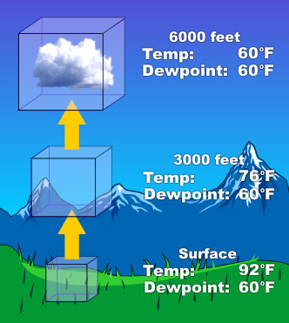
How are clouds made?
Clouds form when air is cooled to its dewpoint
  Remember dewpoint? It’s when air becomes saturated
Often occurs through lifting
As an air parcel rises, it cools, but it’s moisture remains the same
  The rate of cooling is called its lapse rate, 5.4 °F per 1000 feet
When the parcel temperature equals the dewpoint, condensation occurs, forming a cloud
  Condensation nuclei, such as salt or dust, provide surfaces onto which water may condense
Likewise, as air descends it warms
  Moist air does not heat or cool as quickly as dry air, so air coming out of a thunderstorm may be cooler than its surroundings
Source: NOAA National Weather Service Jetstream

Slide 3
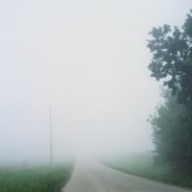

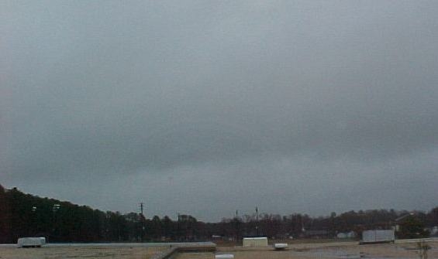
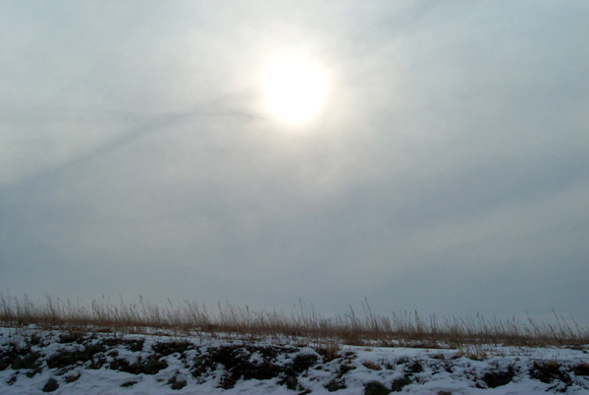
Cloud Types—Stratus, Cumulus, Cirrus
Stratus
  Low-lying clouds that are wider than they are tall; they often cover a large portion of the sky.
  Includes:
    Fog—A cloud that often forms in low-lying areas overnight
    Stratus—A low, uniform cloud, that sometimes has drizzle; the sun is usually not visible through it
    Nimbostratus—A dark cloud that often covers the entire sky; steady rain/snow falls from its base
    Altostratus—A gray-looking water/ice middle cloud that makes the sun appear “dimly visible”

Slide 4
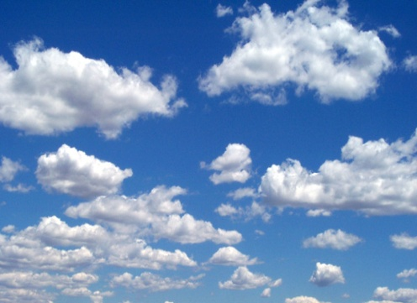
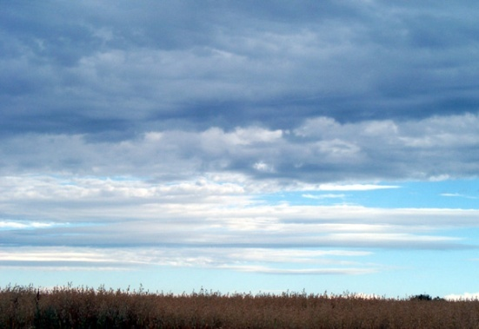
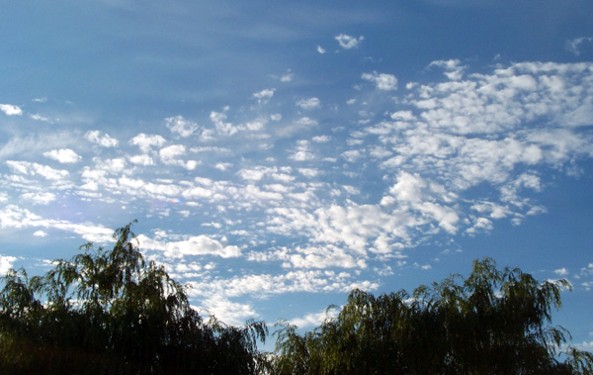
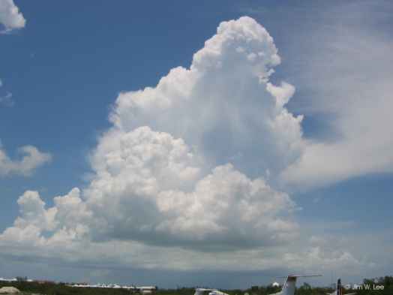
Cloud Types—Stratus, Cumulus, Cirrus
Cumulus
  Puffy clouds with relatively flat bases; these clouds can be either wider than they are tall or taller than they are wide
  Includes:
    Cumulus—Small, puffy clouds with relatively flat bases and limited vertical growth
    Stratocumulus—A low, lumpy-looking wide-spread cloud with dark and light shading (individual cloud = fist)
    Altocumulus—Small puff middle clouds composed of water and ice (individual cloud = thumbnail)
    Cumulonimbus—A heavy, dense cloud with great vertical growth—storm cloud

Slide 5
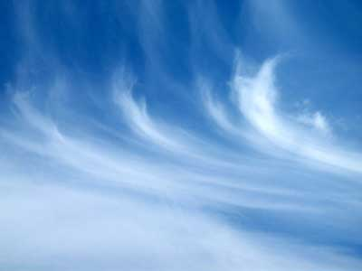

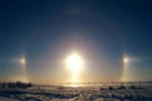
Cloud Types—Stratus, Cumulus, Cirrus
Cirrus
  High cloud with a fibrous or feathery appearance
  Includes:
    Cirrus
    Cirrocumulus—High clouds made of ice; miniature puffs in the form of ripples or grains
    Cirrostratus—A white, wide-spread high cloud composed of ice that creates halos around the sun or moon

Slide 6
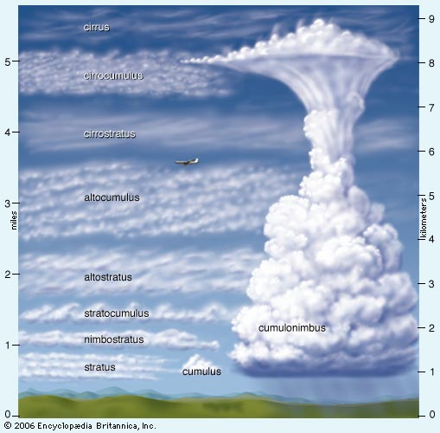
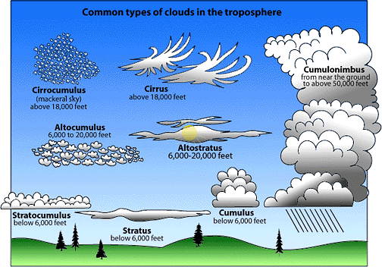
Cloud Types—Stratus, Cumulus, Cirrus

Slide 7
THUNDERSTORMS

Slide 8
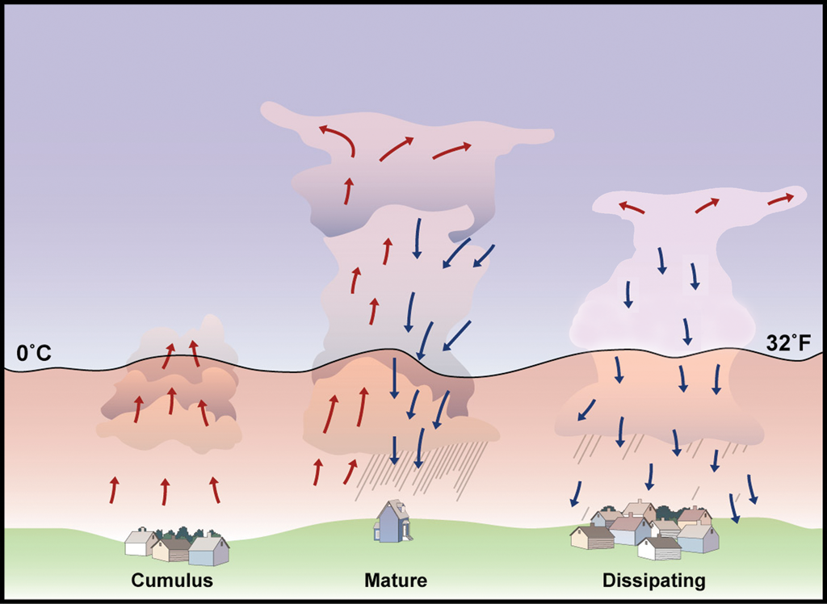
Life Cycle of a Thunderstorm
Cumulus Stage:
  Towering cumulus cloud indicates rising air
  Usually little if any rain during this stage
  Lasts about 10 minutes
  Occasional lightning during this stage

Slide 9
Life Cycle of a Thunderstorm (cont.)
Mature Stage:
  Most likely time for hail, heavy rain, frequent lightning, strong winds, and tornadoes
  Storm occasionally has a black or dark green appearance
  Lasts an average of 10 to 20 minutes but may last much longer in some storms

Slide 10
Life Cycle of a Thunderstorm (cont.)
Dissipating Stage:
  Rainfall decreases in intensity
  Some thunderstorms produce a burst of strong winds during this stage
  Lightning remains a danger during this stage

Slide 11
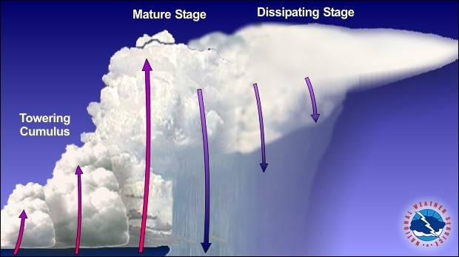
Types of Thunderstorms
Multicell Cluster
Main threat: flooding rains
Cells carried downstream by prevailing winds as they mature
If speed of development matches speed of movement, may have “training echoes” producing heavy rainfall over the same place
Source: NOAA National Weather Service Jetstream

Slide 12
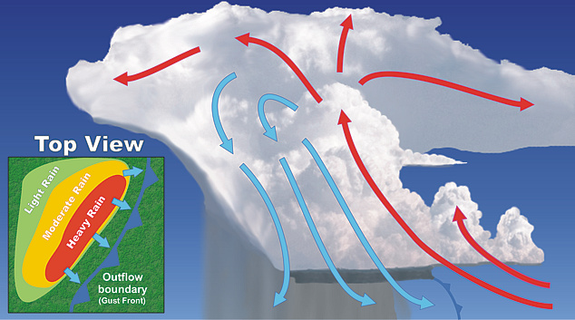
Types of Thunderstorms
Multicell Squall Line
Main threat: damaging winds and hail
Cells form along leading edge of a boundary, such as a cold front
Downdraft of rain-cooled air reinforces the boundary, creating additional lift
Line may stretch for 100 miles or longer
Persists for hours
Source: NOAA National Weather Service Jetstream

Slide 13
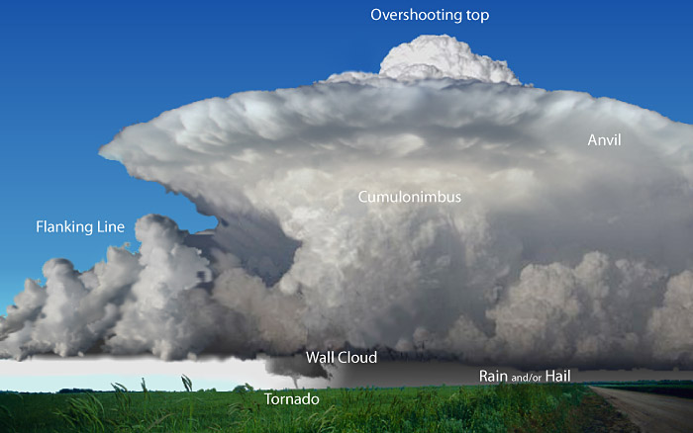
Types of Thunderstorms
Supercells
Main threat: tornadoes, large hail, strong winds, flash flooding
Single-cell thunderstorm, may persist for hours
Wind sheer (change in direction and speed with height) produces rotation within the storm
Updraft is tilted so that rain (and associated cooler air) is downwind of the storm’s energy source
Source: NOAA National Weather Service Jetstream

Slide 14

Thunderstorm Ingredients
Necessary ingredients for convection:
  Moisture
  Instability
  Lift
For long-lived, rotating storms (supercells), we also need Shear.

Slide 15

Thunderstorm Ingredients
Ingredient #1: Moisture
  It is the “fuel” for storms.
  Typically, we want surface dewpoints above 50-55°F.
  It comes from large bodies of water, large areas of vegetation or irrigated regions, or from previous storms.
  Related terms that you might
  hear on the news:
    Tropical Moisture
    Dewpoints
    Low-level moisture
Mmmm…moisture

Slide 16

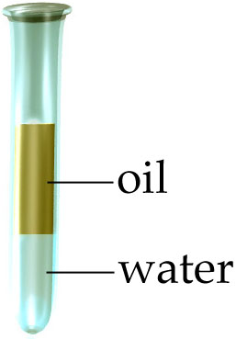
Thunderstorm Ingredients
Ingredient #2: Instability
  It is the “engine”.
  Does the atmosphere support rising motion?
    Rising motion can occur when the mid to upper atmosphere is cooler (more dense) than the lower atmosphere (less dense).
    Large instability can mean stronger updrafts.
Unstable (Lava lamp)
Stable (Oil and water)

Slide 17
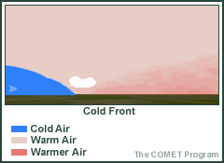

Thunderstorm Ingredients
Ingredient #3: Lift
  It is the “trigger”—the initiating “push” that is required to start storms
  It is caused by:
    Boundaries
      Front
      Dryline
      Outflow boundary
      Sea breeze
    Mountains
The T cools down to near the T_{d} and condensation occurs, which creates a cloud

Slide 18


Thunderstorm Ingredients
Special Ingredient: Shear
  It helps storms to survive longer; it may create rotation.
  It is defined as the turning and/or increasing of winds with height.
We are mostly concerned with vertical wind shear.
Typically, wind speed increases with height.
The atmosphere can create “spin” (or vorticity) by speed or directional shear.
For severe weather, look for a veering (clockwise) wind profile with height.
More force (faster)
Height
Less force (slower)
W
W
SW
SSW
SSW
SE
More directional shear=more “spin”

Slide 19

Thunderstorm Ingredients
If we mix all of the ingredients together, do we get storms?
  Not always!
  The ingredients are an indicator of potential for storms.
  A strong cap can stop convection completely, or it can stop it just long enough to create really strong storms later in the day.

