Slide 1
Monitoring drought
Funding provided by NOAA
Sectoral Applications Research Project
Basic Climatology
Oklahoma Climatological Survey

Slide 2
DEFINING DROUGHT

Slide 3
First off, just what is drought?
Define a tornado
Define a severe thunderstorm
Define a hurricane
Define a volcanic eruption
When did it begin? Where was it? How bad was it? When did it end? Can you point to one on a map or radar display?
Okay, do the same for drought

Slide 4
First off, just what is drought?
Precipitation deficits?
Soil moisture?
Streamflow?
Plants wilting?
Wildfire?
Famine?
Other?

Slide 5
Drought defined by its impacts
Meteorological Drought – departures from “normal” precipitation
Agricultural Drought – soil / groundwater deficits that affect vegetation
Hydrologic Drought – deficiency of water in watersheds, rivers; often lags agriculture impacts
Socio-Economic Drought – shortage of some item (water, food, fish, natural values) that affects the balance of supply and demand
Source: National Drought Mitigation Center

Slide 6
What is drought?
Drought is the condition that occurs when water resources are insufficient to meet water needs.
… in other words …
Drought is a social phenomenon.
  It’s what it does to people that counts!
  We read about droughts in the Sahel, but not the Sahara. Why? Because people live in the Sahel.

Slide 7
Multiple competing values, Multiple competing objectives
Hydropower
Ecosystems
health
Recreation
Consumptive
use
Flood
control
Agriculture
Source: Roger Pulwarty, NIDIS

Slide 8
What is Drought?
Drought is a multi-faceted issue and requires a multi-faceted assessment.
  Does a doctor take your temp, check a chart and say “based on your temp, you are moderately-to-severely sick”?
  Instead, she uses the results of several patient-appropriate and symptom-appropriate tests. i.e., well-chosen indicators in concert with each other.
  A responsible drought decision-maker (and those who supply her data) should take the same approach.

Slide 9
Why Monitor Drought Impacts?
Drought is one of the most costly U.S. natural disasters
  Estimated annual losses at $6-8 billion (1995)
  1988: $39 billion ($68B in 2007 $)
  2002, 2003, 2004, 2005, 2006, 2007: ???
  Europe, 2003: US$13B
  Canada, 2001-02: US$5.7B
USDA/Risk Management Agency, 2006: US$1.71B indemnities
Congress has appropriated approximately $30 billion in drought relief since 1988

Slide 10
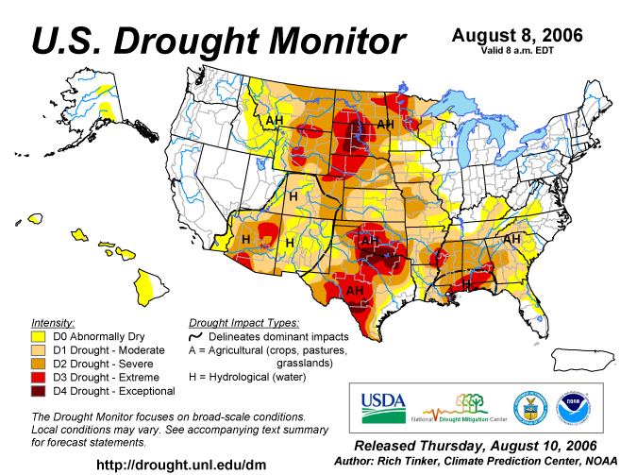
Approximate Peak of 2006 Drought

Slide 11
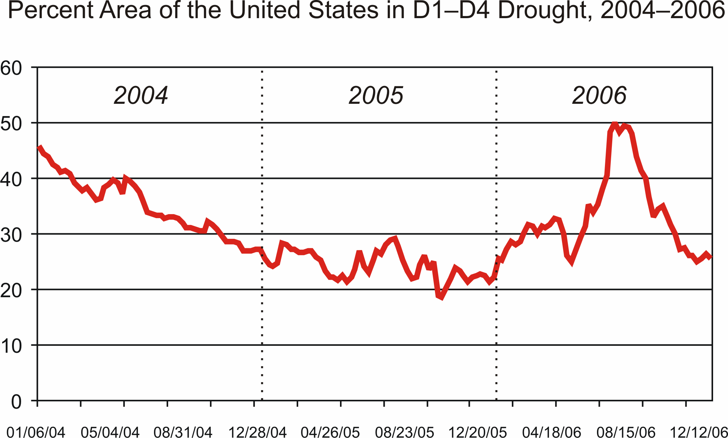
50% of US in Drought
Source: National Drought Mitigation Center

Slide 12
Economic Impacts of Drought
Source: National Drought Mitigation Center

Slide 13
DROUGHT INDICATORS

Slide 14
Precipitation Departures
Precipitation the key indicator for vegetation growth, water resources
  Temperature effects also important, but precipitation dominates
Measured virtually everywhere
Easy to calculate
Can be done for points or over areas (such as a state or climate division)

Slide 15
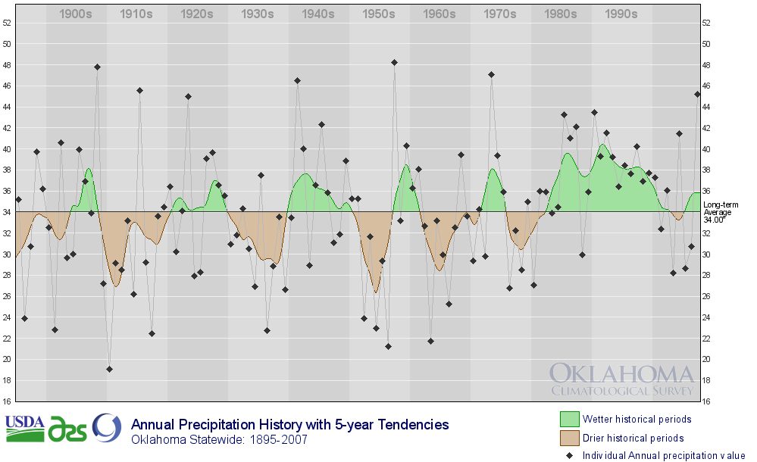
Droughts are a part of Oklahoma

Slide 16
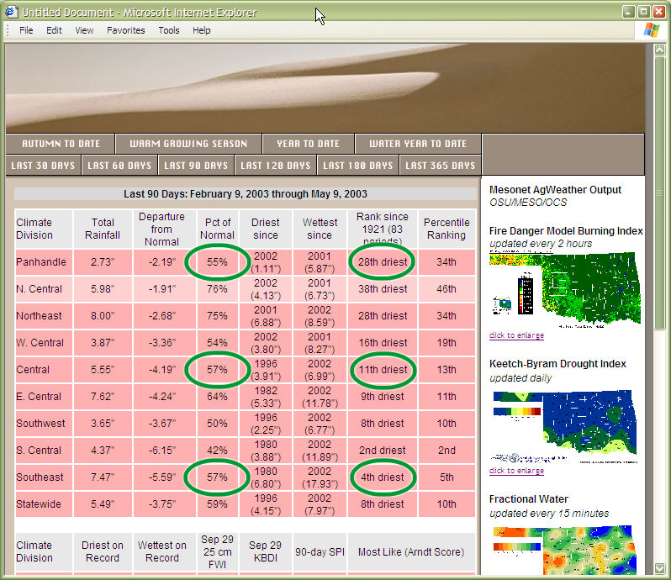
Lies, Darn Lies and Statistics
Often, the raw statistics do not reveal the complete picture!
55% vs. 57% vs. 57% doesn’t necessarily mean they’re all in the same situation!

Slide 17
Palmer Drought Severity Index (PDSI)
Developed in 1965 (first widely used soil moisture model)
Uses temperature and precipitation departures to determine dryness
Ranges from -4 (extreme drought) to +4 (extreme wet)
Standardized to local climate
  Based on departures from local climate normals
Good for measuring long-term drought in relatively uniform regions
  Not good for short-term drought / rapid changes
  Not good for variable terrain (i.e., mountains)
May lag emerging drought conditions by several months

Slide 18
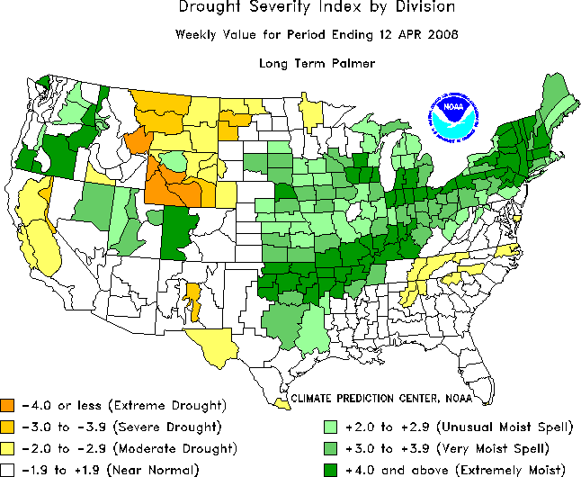
Palmer Drought Severity Index (PDSI)

Slide 19
Crop Moisture Index (CMI)
Developed in 1968
Geared for agricultural drought
Uses same categories as PDSI
Responds more rapidly than PDSI
  Short-term dryness or wetness
Starts and ends growing season at near zero
  Not good for long-term assessments
May overestimate recovery resulting from short-term rainfall

Slide 20
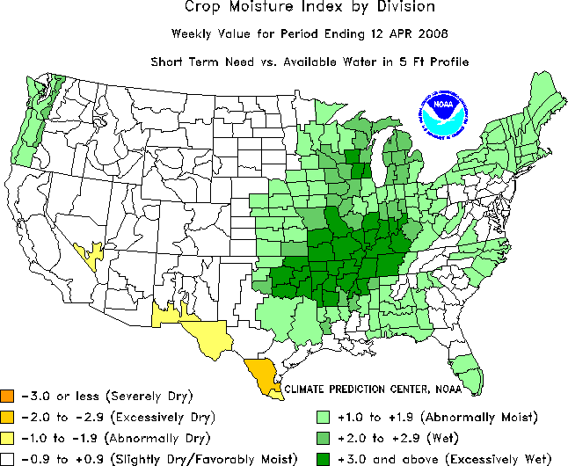
Crop Moisture Index (CMI)

Slide 21
Standardized Precipitation Index (SPI)
Developed in 1990s
Can be produced for a variety of time periods, depicting both short-term and long-term conditions
Based on precipitation over an accumulation period compared to the station’s historical distribution
  Statistical “unusualness” of a period
PDSI uses a water-balance model to estimate evaporation based on temperature
Values of -2 or less are extremely dry; +2 and greater are extremely wet

Slide 22
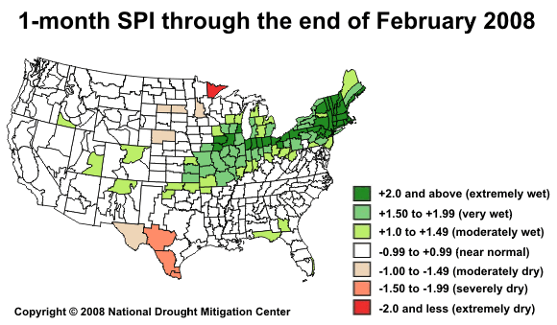
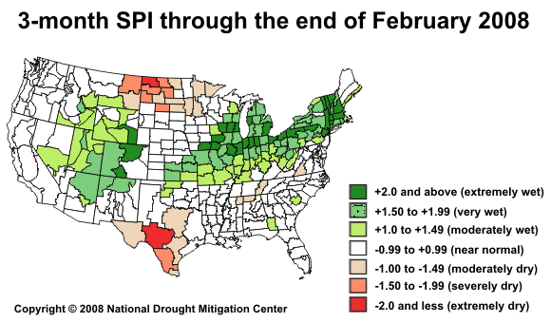
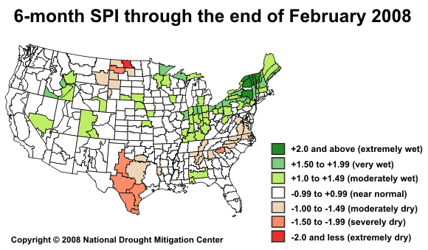
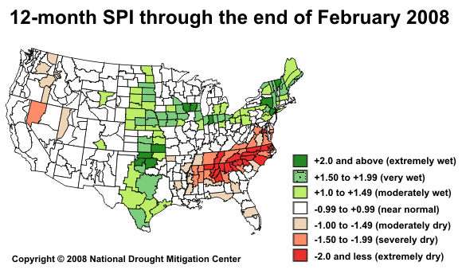
Standardized Precipitation Index (SPI)

Slide 23
Keetch-Byram Drought Index (KBDI)
Estimates dryness of soil and dead vegetation
Ranges from 0 (saturated soil) to 800 (dry soil)
Based on combination of recent precipitation and estimated evaporation
  Soil may dry because of extended periods without precipitation or by high temperatures / strong winds
Developed for fire management purposes, but also a good short-term drought indicator

Slide 24
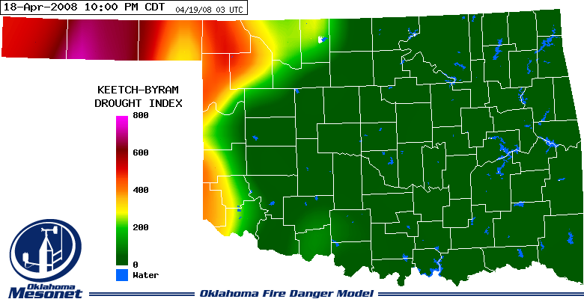
Keetch-Byram Drought Index (KBDI)
KBDI Value | Interpretation
0-200 | No Drought-Slight Drought. Fuels and ground are quite moist.
200-400 | Moderate Drought. Dry vegetation begins to contribute to fire.
400-600 | Severe Drought. Escaped fire is difficult to control.
600-800 | Extreme Drought. Fire suppression is a major problem.

Slide 25
Other Drought Tools
Evaporation models
  Often the missing link in drought understanding
  Direct measurement difficult and disappearing (pan evap)
  ET models are getting more sophisticated
Soil Moisture
  Integrates precipitation deficits over time
  Lagging indicator but strongly related to impacts
  Valuable for assessing recovery

Slide 26
DROUGHT MONITORING

Slide 27
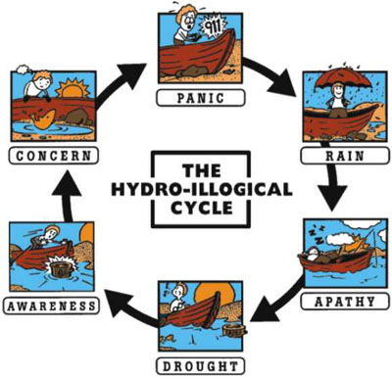
The “normal” reaction to drought
Source: Don Wilhite, National Drought Mitigation Center

Slide 28
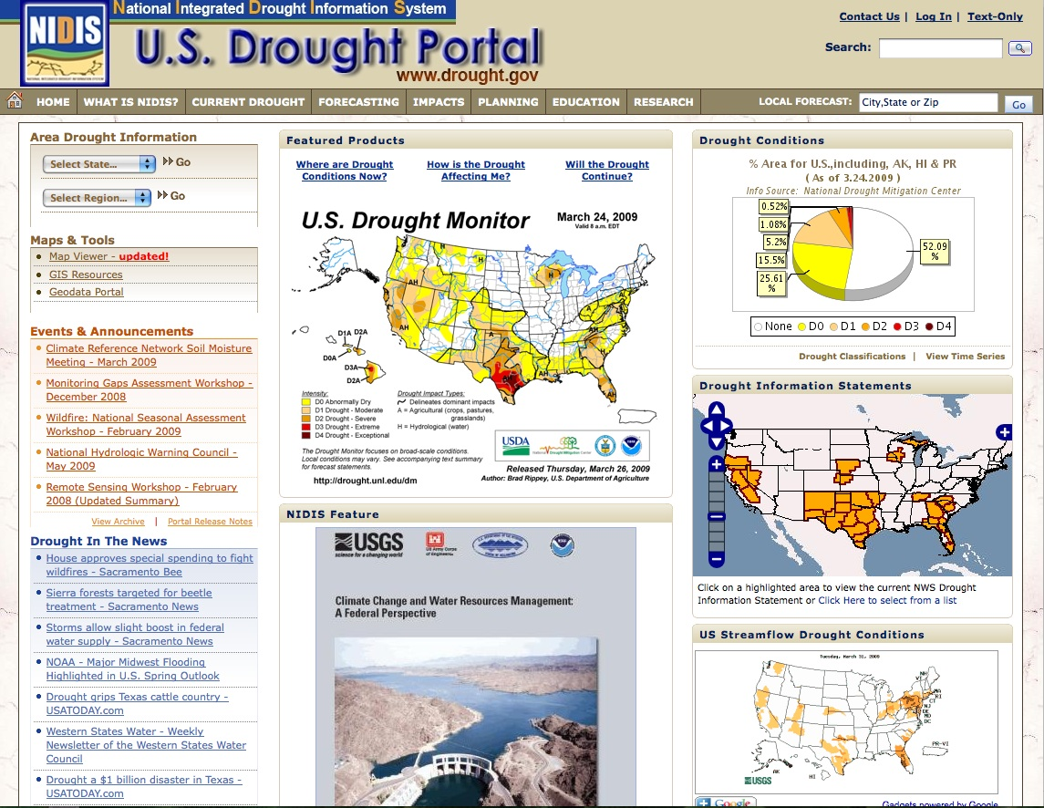
NIDIS Drought Portal http://www.drought.gov
Drought Monitor
Drought Impact Reporter
Drought Outlook

Slide 29
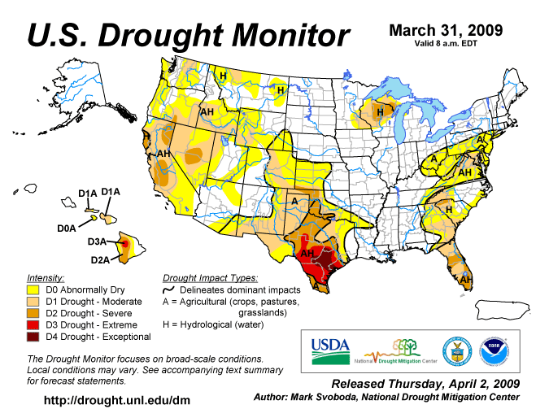
NIDIS Drought Portal
U.S. Drought Monitor
D0 – Abnormally Dry
- Heads Up!
D1 Drought – Moderate
- Some localized impacts
D2 Drought – Severe
- Losses likely, water restrictions
D3 Drought – Extreme
Widespread & severe losses,
water shortages
D4 Drought – Exceptional
- Dust Bowl

Slide 30
The Drought Monitor Concept
A consolidation of indicators into one comprehensive national drought map
Trying to capture these characteristics:
  the drought’s magnitude (duration + intensity)
  spatial extent (how widespread)
  how often similar conditions occur
  Impacts
Rates drought intensity by percentile ranks
An assessment – not a forecast, not a declaration

Slide 31
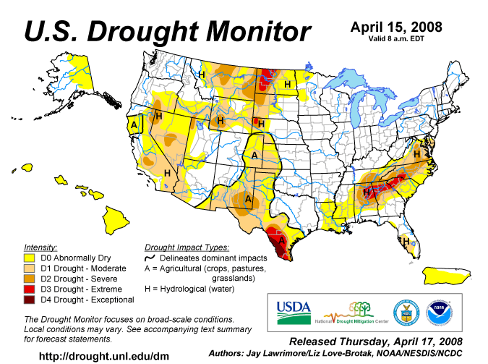
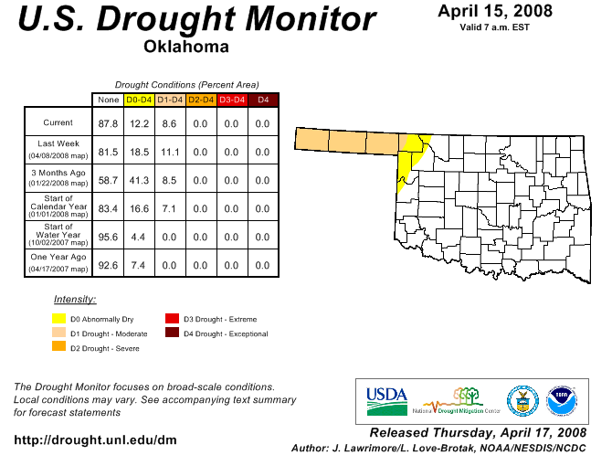
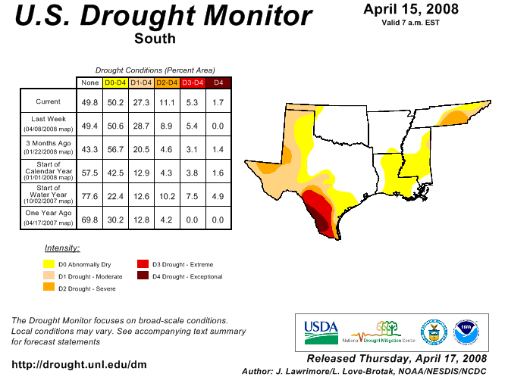
From National to Local…

Slide 32
Key Variables for Monitoring Drought
climate data
soil moisture
stream flow
ground water
reservoir and lake levels
snow pack
short, medium, and long range forecasts
vegetation health/stress and fire danger

Slide 33
Who Makes the Drought Monitor?
A partnership between the National Drought Mitigation Center, USDA and NOAA’s Climate Prediction Center and National Climatic Data Center (authors)
Incorporate relevant information and products from all entities (and levels of government) dealing with drought (Regional Climate Centers, State Climatologists, federal/state agencies, etc.) (experts)
The Drought Monitor is updated weekly and provides a general up-to-date summary of current drought conditions across the 50 states, Puerto Rico and the Pacific possessions

Slide 34
Monitor Development (Period starts 12Z last Tuesday)
Monday (5 Days available)
Draft map sent to local experts
Tuesday (6 Days available)
Local expert feedback
Draft map(s) sent to local experts
Draft text sent to local experts
Wednesday (7 Days available; ending 12Z yesterday)
Local expert feedback
Draft map(s) sent to local experts
Draft text(s) sent to local experts (Outlook)
Final map and text sent to secured ftp server
Thursday
Final map & text released on NDMC Website

Slide 35
Why Does This Matter?
Use of the DM in Decision-Making
USDA Conservation Reserve Program Release hot spot trigger (D2)
USDA Dried Milk Program 2002-03
Numerous states use as a drought trigger (Governor’s declarations)
2006 USDA Livestock Assistance (D3)
2006 IRS (tax deferral on livestock losses)

Slide 36
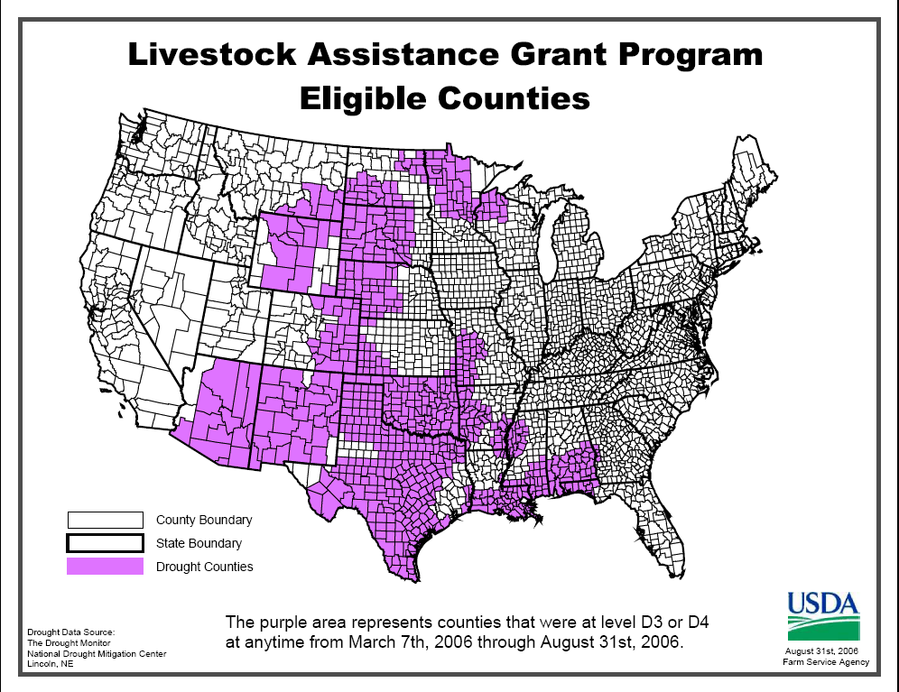
Source: National Drought Mitigation Center

Slide 37
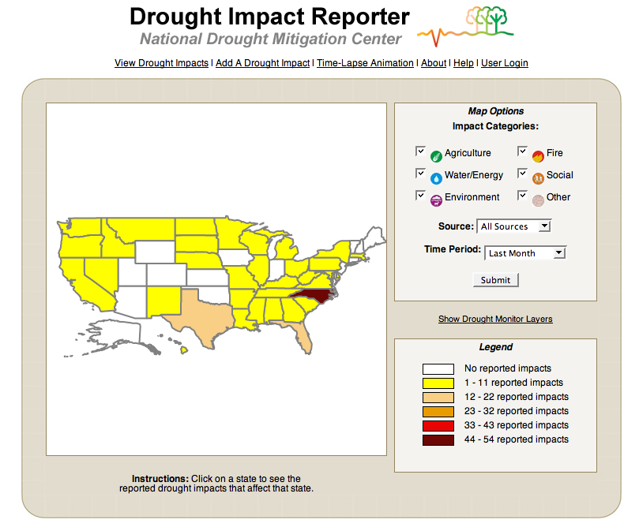
NIDIS Drought Portal
Drought Impact Reporter

Slide 38
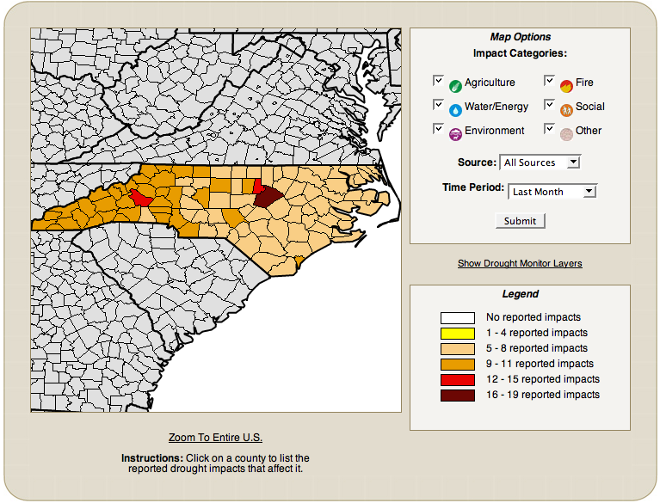
Drought Impact Reporter

Slide 39
What can you find in the
Drought Impact Reporter?
Individual and media reports of drought “events”
Color-coded maps to show counties, states reporting many impacts
Number of reports does not necessarily indicate severity
  Could have many reports from an organized community
  Could have few (or zero) reports from sparse areas
  Local “chatter” doesn’t make it into the DIR unless somebody submits it

Slide 40
The Importance of Reporting
A rancher submitted the following report: In Alfalfa County in NW Oklahoma for the month of June I recorded 1.3 inch of rainfall west of Manchester. Wells are running dry and we are drilling new wells. Most all farm ponds are dry and many streams are dry. Water is hauled to livestock from Manchester. We had two very short cuttings of alfalfa hay at 10 percent of average yield. There will not be a 3rd cutting in many fields. The 4th of July we received .35 inch rain. The Palmer Drought Index is off track once again. The extreme drought leads much farther east than is shown on their map clear into Grant County. Kansas is receiving beneficial rains. As close as 15 miles north and east 2 inches of rain was recorded in Anthony, Kansas, and east of Anthony. I would feed my cattle hay, if I had it or could afford to buy it. - “Jack the Toad”
…but nothing particularly unusual in Alfalfa County
compared to neighbors at first glance

Slide 41
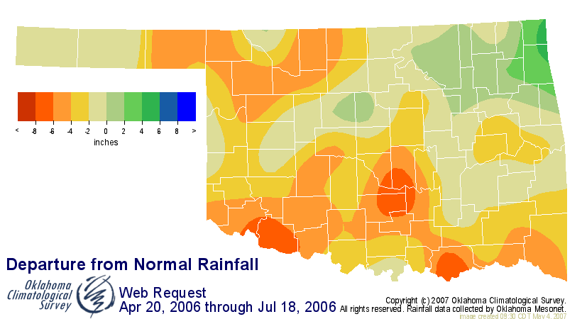
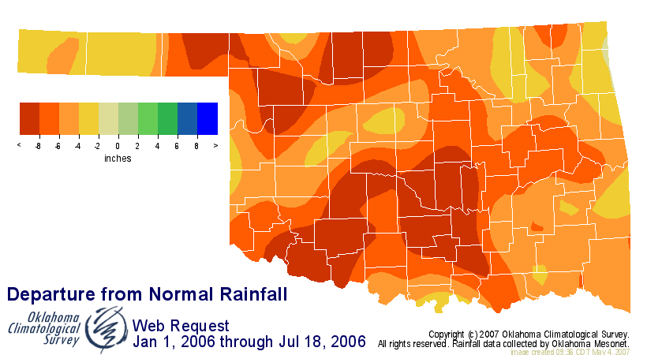
The Indicators Told Different Stories
But the long-term
revealed underlying
problems
The short-term
didn’t look so bad

Slide 42
Set off Discussion
I often don't do such large, drastic changes but the last couple of weeks have made me think we need to step this up - that our precip-based indicators just aren't keeping up with impacts.
It shows a rapidly deteriorating conditions pretty much statewide. With more 100s on the way, any moisture that's left in the soil is getting sucked out quickly. I'm giving up on rainfall as an indicator of drought - it just doesn't last long enough now to make a difference.
And the most telling indicator of all - there are fewer campaign signs around this year even though we have some very contested races. It's tough to put those in the ground (especially the big signs).

Slide 43
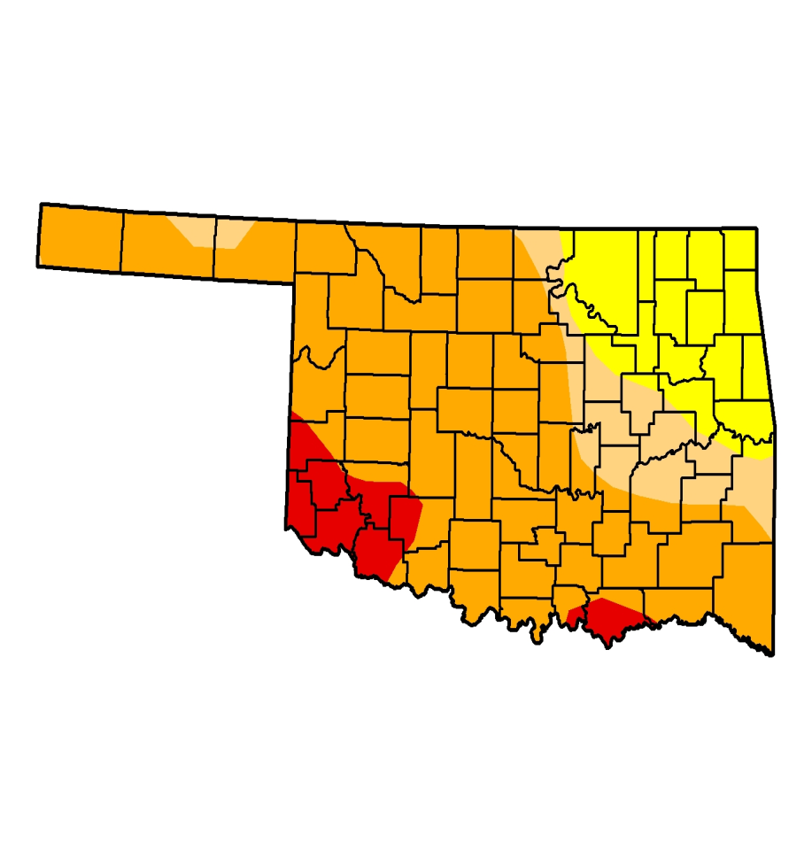
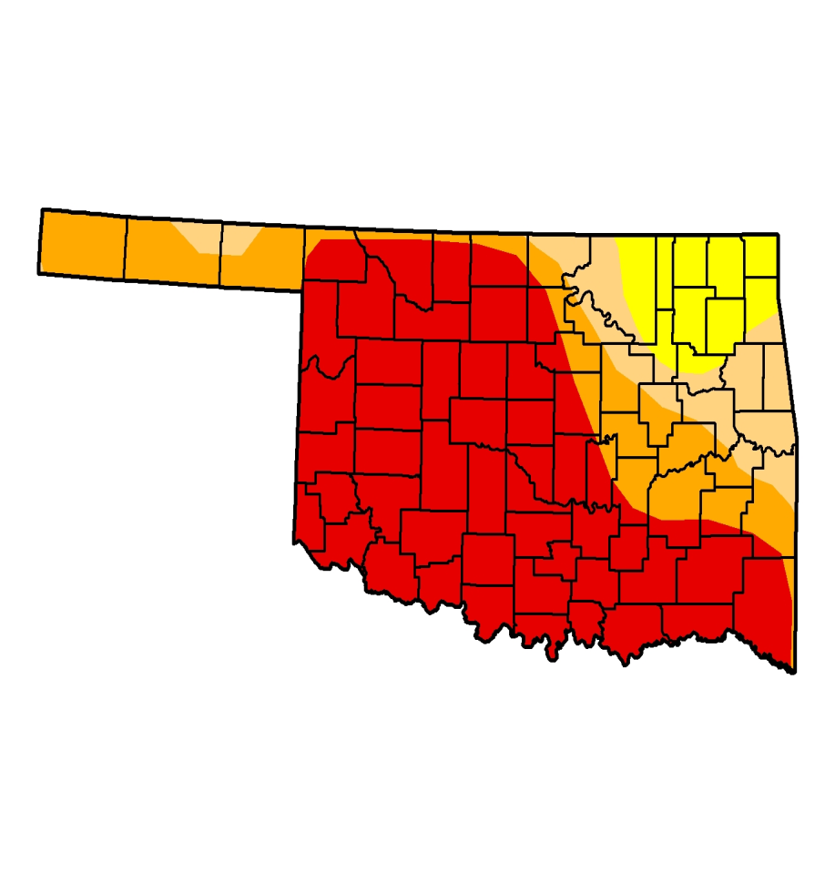
We Listened!
D0
D1
D2
D3
D4
D0
D1
D2
D3
D4
July 18, 2006
July 25, 2006

Slide 44
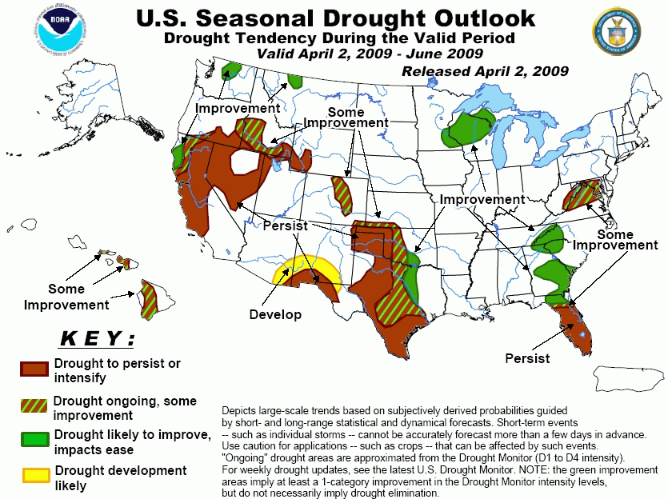
NIDIS Drought Portal
Drought Outlook

Slide 45
What Does the
Drought Outlook Tell Us?
Shows expected changes from current Drought Monitor (D1-D4)
  Essentially a 3-month forecast
Large-scale trends
  Seasonal forecasts usually lack skill on small scales
  Does not forecast impacts of a single event
Subjective, based on models
Forecasted development based on areas already depicted as abnormally dry (D0)
Improvement may just be one category
  Not necessarily elimination of drought

Slide 46
NIDIS Drought Portal http://www.drought.gov
Drought Information Statements
Feature Story / Report
Map Viewer

Slide 47
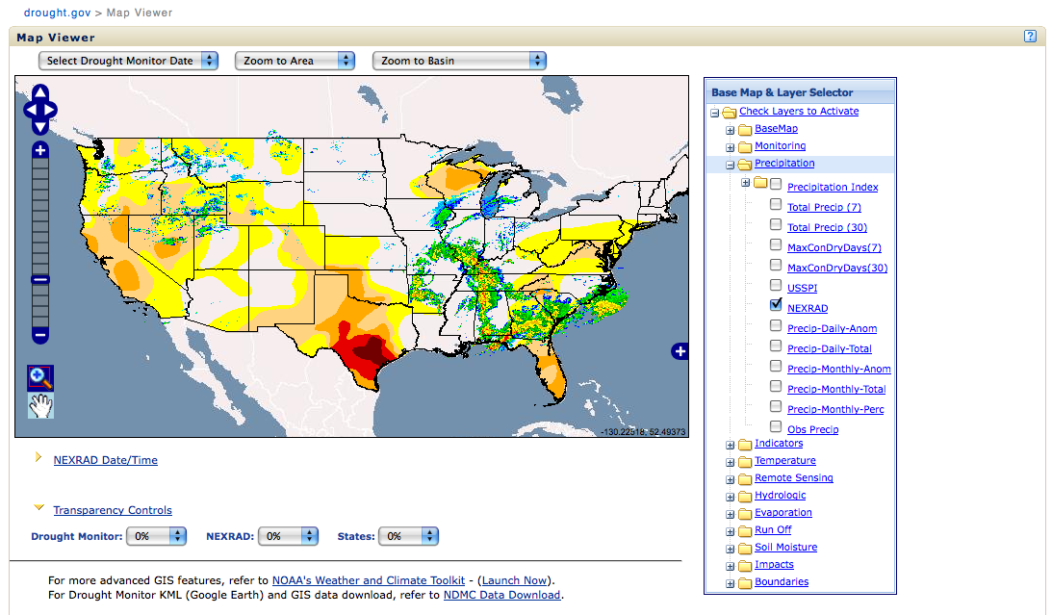
NIDIS Drought Portal
Map Viewer

Slide 48
NIDIS Drought Portal http://www.drought.gov
What about Oklahoma?
Tell me more!
I really, really want to know details

Slide 49
NIDIS

Slide 50

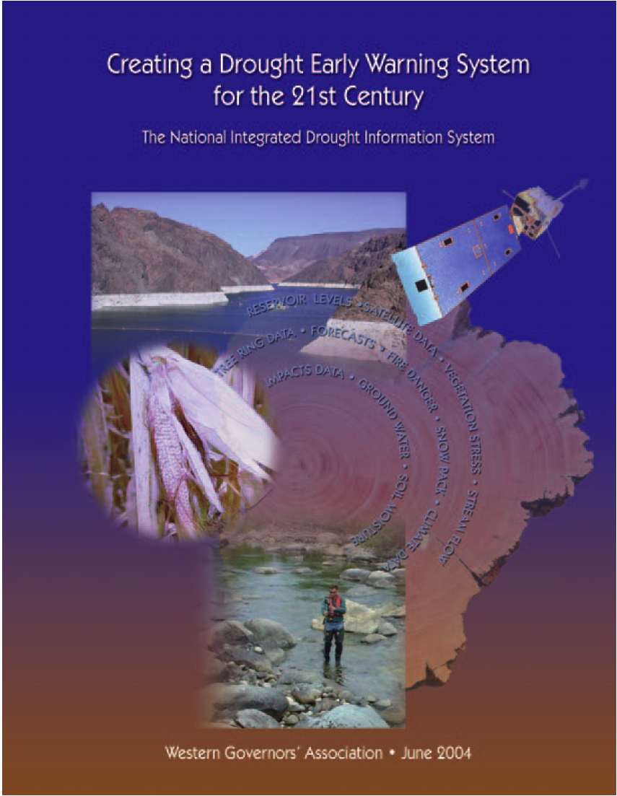
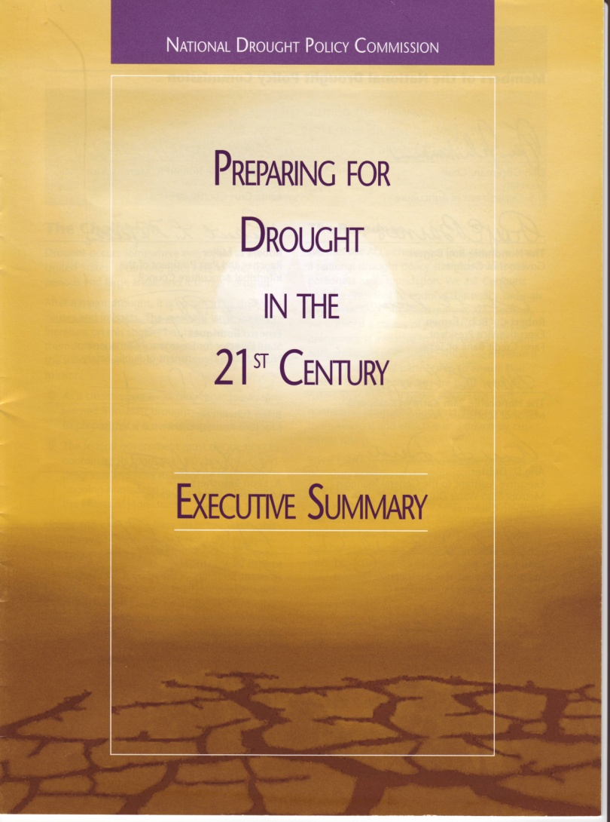
The Future of Drought?

Slide 51
NIDIS VISION and GOALS
“A dynamic and accessible drought information system that provides users with the ability to determine the potential impacts of drought and the associated risks they bring, and the decision support tools needed to better prepare for and mitigate the effects of drought.”
Public Law 109-430 (Signed by the President December 2006)
Notes:
51
51

Slide 52
NIDIS Objectives
Creating a drought early warning information system
  Coordinating national drought monitoring and forecasting systems
  Providing an interactive drought information clearinghouse and delivery system for products and services—including an internet portal and standardized products (databases, forecasts, Geographic Information Systems (GIS), maps, etc)
  Designing mechanisms for improving and incorporating information to support coordinated preparedness and planning
Notes:
52
52

Slide 53
Drought Information: NIDIS
Early Warning (sub)Systems
Monitoring and forecasting subsystem
National, regional and local levels
Risk assessment sub-system
Enable disaster management authorities to generate risk and impact scenarios, trigger and tools development
Preparedness sub-system
Outline and inform and coordinate actions required to reduce the loss and damage expected from an impending event and for post-event planning

Slide 54
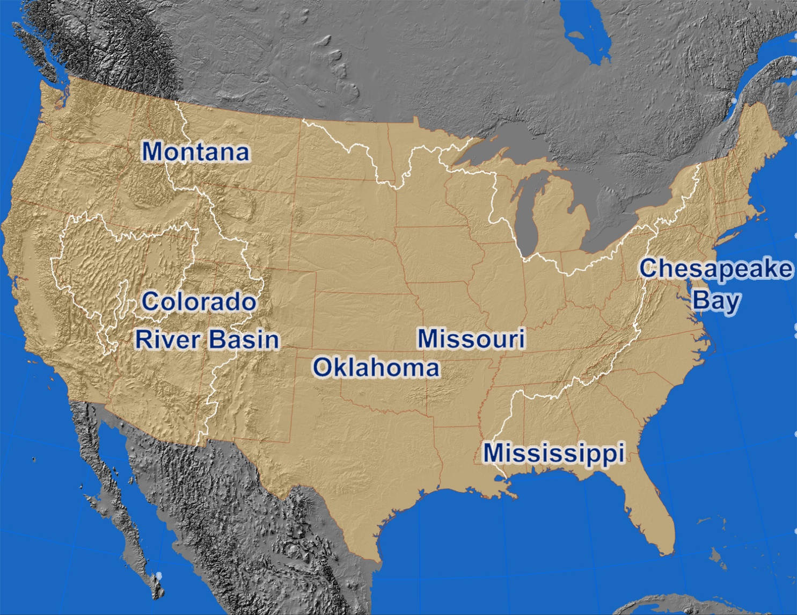
NIDIS Early Warning Systems Pilots –
Selected by Drought-type and analysis units
Southeast
Notes:
54

Slide 55
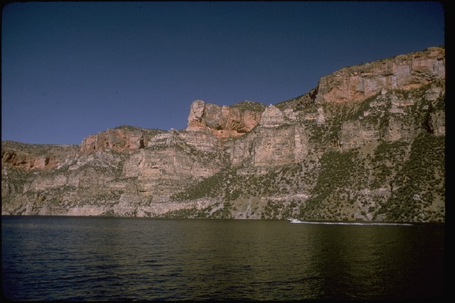
NIDIS Pilots
Upper Colorado River Basin
Water management issues in a region with growing demand
Arid region with long-term climate change threats
Multi-year droughts recent occurrences (ongoing)
First Pilot, launched in 2008
Federal Planning Meeting - NIDIS Pilot for the Colorado River Basin, Salt Lake City UT, May 2008
Scoping Workshop for the Upper Colorado River Basin NIDIS Pilot, Boulder CO, October 2008

Slide 56
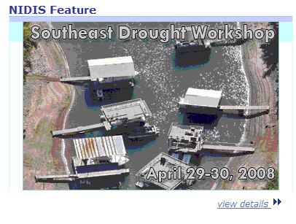
NIDIS Pilots
Southeast U.S.
Institutional issues governing water management across state boundaries
Southeast US Drought Workshop (Peachtree City, GA, April 2008)
Overview of Federal Drought Products
Overview of State Plans and Triggers: What Works & What is Needed
Coastal and Estuarine Issues and Drought
Current Long Range Forecast from NOAA
Status: Fall 2009 scoping workshop

Slide 57
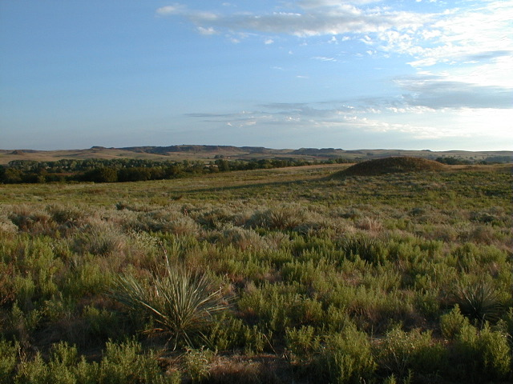
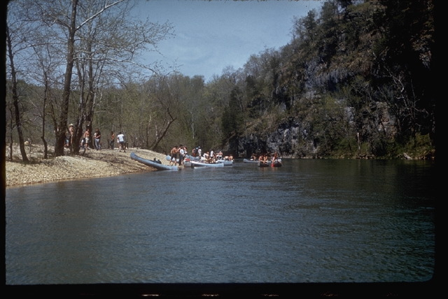
NIDIS Pilots
Oklahoma/Missouri
Transition area between semi-arid (west) to abundant precipitation (east)
Rain-fed agriculture, aquifers, small reservoirs
Technology transfer issues
Surveys being conducted of drought management & communication
How do they manage drought?
What are their sources of information?
How do they convey that information
Status: Planning

Slide 58
NIDIS Pilots
Montana / Northern Plains
Tourism and Recreation
Farming and Ranching in a semi-arid area
Dependent upon rainfall, snowfall
Short-term rapid-onset drought
Trans-boundary issues (Canada)
Status: Pending

Slide 59
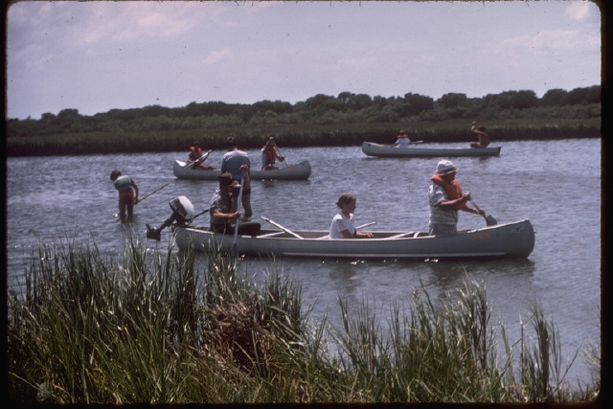
NIDIS Pilots
Chesapeake Bay
Densely-populated urban environment
Multiple environmental stressors
Low water storage capacity
Water quality issues
Focus on instream flows
Status: Pending

Slide 60
Pilot Implementation
Upper Colorado River Basin
Year 1 Actions from the Scoping Workshop for the Upper Colorado River Basin NIDIS Pilot
Build a UCRB community on the NIDIS Drought Portal (www.drought.gov)
Inventory and assessment of drought indicators and triggers presently used in the UCRB
Facilitate access to indicator and trigger observational data and information products via the UCRB community on the NIDIS Drought Portal
Perform a monitoring networks gap analysis for the UCRB
  Targeted completion October 2009

Slide 61
Pilot Implementation
Upper Colorado River Basin
Year 2 Actions
Initiate Colorado Basin Drought Information Portal (as a subset of the U.S. Drought Portal)
Establish network for ongoing briefings on impacts and projections across climate timescales (UCRB Drought Monitor)
Develop decision support tools for demand projections and review of triggering criteria (Northern Water, Denver Water, Grand Valley)
Feedback into “Colorado Basin” Drought Monitor and Portal, Early Warning System maintenance and transfer
Prototyping: Given better data and information coordination, would responses have been improved for past events? Assess:
  Value of improved information using past conditions
  Responses for projections / scenarios (decadal, climate change)
  Feedback on priorities (e.g. data gaps) to Executive Council

Slide 62
Pilot Implementation
Upper Colorado River Basin
Improvements to Water Supply Forecasting
Integrate objective climate forecasts into RFC Ensemble Streamflow Predictions (ESP)
Introduce time-varying potential evapotranspiration into ESP water supply forecasts
Develop USBR operations management model that can make use of ESP continuous, probabilistic forecast to reckon chance of hitting EIS trigger points, instead of single value NOAA/NRCS water supply forecasts

Slide 63
SOME CLOSING THOUGHTS

Slide 64
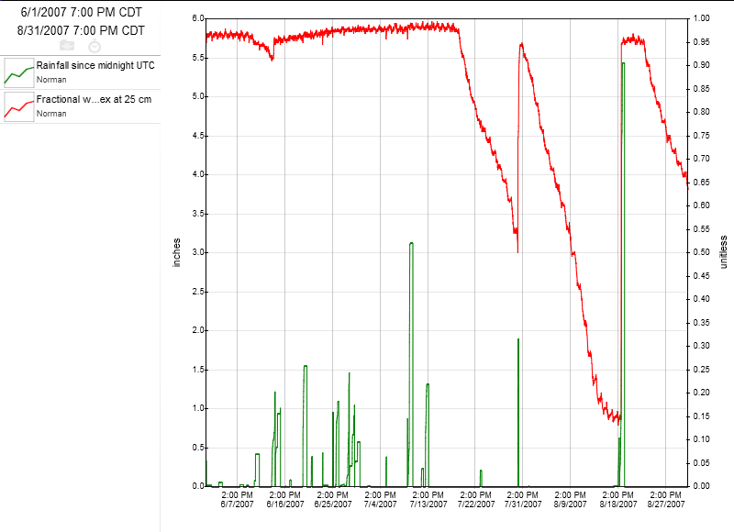
Even the wet years have dry-downs
Soil Moisture (10”) & rainfall for Norman, OK; June-Aug 2007

Slide 65
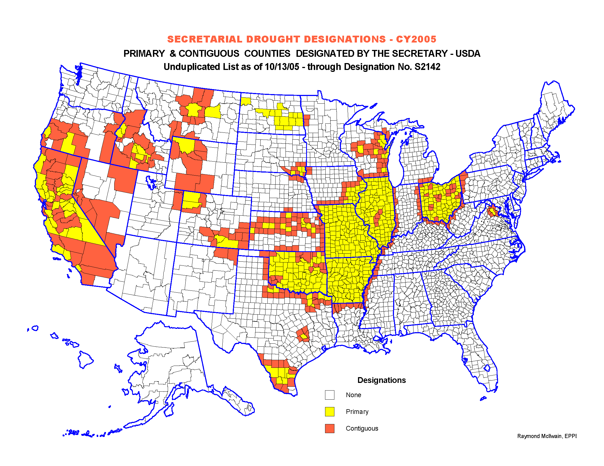
Are Drought Designations
Purely Objective?

