Slide 1
Climate products
Funding provided by NOAA
Sectoral Applications Research Project
Basic Climatology
Oklahoma Climatological Survey

Slide 2
OBSERVING NETWORKS

Slide 3
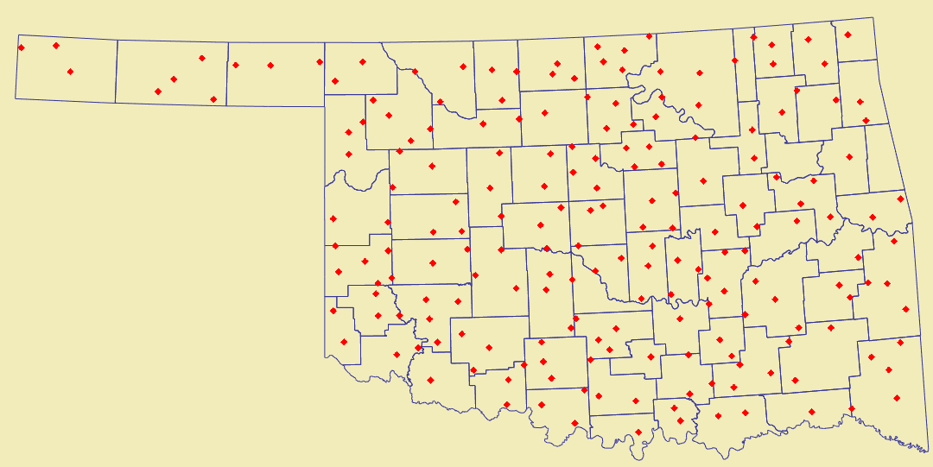
Cooperative Observer Data (COOP)
What is it?
Volunteers record temperature and precipitation observations once a day
Observations are either mailed on written forms or entered through the computer or a telephone system
Data are collected by the National Climatic Data Center (NCDC), where they are quality-assured
Typically takes 4-5 months before data are declared “official”
What is observed?
Daily Maximum and Minimum Temperatures
Precipitation (liquid)
Snowfall, Snow Depth
Where is it recorded?
~8000 sites nationwide
~200 active sites in Oklahoma
Dates back to before 1900

Slide 4
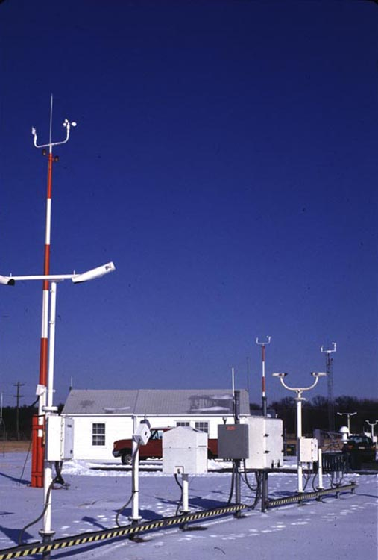
NWS – ASOS and AWOS
Automated Surface Observing System (ASOS)
882 NWS/FAA stations in the United States
Generally dating back to ~1940s
Hourly weather observations
Automated Weather Observing System (AWOS)
Operated by the Federal Aviation Administration (FAA)
About 600 FAA stations in the United States
Older than ASOS
Usually do not report special observations (e.g., time of wind shifts)
The original observations relate to WEATHER, not CLIMATE. But if we look at this information over a much longer period of time, we can see climate trends.

Slide 5
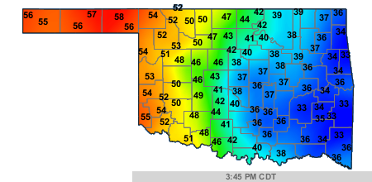
Oklahoma Mesonet
County-level, real-time
120 stations in Oklahoma
Commissioned in 1994
Data reported every 5 minutes:
Temperature
Rainfall
Humidity
Winds
Sunshine (solar radiation)
Pressure
Soil temperature, soil moisture
http://www.mesonet.org

Slide 6
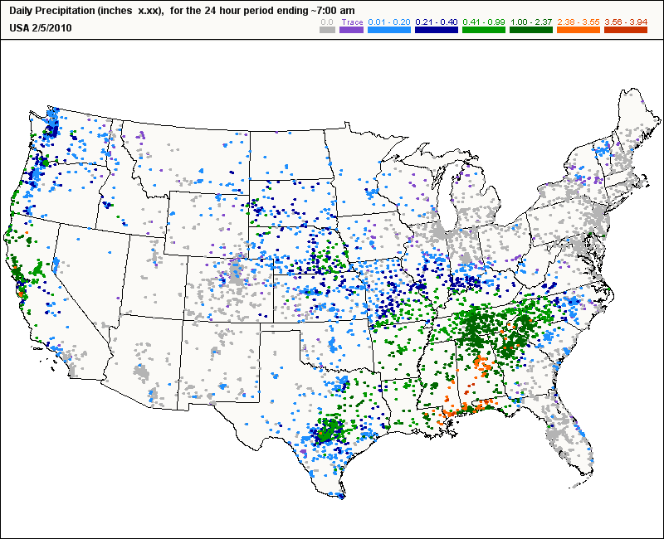
CoCoRaHS
Community Collaborative Rain, Hail and Snow Network
Volunteer observers report rain, snow, and hail each day
Online “journal” allows tracking over time, comparing with neighbors
Established in Colorado in 1998
Currently 11,000+ observers in
all 50 states
Goal: a raingauge every mile
Need County Coordinators!
http://www.cocorahs.org

Slide 7
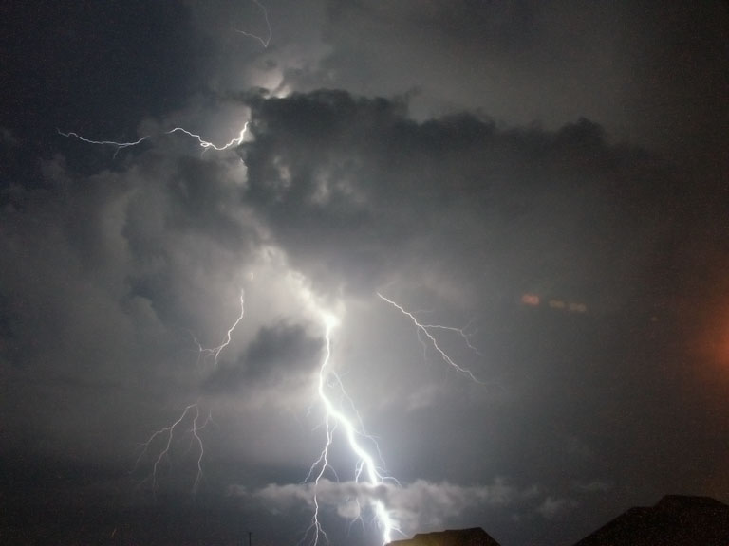
Storm Reports
NOAA Storm Data publication (monthly – OFFIICIAL RECORDS):
http://www7.ncdc.noaa.gov/IPS/sd/sd.html
NCDC Storm Events Database (usually 90-120 days behind the current month):
http://www4.ncdc.noaa.gov/cgi-win/wwcgi.dll?wwEvent~Storms
Storm Prediction Center (unofficial reports usually up within a day or so):
http://www.spc.noaa.gov/ (Reports tab)
Local Storm Reports (issued by National Weather
Service offices as events are reported)
Contact your State Climate Office for assistance:
http://www.stateclimate.org/

Slide 8
SOME USEFUL CLIMATE WEBSITES

Slide 9
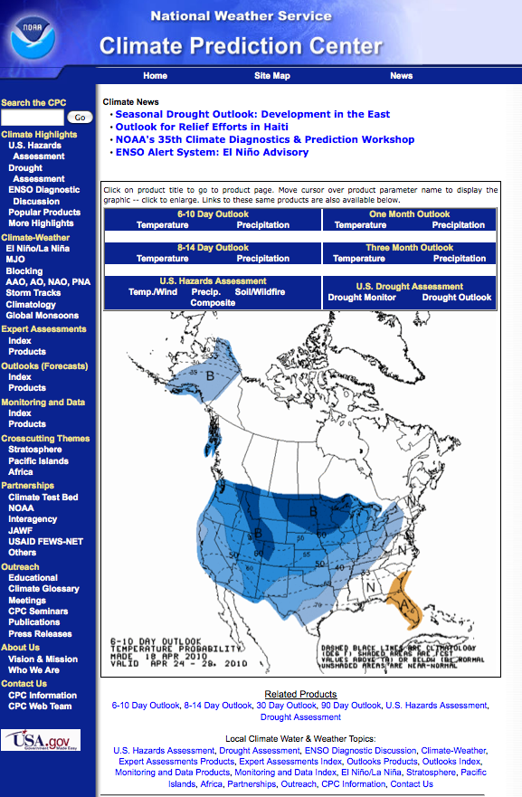
NOAA Climate Prediction Center www.cpc.noaa.gov
1 and 3 month outlooks
Short-term outlooks
U.S. Hazards Assessments
U.S. Drought Assessment
(also see www.drought.gov)
ENSO (El Nino/La Nina)

Slide 10
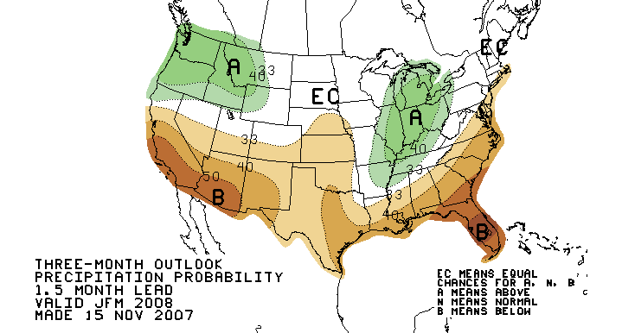
Seasonal Outlooks
From the Climate Prediction Center: http://www.cpc.noaa.gov/
Three Month (seasonal) and One Month outlooks
Forecast is actually how confident they are about general tendencies (above, below, or near normal)
The darker the shading, the more confident the forecaster is that warmer/cooler/near normal/wetter/drier conditions will occur

Slide 11
Interpreting Seasonal Outlooks
A=Above, B=Below, N=Near Normal, EC=Equal Chances
EC indicates a 33.3% chance of conditions falling into one of the three categories (above, near normal, or below)
A (B) indicates that the forecaster thinks that conditions will be above (below) normal
Does not forecast how much above normal
Any contours show an increased confidence in the forecast trend
 | Above | Near Normal | Below
Equal Chances | 33.3 | 33.3 | 33.3
40% Above | 40.0 | 33.3 | 26.7
50% Below | 16.7 | 33.3 | 50.0

Slide 12
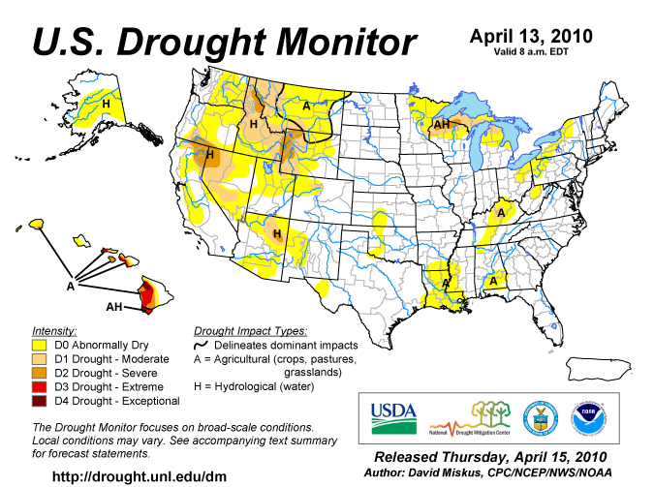
Drought Monitor www.drought.gov

Slide 13
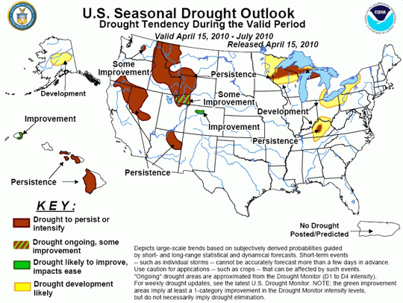
Drought Outlook www.drought.gov

Slide 14
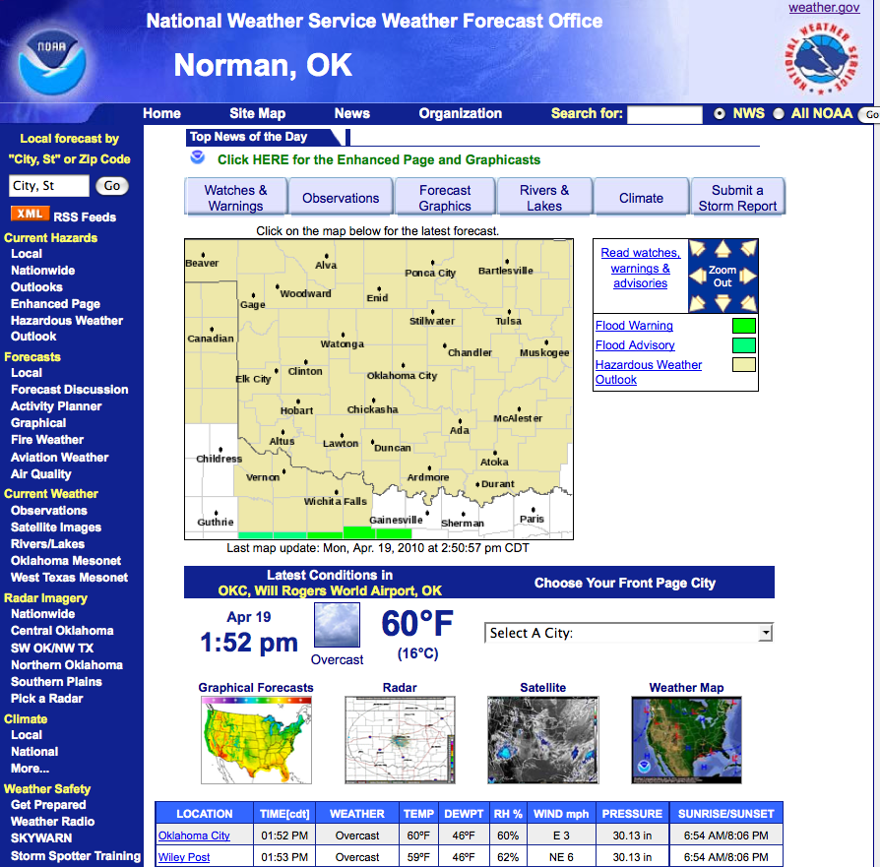
National Weather Service Norman: www.srh.noaa.gov/oun/ Tulsa: www.srh.noaa.gov/tsa/
Enhanced Page
(current concerns)
Data!
Point-and-click
Forecasts

Slide 15
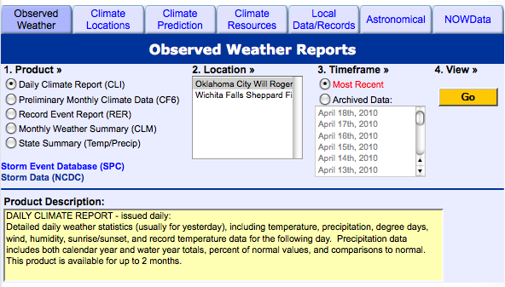
NWS – Climate Section

Slide 16
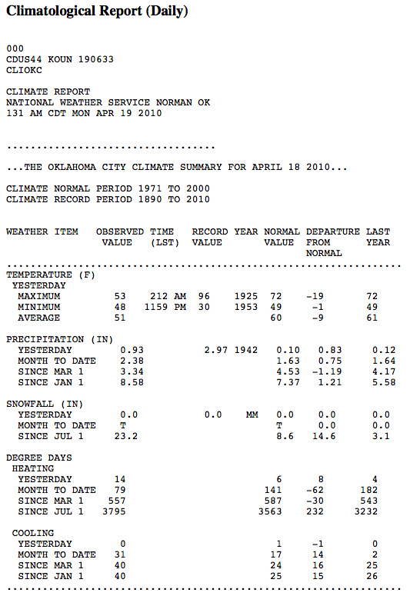
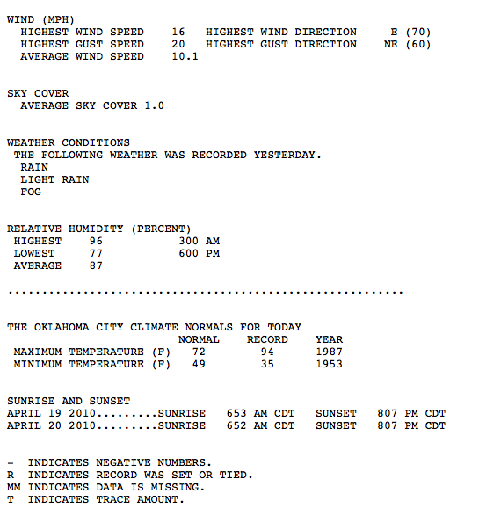
Daily Climate Report (CLI)

Slide 17
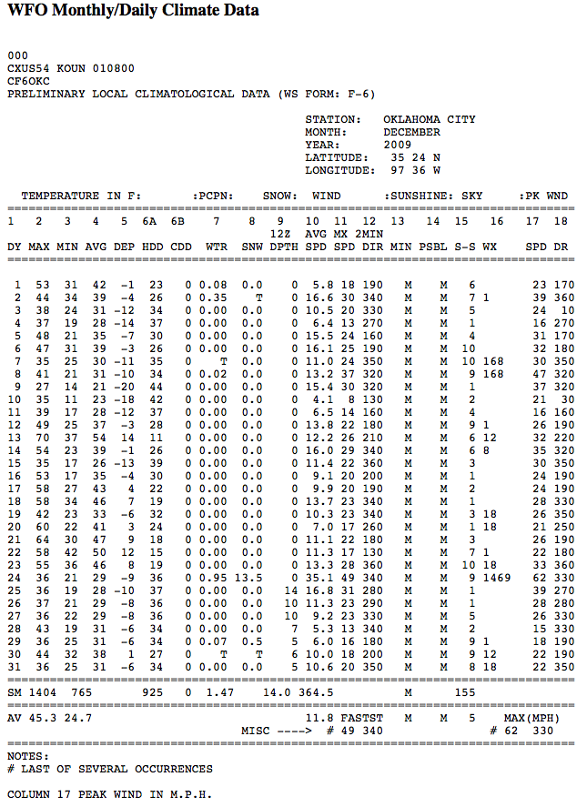
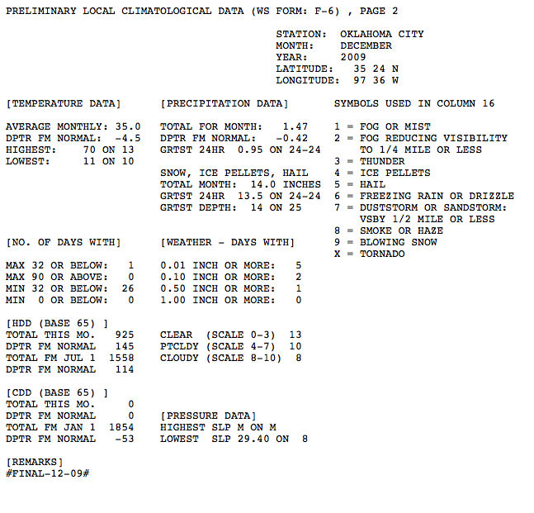
Monthly Climate Data (f6)

Slide 18
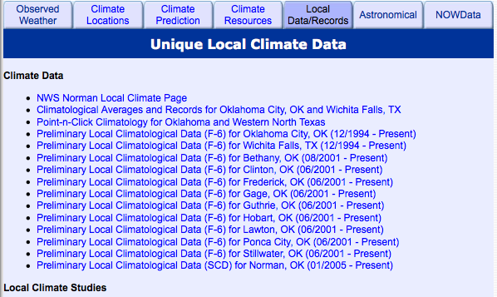
NWS – Climate Section
Summaries, studies, and resources produced by the local office

Slide 19
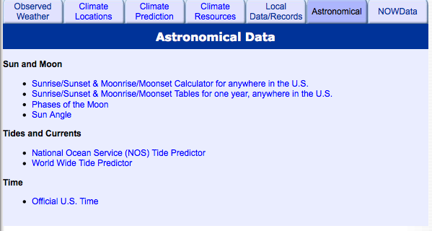
NWS – Climate Section

Slide 20
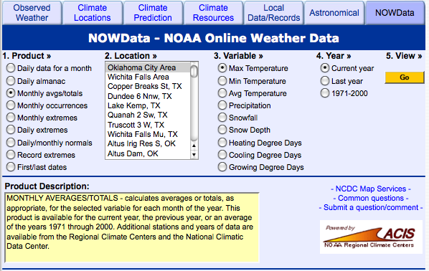
NWS – Climate Section

Slide 21
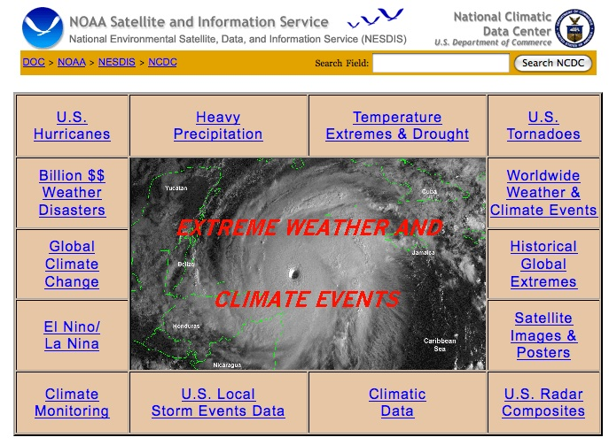
National Climatic Data Center http://www.ncdc.noaa.gov/oa/climate/severeweather/extremes.html

Slide 22
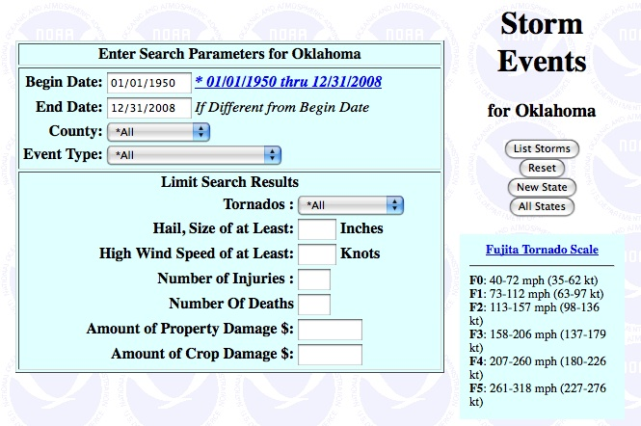
National Climatic Data Center Storm Events Database

Slide 23
National Climatic Data Center Climate Monitoring Reports

Slide 24
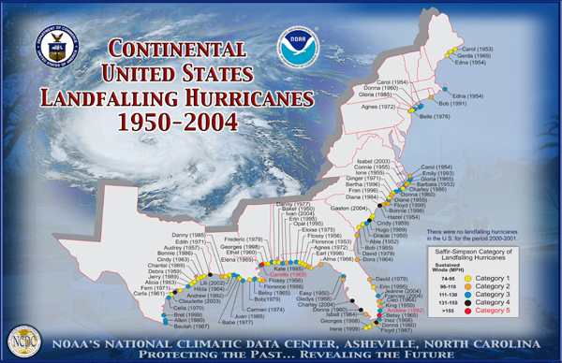
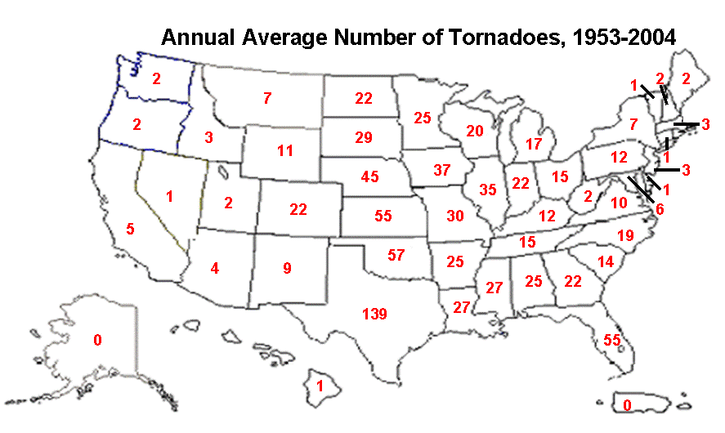
National Climatic Data Center Hurricanes and Tornadoes

Slide 25
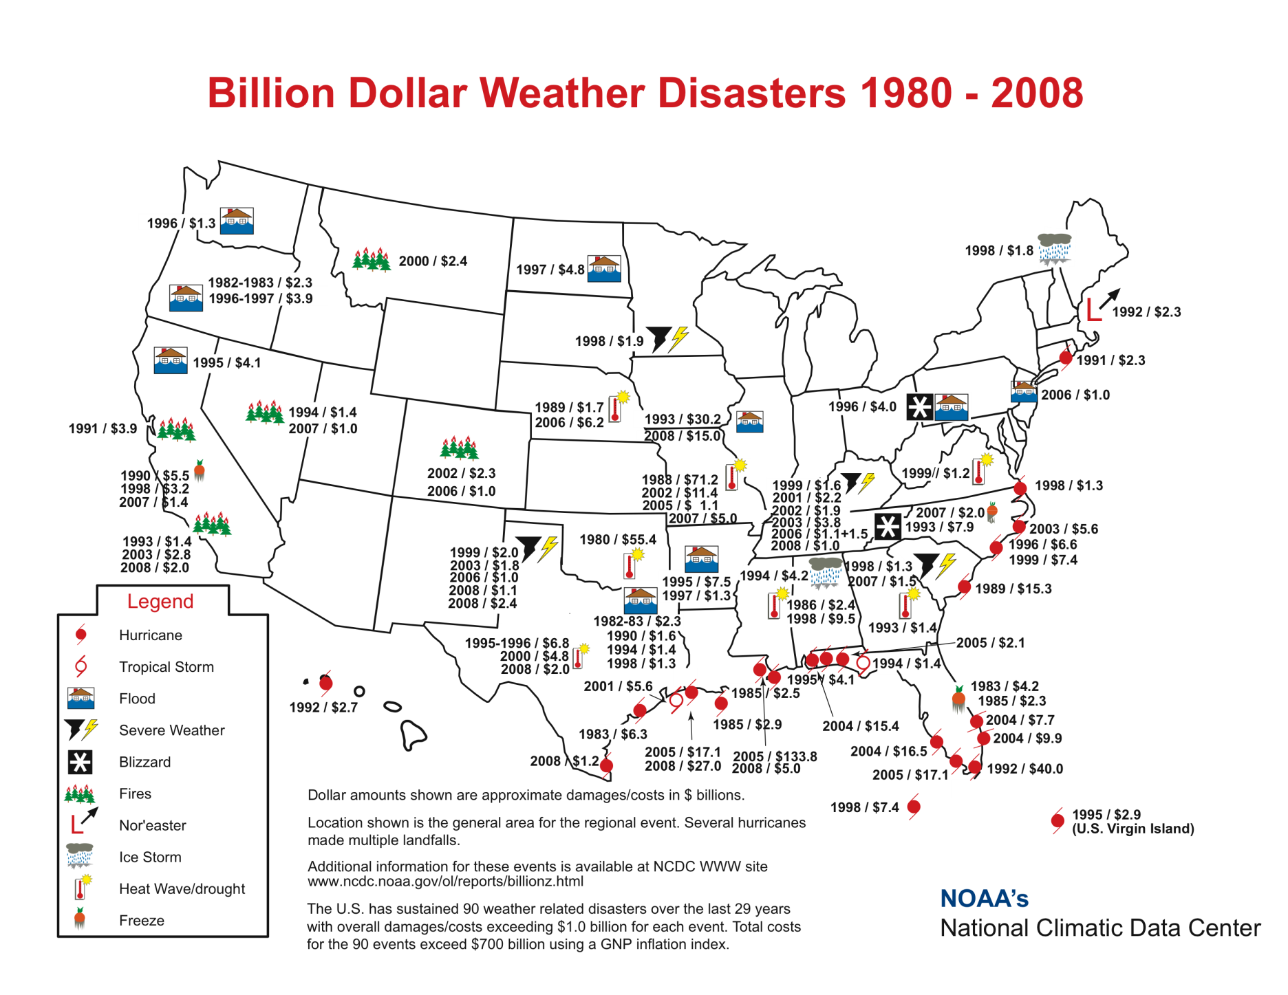
National Climatic Data Center Weather Disasters

Slide 26
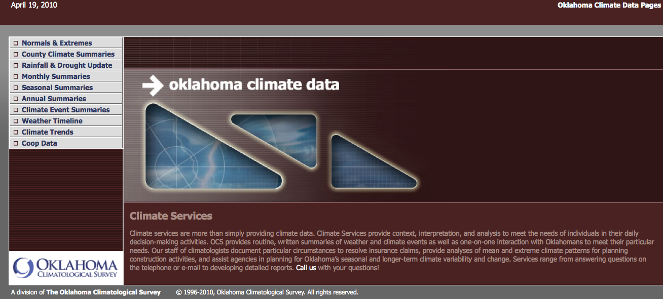
Oklahoma Climate Survey http://climate.ocs.ou.edu

Slide 27
Normals & Extremes Days over 100 degrees

Slide 28
Normals & Extremes First Freeze of Autumn

Slide 29
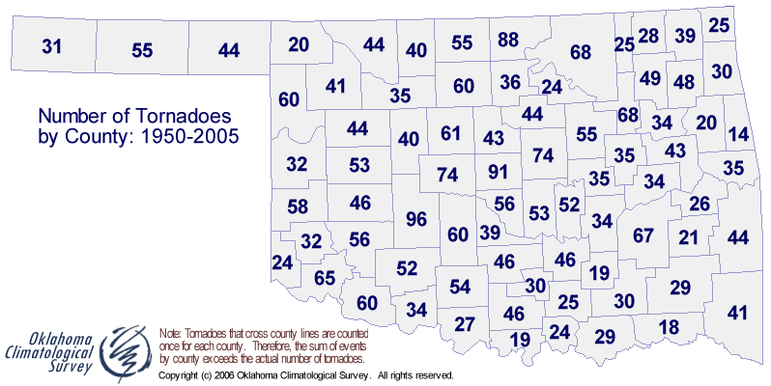
Normals & Extremes Tornadoes by county

Slide 30
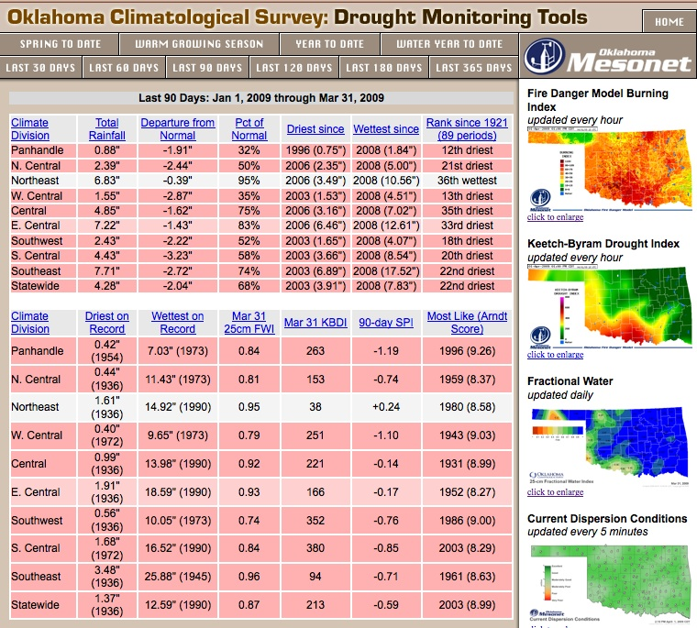
Rainfall and Drought Update
Choose from ten drought “seasons”
Sorted by climate division
Basic statistics
Historical perspective & rankings
“Specialized” indices
Analog years (“most like current season”)
Related fire danger and smoke management products

Slide 31
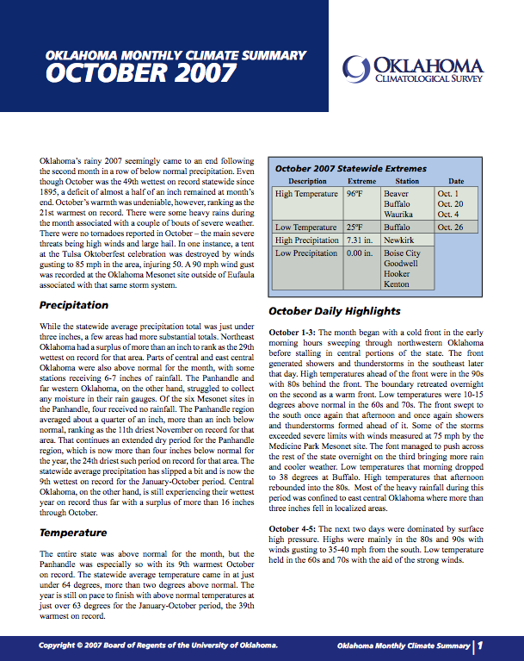
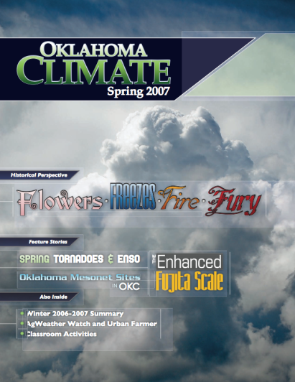
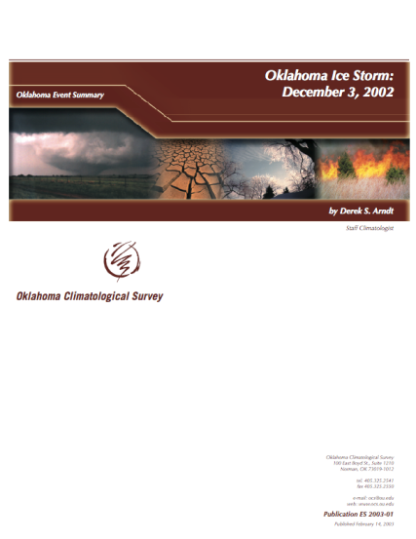
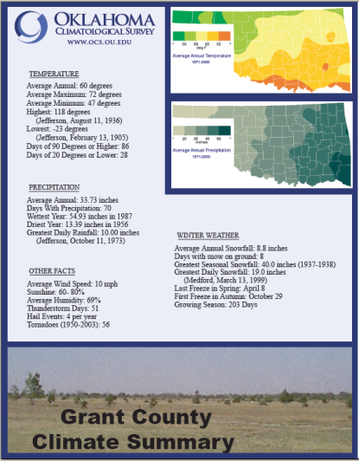
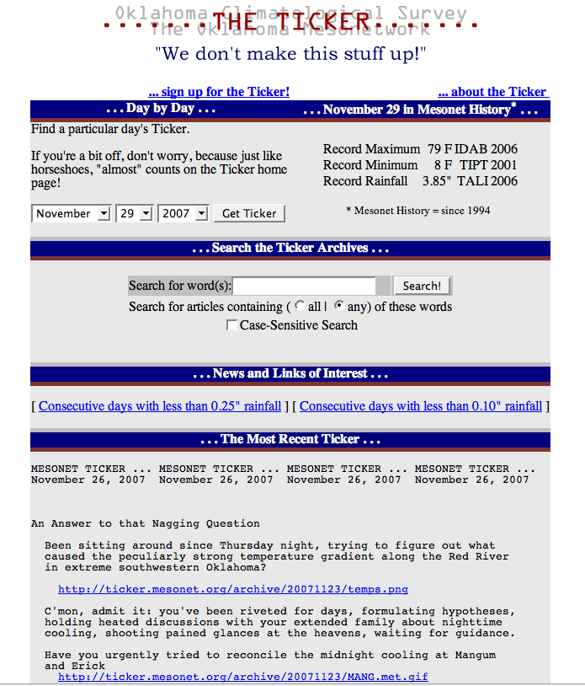
OCS Publications
Monthly Summaries
Oklahoma Climate (Seasonal Summaries)
Climate Event Summaries
Ice Storm
Tornado
Drought
County Climate Summaries
OCS/Mesonet Ticker

Slide 32
OCS Publications—Monthly Summary
http://climate.mesonet.org/monthly_summary.html
Overview and daily highlights
Severe weather reports
Statewide maps of precipitation, temperature, departures from normal, and soil moisture
Mesonet station summaries
Climate division comparisons (OK is divided into
9 regions, assuming similar climates within each
region)
Next month’s outlook
Drought Monitor and Outlook; seasonal forecast

Slide 33
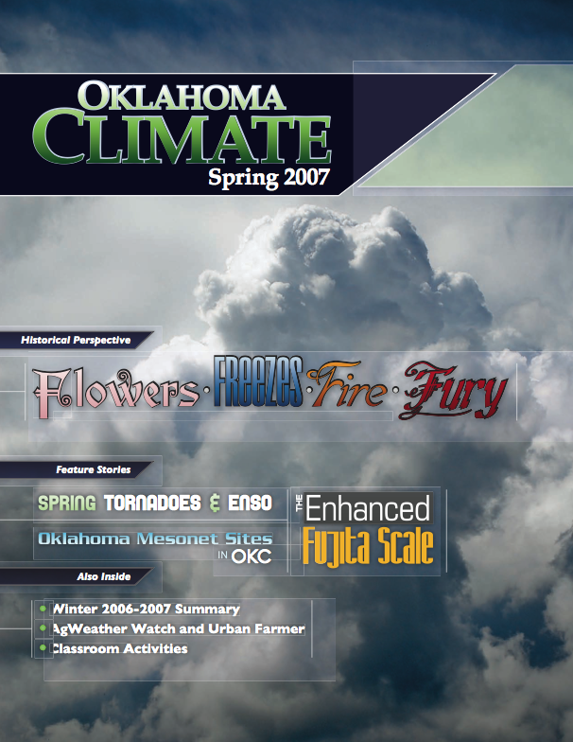
OCS Publications—Seasonal Summary
http://climate.mesonet.org/seasonal_summary.html
Oklahoma Climate
Published in March, June, September, December
Built around a theme (e.g., fall weather)
Historical perspective of Oklahoma climate or event
Feature articles on OCS outreach, research, climate services, etc.
Photos from the field
Seasonal summary
Agriculture articles
Classroom activity/interpretation

Slide 34
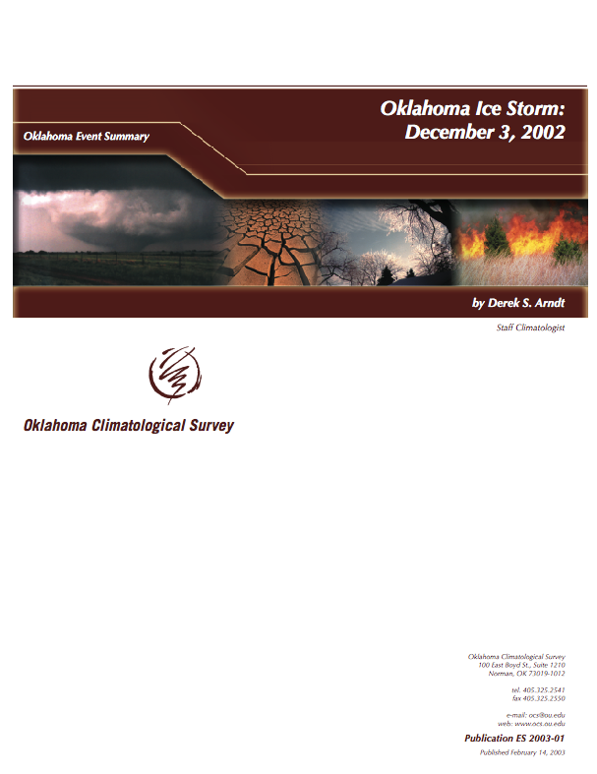
OCS Publications—Event Summaries
http://climate.mesonet.org/event_summary.html
Overview of federally-declared disasters
The meteorology of the event
Impacts
Historical perspective
Climate Event Summaries have been prepared for:
January 28-30, 2002: Oklahoma Ice Storm
The Oklahoma Drought of 2001-2002
Oklahoma Ice Storm: December 3, 2002
May 8-9, 2003 Central Oklahoma Tornadoes

Slide 35
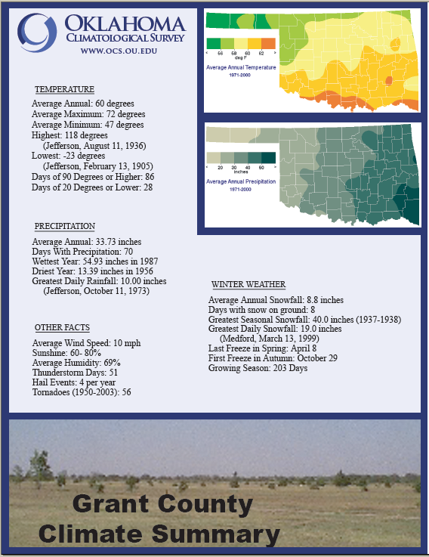
County Climate Summaries
Historical summaries for each county
Quick Facts 1-page overview of normals & extremes
PDF summary and tables for county, including month-by-month temperatures, rainfall, snowfall, tornado records, etc.
Station summaries for Coop and Mesonet sites
All long-term stations within county listed
Similar tables to PDF summary, but for each site
Includes ranges of “likely” conditions; not just monthly averages
Freeze/Frost dates for each site

Slide 36
Weather Timeline

Slide 37
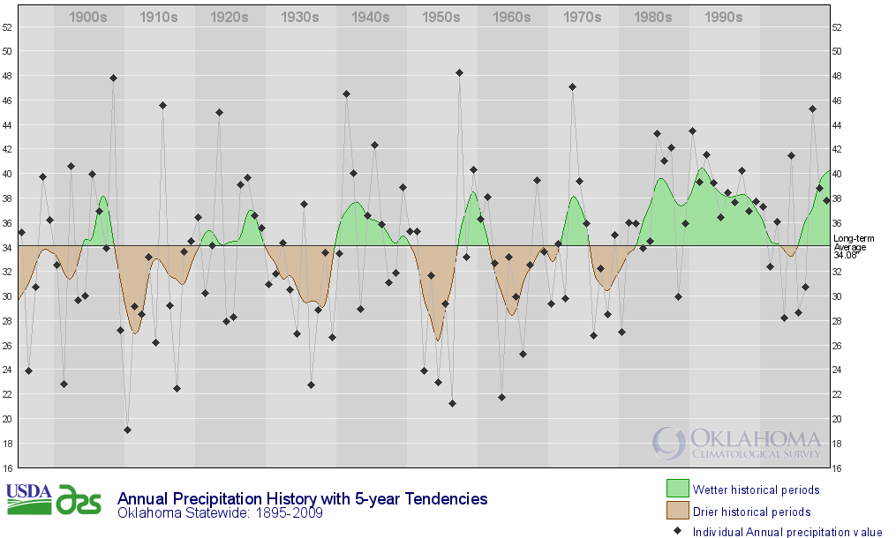
Climate Trends Annual Precipitation, 1895-2009

Slide 38
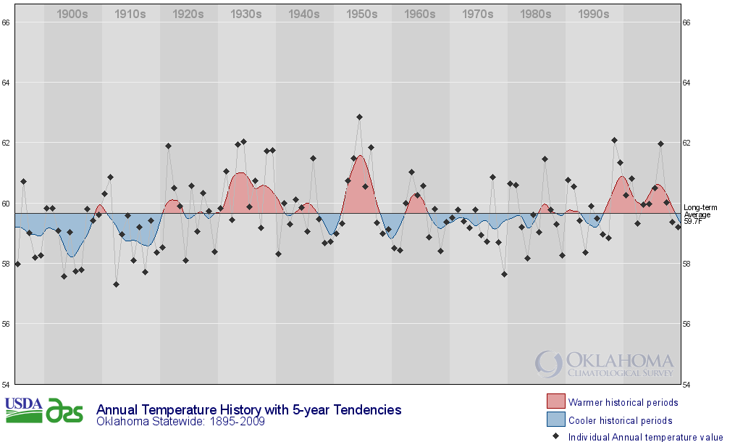
Climate Trends Annual Temperature, 1895-2009

Slide 39
Cooperative Observer Data Time Series

Slide 40
Cooperative Observer Data A Month in Time

Slide 41
Cooperative Observer Data Climate Calendar

Slide 42
Cooperative Observer Data CLIMOCS (long-term summaries)

Slide 43
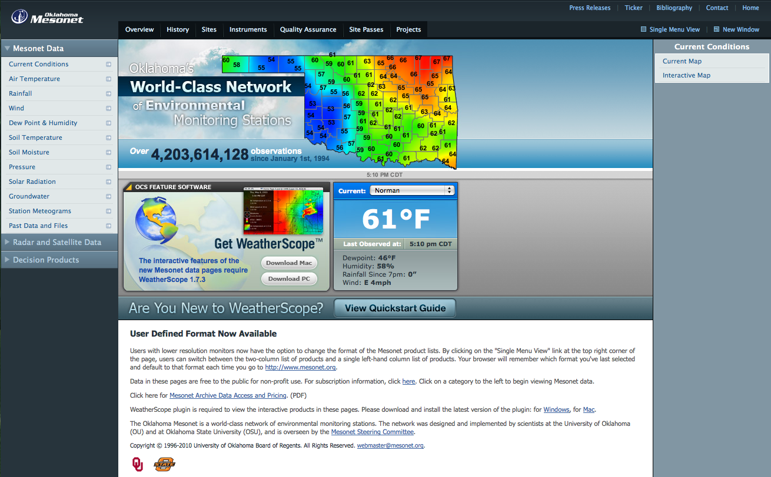
Oklahoma Mesonet www.mesonet.org

Slide 44
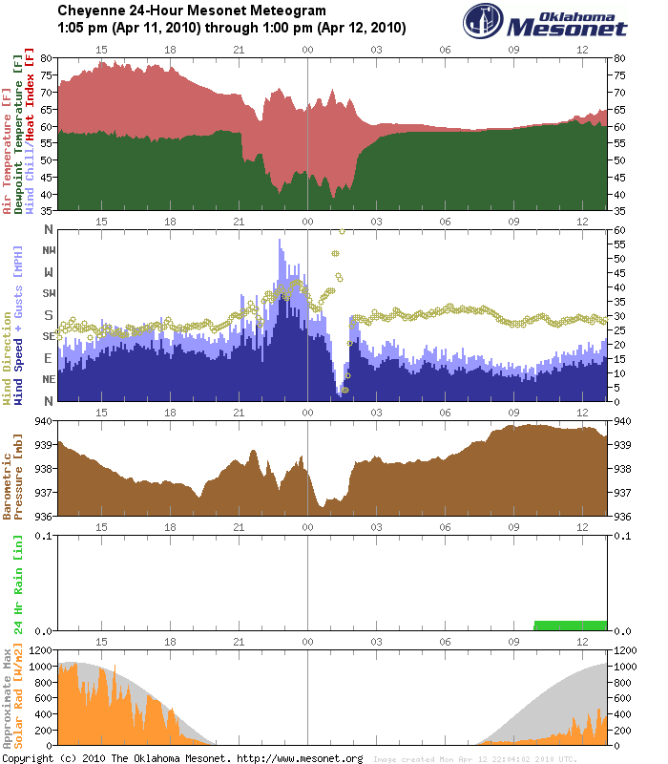
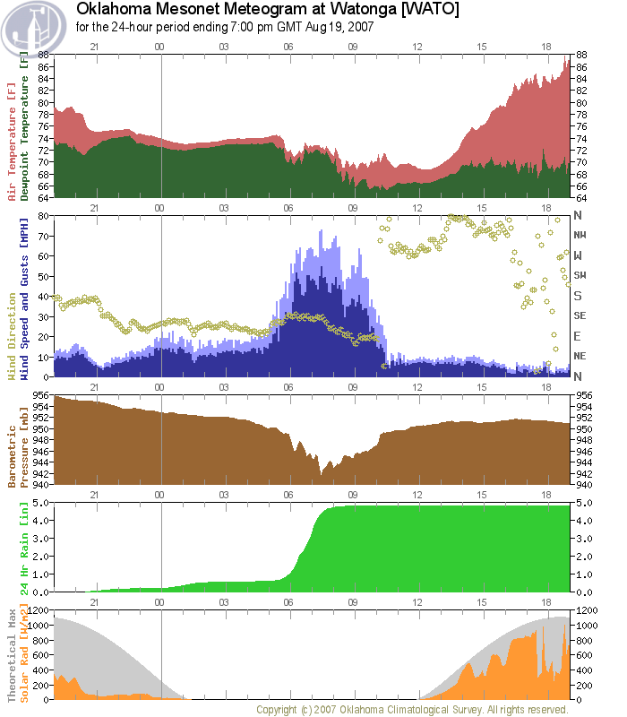
Oklahoma Mesonet - Meteograms

Slide 45
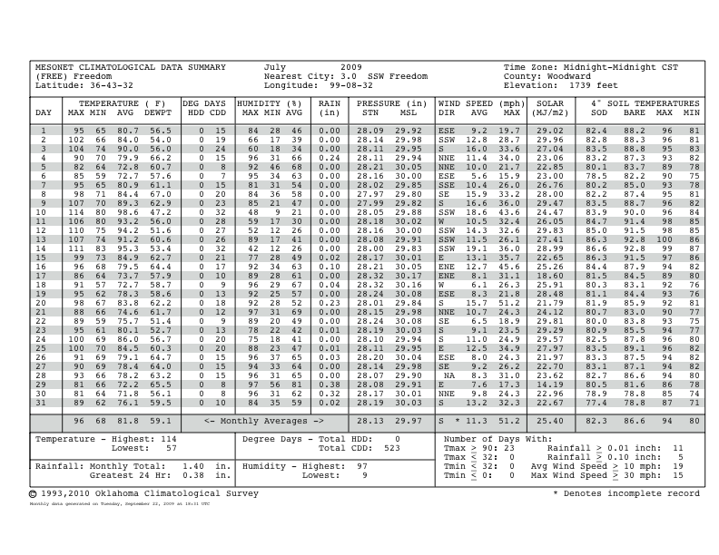
Mesonet Climatological Data

Slide 46
OCS/Mesonet Ticker
http://ticker.mesonet.org
Fun, interesting weather and climate information
A few of the recent really funny/interesting/informational tickers:
January 5, 2010 – deep freeze of December 1983
January 12, 2010 – uncommon cold
January 25, 2010 – ice storm coming!
February 18, 2010 – once upon a midnight dreary
March 8, 2010 – this past winter explained
March 23, 2010 – spring break snow perspective
March 30, 2007 – winds, warm weather, and fire danger
April 14, 2010 – black Sunday revisited

