Slide 1
ALTERING CLIMATE
Funding provided by NOAA
Sectoral Applications Research Project
Basic Climatology
Oklahoma Climatological Survey

Slide 2
ATMOSPHERIC POLLUTANTS

Slide 3
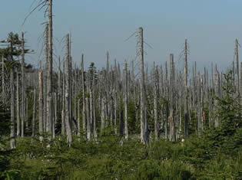
Acid Rain
Acid Rain is the precipitation that carries higher-than-normal amounts of nitric or sulfuric acid
  Actually includes dry deposition; some of these particles may settle out of the atmosphere in the absence of rain
‘Neutral’ rain is slightly acidic (pH around 5.6) due to naturally-occurring chemicals
  pH of 7.0 is neutral; less than that is considered acidic, greater than that is alkaline
  Each 1.0 decrease in the scale indicates a 10-fold from the next-higher number (e.g., water with a pH of 5.0 is 10 times more acidic than one with a pH of 6.0)
  The most acidic rain in the U.S. (as of 2000 according to the EPA) had a pH of 4.3
Causes of Acid Rain:
  Volcanic eruptions
  Decomposition of organic matter
  Burning wood
  Burning fossil fuels
Main anthropogenic (man-made) sources are sulfur dioxide (SO₂) and Nitrogen Oxides (NO_{x}) emitted by power plants, industry, and automobiles
Source: NASA

Slide 4
Impacts of Acid Rain
Surface Waters:
  Kills or sickens fish and other food sources (such as insects) upon which they rely
  Excess nitrogen depletes oxygen (eutrophication), causing algae blooms and fish kills
  Leaches heavy metals, particularly aluminum, from the soil, which is toxic to many fish and plants
  Alkaline substances in the soil may counteract the effects of acid rain, but may become overwhelmed
  May get a ‘shock’ with spring snowmelt, runoff
Forests:
  Acid buildup in soil weakens trees, making them more susceptible to other threats
  Dissolves and washes away nutrients
  Fog at higher elevations constantly bathe trees in acid, washing away nutrients
Materials:
  Causes blotches and fading of painted surfaces, including cars
  Deterioration of stone, particularly marble and limestone
  Corrosion of metals such as bronze and steel
Visibility:
  Molecules are larger and scatter more incoming light, reducing visibility
  Accounts for 50-70% of visibility reduction in the eastern U.S.
Human Health:
  Increase in heart and lung disorders, including asthma and bronchitis
  Causes an estimated $50 billion annually in premature mortality, hospital admissions, and emergency room visits

Slide 5
Reducing Acid Rain
Monitor and Report
Reduce smokestack emissions
  Remove sulfur at the source; clean coal
  Use scrubbers to remove SO₂ before it leaves the smokestack (chemical interactions that bind it with other substances that can be collected)
  Use catalytic converters to remove NO_{x} from automobile emissions
Use alternative energy sources
  Natural gas: still pollutes, but not as much
  Nuclear energy
  Hydropower
  Renewable energy: wind, solar, geothermal
  Electric vehicles
Restore damaged environments
  Limestone may be added to water to cancel out some of the acidity on a short-term basis (but very expensive)

Slide 6
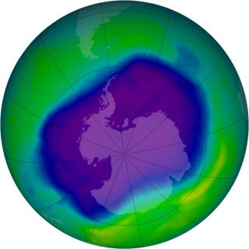
Ozone
The ozone layer is a concentration of ozone (O₃) particles in the stratosphere
Ozone is very good at absorbing harmful high-energy ultraviolet radiation from the sun
During the 1980s it was discovered that chemicals, called chlorofluorocarbons (CFCs), were depleting the concentration of atmospheric ozone
  CFCs were commonly used in refrigeration, aerosol sprays, and solvents
  One chlorine atom can break apart more than 100,000 ozone molecules
The Montreal Protocol agreement in 1987 put in place a ban on CFCs
  Alternative chemicals and technologies have been developed to replace CFCs
As a result of these actions, the ozone layer is expected to recover by 2050
Source: NASA

Slide 7
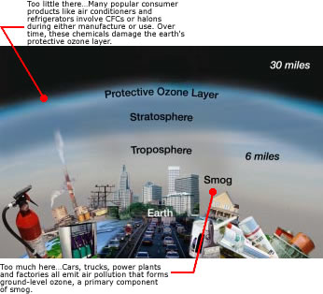
But I Thought Ozone Was Good…
Up high, ozone filters harmful solar radiation…
…but it’s not a good thing to breathe
  Can worsen bronchitis, asthma, and emphysema
  Prolonged exposure can irritate and scar lung tissue
Ozone can also harm vegetation and ecosystems and make trees more susceptible to disease
Ozone is created from Nitrogen Oxides (NO_{x}) – the same bad guys as in acid rain
Ultraviolet radiation from the sun converts NO_{x} near the surface into ozone
  Strong sunlight and high temperatures accelerate the process
  Winds may carry emissions far from their sources, so regions downwind may have similar air quality problems
Source: EPA

Slide 8
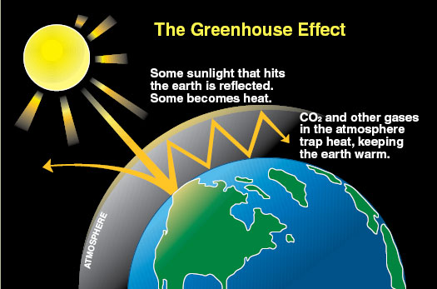
Carbon Dioxide
Carbon Dioxide (CO2) is a critical component of the Earth’s biosystems
  Used by plants to convert to sugars (energy)
  Plants release oxygen as a waste product, which animals use
  Animals, in turn, release carbon dioxide as a waste product
However, high in the atmosphere, the radiative properties of CO2 cause trouble
  Relatively transparent to incoming solar radiation but a good absorber of longer-wavelength radiation emitted by the Earth
  CO2 essentially allows in the sun’s energy but traps the outgoing energy from the Earth, causing temperatures to rise in what is known as the Greenhouse Effect
Carbon dioxide has been building in the atmosphere as a byproduct of the combustion of fossil fuels – coal, oil, and natural gas
  Some CO2 is a good thing – recall that the Earth’s average temperature would be about 0°F without it
Other gasses can also add to the greenhouse effect, particularly methane, which is a byproduct of agricultural production
Source: Washington Department of Ecology

Slide 9
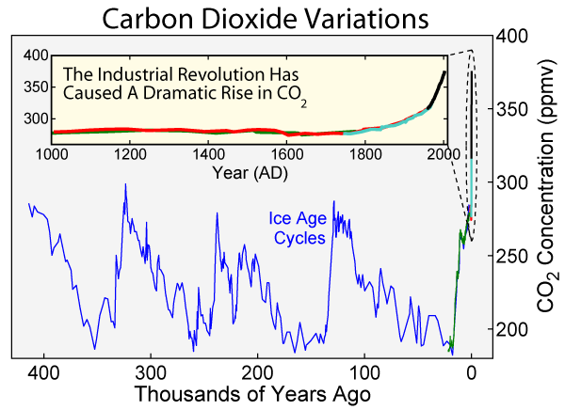

Slide 10
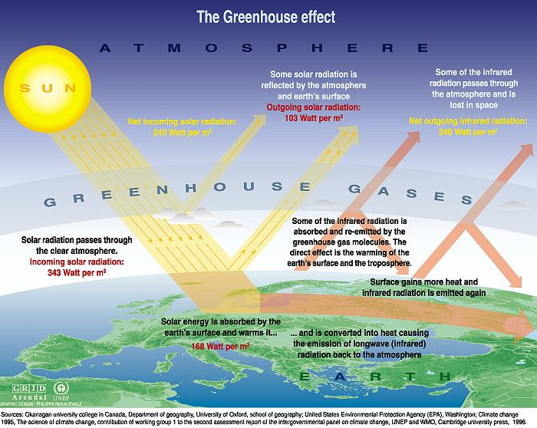

Slide 11
HOW THEY AFFECT CLIMATE

Slide 12

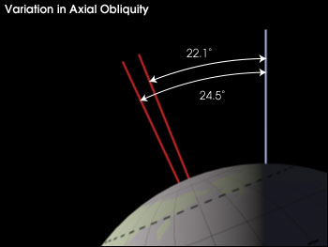
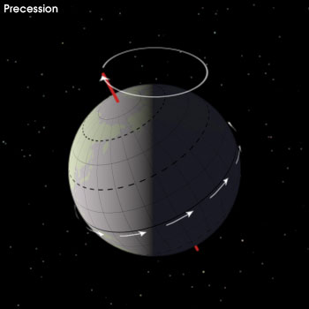
Factors Affecting Climate
Orbital Variations (millennia)
  Eccentricity – the shape of the orbit around the sun (90,000-100,000 years)
  Obliquity – changes in the angle that Earth’s axis makes with the plane of Earth’s orbit (40,000 years)
  Precession – the change in the direction of the Earth’s axis of rotation (25,800 years)

Slide 13
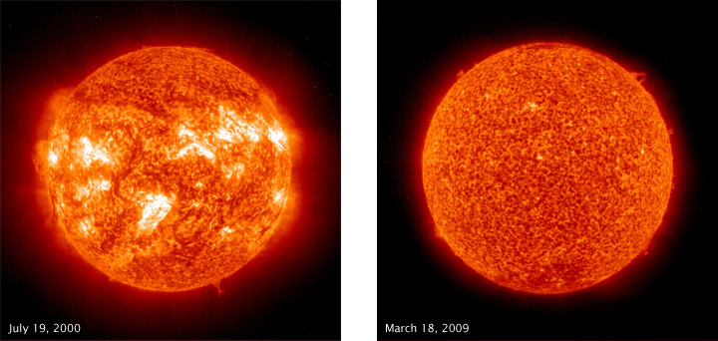
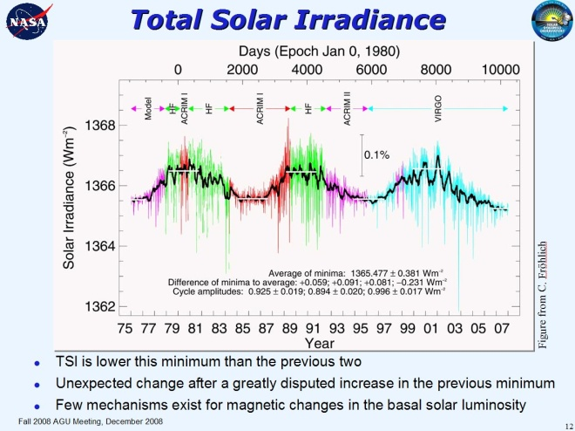
Factors Affecting Climate
Orbital Variations (millennia)
Solar Variations (decades)
  A fairly regular 9-14 year (average 11) cycle in solar energy output, seen through the number of sunspots
  Last solar maximum was in 2001; next is predicted for May 2013
Source: NASA

Slide 14
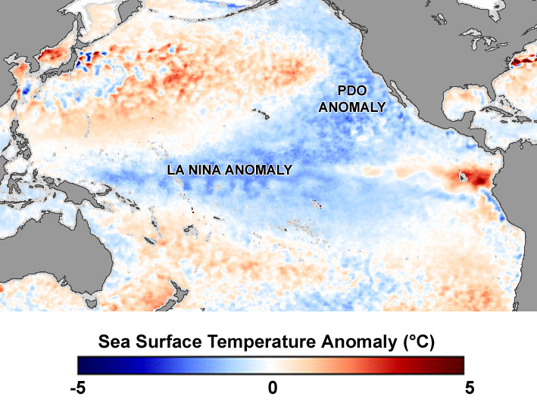
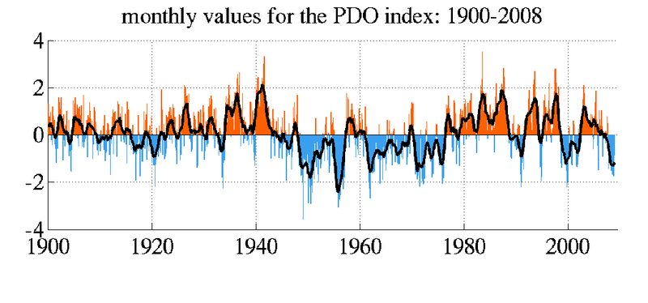
Factors Affecting Climate
Orbital Variations (millennia)
Solar Variations (decades)
Oceanic Circulations (decades)
  Periodic episodes of warming or cooling in different ocean basins
  May combine with other circulation patterns to reinforce or counteract other climate trends
Source: NASA

Slide 15
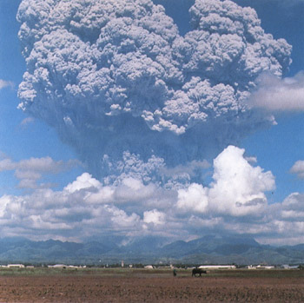
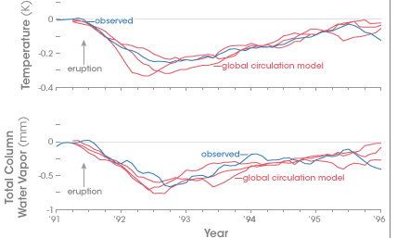
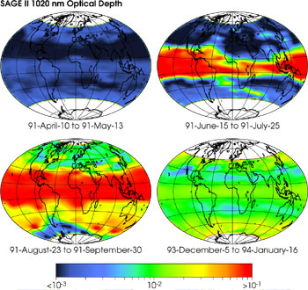
Factors Affecting Climate
Orbital Variations (millennia)
Solar Variations (decades)
Oceanic Circulations (decades)
Volcanic Emissions (1-2 years)
  Sulfate aerosols block solar radiation from surface, causing much lower temperatures (lasts 1-2 years)
  Only eruptions whose plumes penetrate the lower stratosphere cause large variability; very few volcanoes do so
Source: NASA

Slide 16
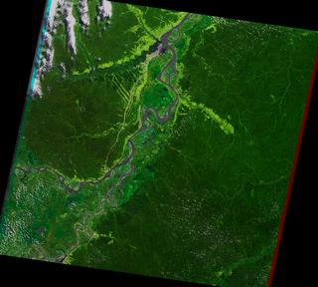
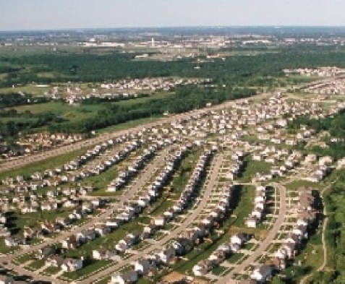
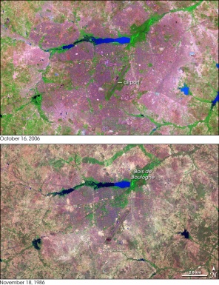
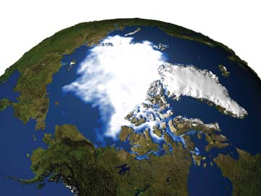
Factors Affecting Climate
Orbital Variations (millennia)
Solar Variations (decades)
Oceanic Circulations (decades)
Volcanic Emissions (1-2 years)
Change in Land Cover (gradual changes, affecting albedo)
  Deforestation: more vegetation creates cooler, wetter surface conditions; less vegetation leads to warmer, drier conditions
  Ice cover: more ice reflects more sunlight, leading to cooling; less ice allows more sunlight to be absorbed, warming the surface
Source: NASA,
USDA

Slide 17
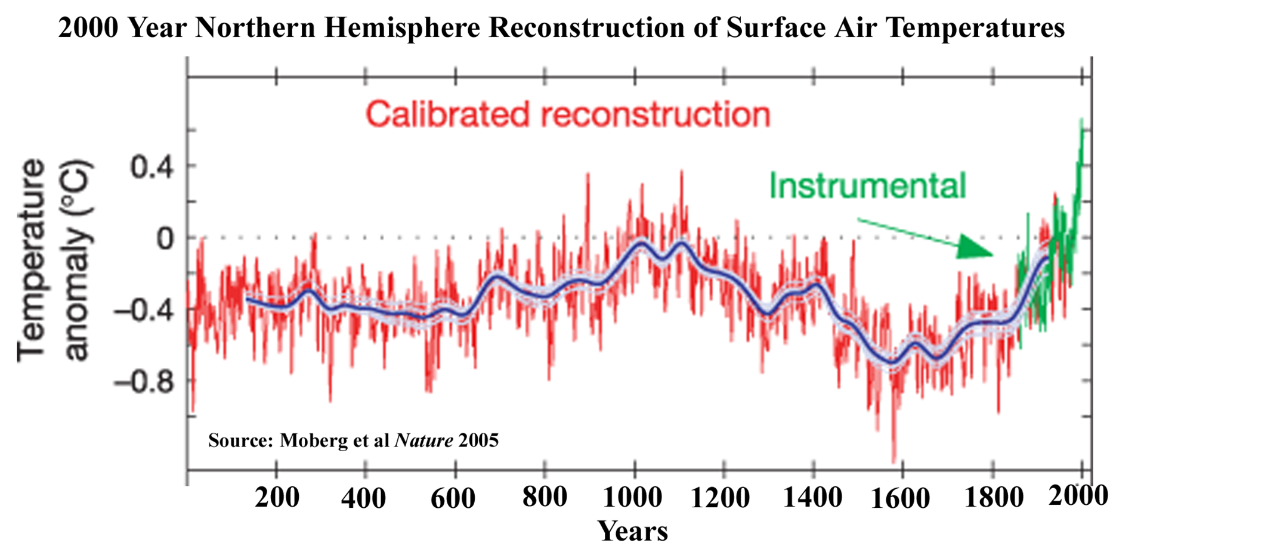
The recent warming is unusual…

Slide 18
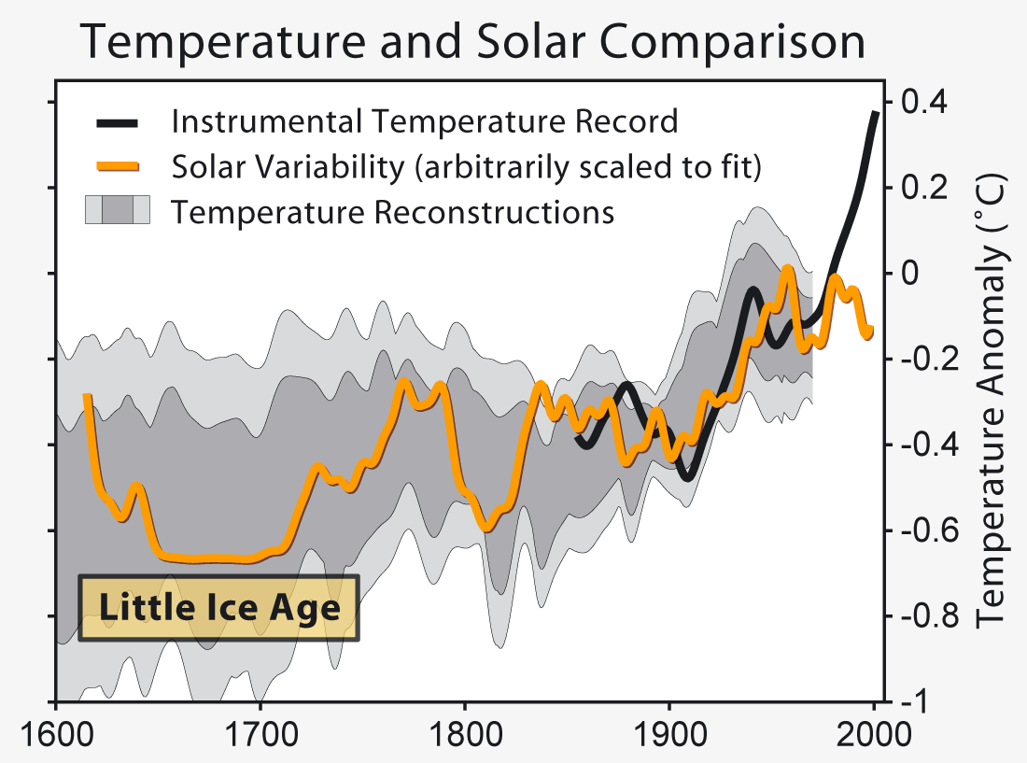
…and solar variability cannot explain it

Slide 19
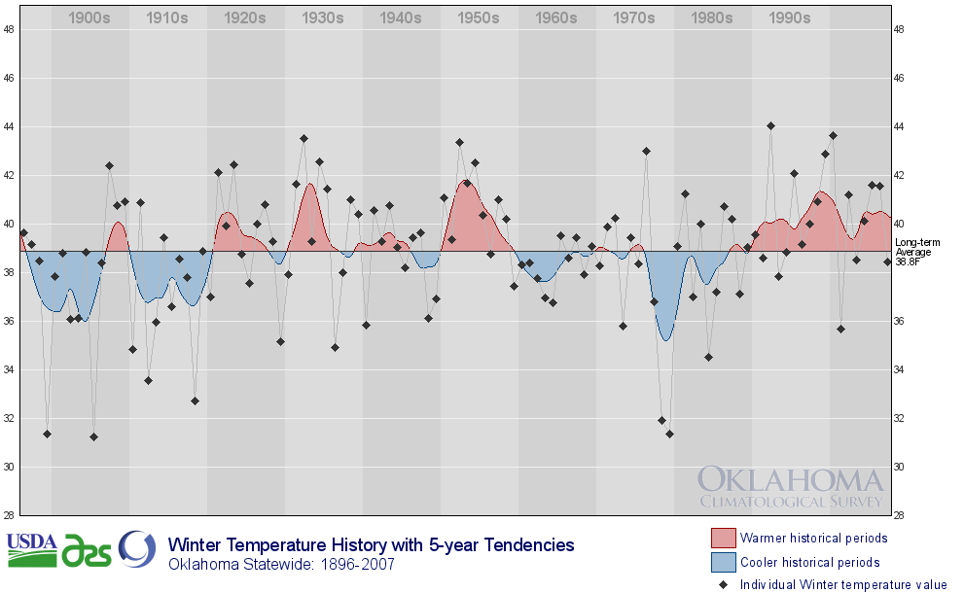
Oklahoma’s Winters Have Warmed
Droughts
Wet!
Ice Storms
Notes:
Got rid of the blue background. Not the content however.

Slide 20
CLIMATE CHANGE PROJECTIONS

Slide 21
International Panel on Climate Change
IPCC Findings from 2007 Assessment:
  Higher confidence now exists in projected patterns of warming than exists for other elements such as rainfall
  Hot extremes and heat waves will increase
  Heavy precipitation event frequency will continue to increase
  Snow cover and sea ice continues to shrink
  Sea levels will rise, but uncertain as to how much and timing
  Storm tracks are projected to move poleward
  Increasing acidification of the ocean
  Further 21st century emissions will contribute to warming & sea level rise for more than a millennium

Slide 22
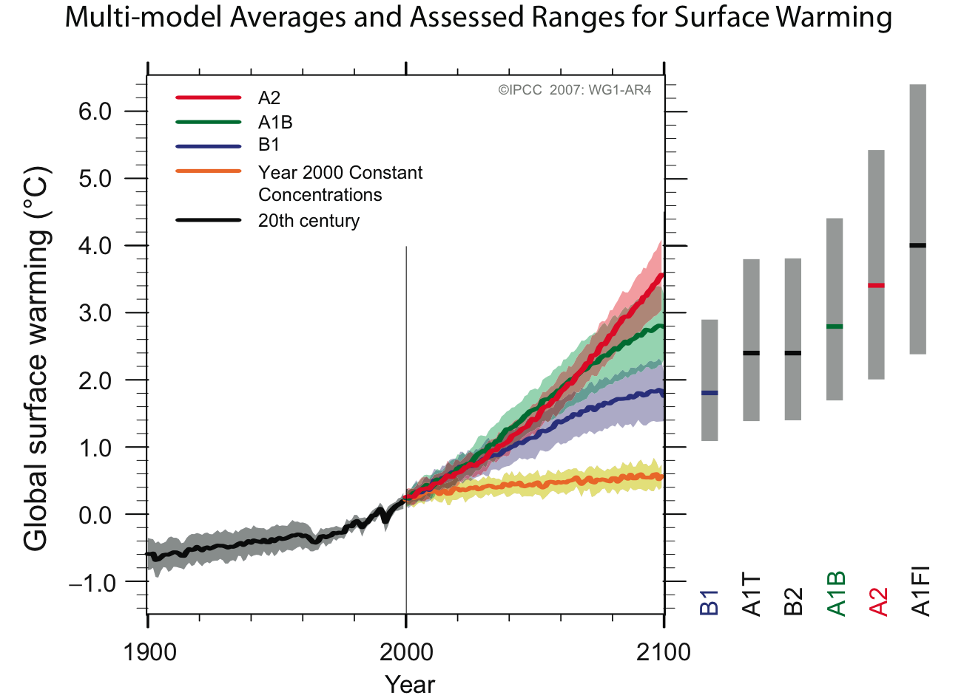
Societal response is key

Slide 23

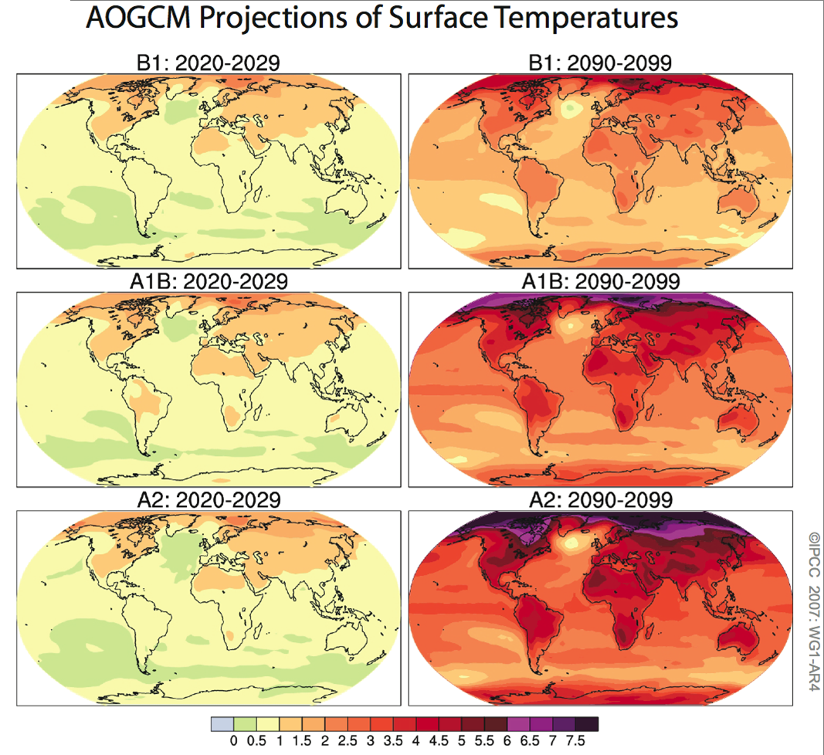
Temperature Projections: A Range of Possibilities
Societal Response
Green Response
Middle Road
Maximum Growth

Slide 24
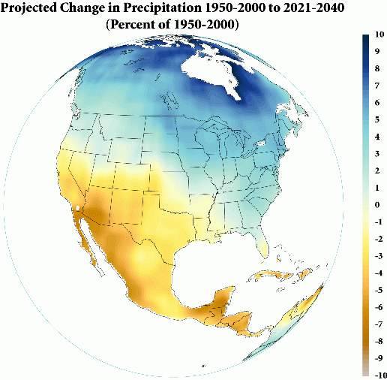
Annual U.S. precip will increase in the northeast and decrease in the southwest
High Confidence

Slide 25
Oklahoma Projections
Temperature (Middle Road scenarios)
  Warming of 2-4°F in annual average temperature by the 2020s
  Warming of 4-7°F in annual average temperature by the 2090s
  Summer becomes longer and spring weather arrives earlier
  Winters warm – longer frost-free periods and a longer growing season
  Earlier maturation of winter wheat and orchard crops leave them more vulnerable to late freeze events
Precipitation
  Rain-free periods will increase, but individual rainfall events will be more intense
  Increased year-round evaporation from the ground and transpiration from green vegetation
  Drought frequency and severity increases
  The risk of wildfires increases, especially during summer

Slide 26
Oklahoma’s Water Future
Fewer (but more intense) precipitation events:
  More runoff, more flooding
  More pollution from runoff
  Increased erosion
  Crop damage
Increased temperatures will increase evaporation
  Will dry out more severely between precipitation events
Possibly less water available, even if yearly totals increase

Slide 27
Winners and Losers
“There will be winners and losers from the impacts of climate change, even within a single region, but globally the losses are expected to far outweigh the benefits.” – from the National Academies’ report “Understanding and Responding to Climate Change”.

