Slide 1
Pressure systems, air masses & fronts
Funding provided by NOAA
Sectoral Applications Research Project
Basic Climatology
Oklahoma Climatological Survey

Slide 2
PRESSURE SYSTEMS

Slide 3
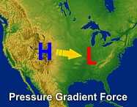
Pressure makes the wind blow
Wind is simply air molecules in motion
  We “see” wind through the force of these molecules on objects, such as leaves
Air moves from areas of high pressure to low pressure
  Recall density – molecules are packed more tightly together when pressure is high, so they want to spread out a bit
Source: NOAA National Weather Service Jetstream

Slide 4
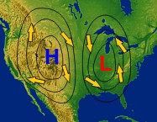
Pressure makes the wind blow
But remember all that stuff about the Earth’s rotation?
  The Coriolis force turns air parcels to the right (in the northern hemisphere)
  This causes air to ‘spin’ around the pressure centers
The air would end up going around in circles around the pressure centers except for friction
  Friction slows wind speeds, lessening the effects of the Coriolis force
Air moving away from high pressure creates divergence at the surface, drawing air downward from aloft
Air moving toward low pressure creates convergence at the surface, forcing air upward near the low’s center
Source: NOAA National Weather Service Jetstream

Slide 5
Low vs. High Pressure (N. Hemis.)
L
H
L
H
L
H
Surface convergence → rising motion
Surface divergence → sinking motion
Counter-clockwise (cyclonic) flow
Clockwise (anticyclonic) flow
In the Northern Hemisphere, if you stand with your back to the wind, then the lower pressure will be to your left.

Slide 6
AIR MASSES

Slide 7
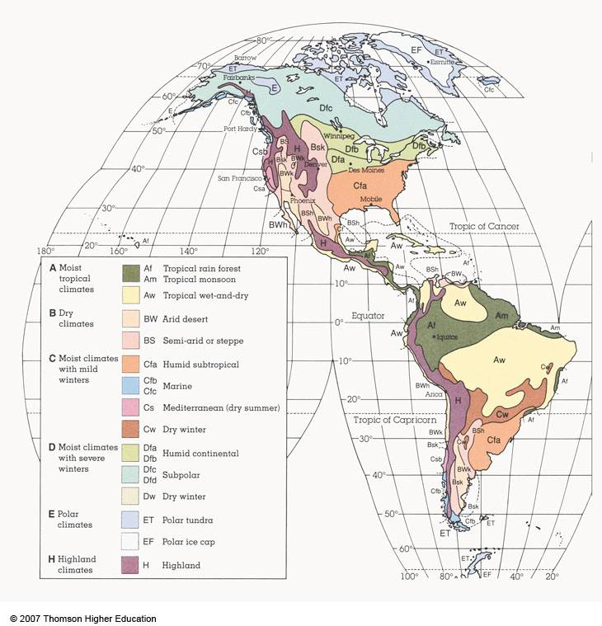
Remember This?
Air in motion brings with it characteristics of its source region
These characteristics are called an air mass
Boundaries between air masses are called fronts

Slide 8
Types of Air Masses
Air masses are distinguished by one of four source characteristics:
  Polar (sometimes called Arctic)
  Tropical
  Continental (land regions)
  Maritime (water regions)
As air masses move, they become modified such that they show characteristics of two source regions
  cP = continental Polar
  mT = maritime Tropical

Slide 9
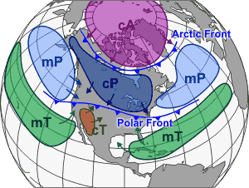
Air Masses of North America
(1) cP and cA Continental Polar and Continental Arctic
Cold (very cold in winter) and dry, stable conditions
(2) mP Maritime Polar
Cool, moist and somewhat unstable. Forms in polar regions, then moves over oceans.
(3) mT Maritime Tropical
Very warm and moist. Forms over the eastern Pacific and the Caribbean sea and Gulf of Mexico.
(4) cT Continental Tropical
Hot, dry and unstable conditions. Forms over northern Mexico and the southwestern U.S. during the summer.
Source: NOAA National Weather Service Jetstream

Slide 10
FRONTS

Slide 11
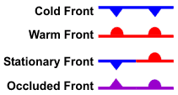
Fronts
Fronts are the boundaries between air masses
Fronts are defined by the characteristics of the air mass it is replacing:
  Cold front: colder air is replacing relatively warmer air
  Warm front: warmer air is replacing relatively colder air
  Stationary front: neither air mass is moving
  Occluded front: a cold air mass (cold front) has overtaken a warmer air mass (warm front), lifting the warm layer aloft
  Dryline: like a front, but a sharp contrast in moisture (humidity) more so than temperature
Fronts are three-dimensional
  Their slope determines the types of clouds that form along the boundaries
Dryline

Slide 12
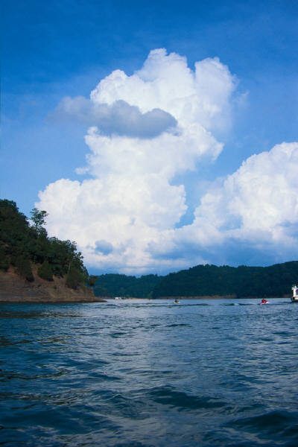
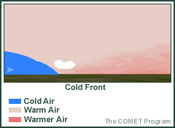
Cold Front
A cold front is a boundary where a cold air mass is replacing a warm air mass.
Blue triangles point in the direction of movement.
Air on the warm side is lifted rapidly over cold air → air rises and cools → condensation begins and clouds form, heavy showers may fall
Cumulus clouds are associated with cold fronts.
A cold front moves faster than a warm front.
Bird’s-eye View
Side View
Colder air
Warmer air

Slide 13

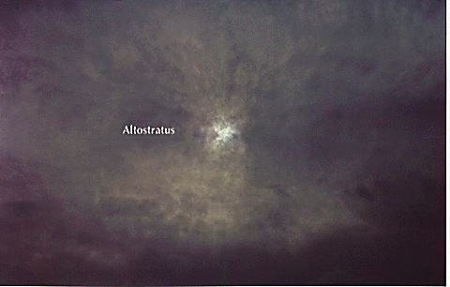
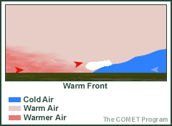
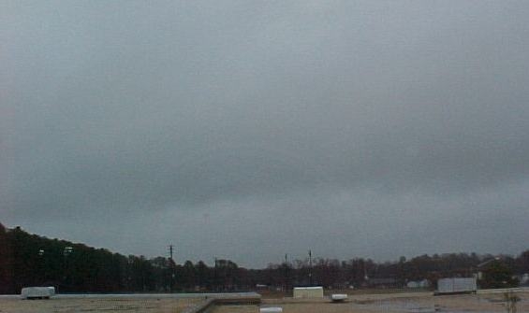
Warm Front
A warm front is a boundary between an advancing warm air mass and a retreating cold air mass.
Red half circles point in the direction of motion.
Warm air rises over cold air at a slant, which leads to gradual lift.
Stratus, altostratus, and cirrus are associated with warm fronts.
Bird’s-eye View
Side View
Colder air
Warmer air

Slide 14
Occluded Front
An occluded front occurs when a cold front catches up to and overtakes a warm front (because the cold front moves faster than the warm front).
It is shown as a purple line with alternating purple triangles and half circles.
Cirrus, altostratus, and stratus are followed by cumulus and possibly heavy showers.
N
Precipitation
Warm
Occluded front
Cold
Cool
Cool
Warm
Initial occlusion
Cold
Cold
Cool
Height
Pre-occlusion
Cold
Warm
Warm
Cool

Slide 15

Stationary Front
A stationary front experiences very little to no movement.
Two air masses are at a “stand-off,” waiting for one to make a move.
The wind blows parallel to the front, but in opposite directions.
You first!
I dare you to move…
Cold air mass
Warm air mass

Slide 16
Identifying Fronts
Now we know the front types…but how do we find them?
  Radar
  Weather map
Fronts on Radar
  Cold front—Precipitation is mostly behind the front, but there is some before and along the front. There is a convective band (high echo values) with a stratiform band (low echo values).
  Warm front—Precipitation is mainly before the front, with some along the front. The precipitation is mainly stratiform (low echo values).
  Occluded front—Precipitation falls before, behind, and along the front.
  Stationary front—There is no precipitation if both air masses are dry; if there is enough moisture, precipitation can fall over the same area for a while, which can lead to flooding!

Slide 17
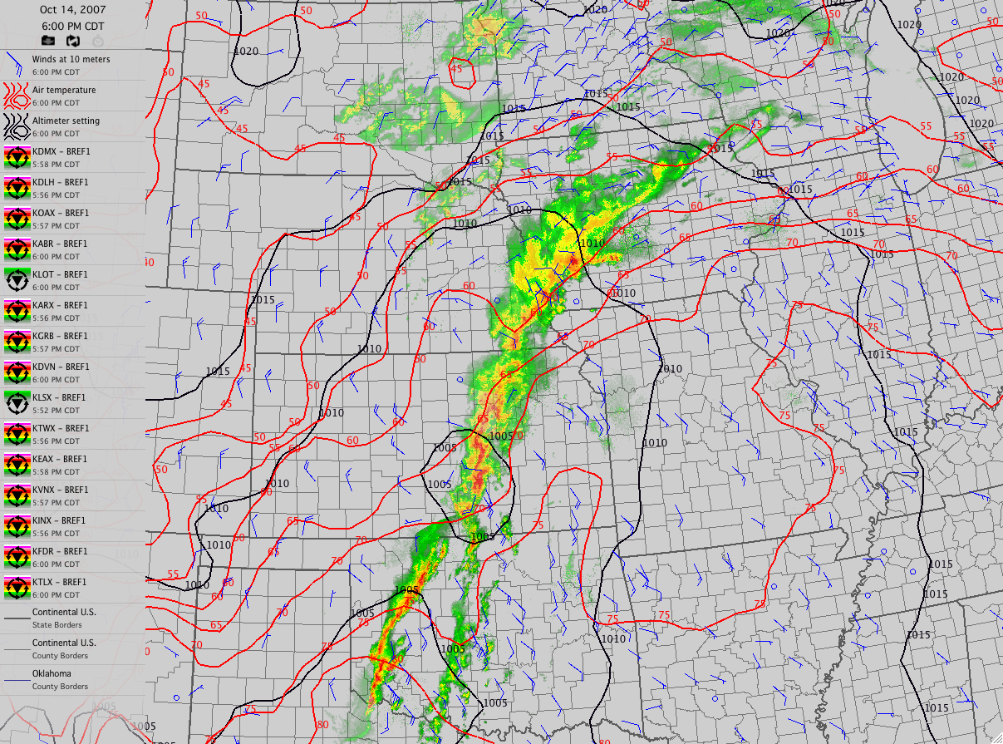
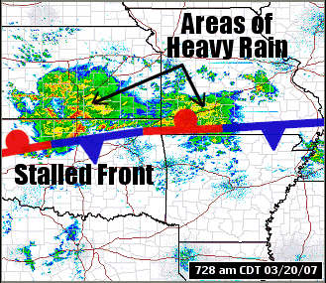
Identifying Fronts on Radar
L

Slide 18
Identifying Fronts on Weather Map
Sharp temperature changes over relatively short distance
Changes in moisture content (dew point changes)
Wind direction shifts
Pressure and pressure changes
Clouds and precipitation patterns (seen in radar/satellite)
50 knots
L
H
H
33
35
10 knots
14
28
20
30
5 knots
16
19
25
31
34
17
22
33
1 knot = 1.15 mph
Air mass 1
Air mass 2
20
30
32
15
17
28
33
23
32
15
26
35

Slide 19
Identifying Fronts on Weather Map
Cold front
  Cooler temperatures with frontal passage
  Lower dewpoint temp. with frontal passage
  Winds: S/SW before front, W/NW after front
Warm front
  Warmer temperatures with frontal passage
  Higher dewpoint temp. with frontal passage
  Winds: S/SE before front, S/SW after front
Occluded front
  Often cooler temperatures with frontal passage
  Slightly lower dewpoint temp. with frontal passage
  Winds: E/SE/S before front, W/NW after front

Slide 20
Identify the Fronts
42
40
35
42
50
45
44
43
46
44
42
41
40
49
46
42
45
48
48
45
43
41
37
42
47
49
48
40
46
47
50
50
46
35
38
43
50
43
45
47
49
21
25
28
40
27
30
43
42
40
47
45
50

Slide 21
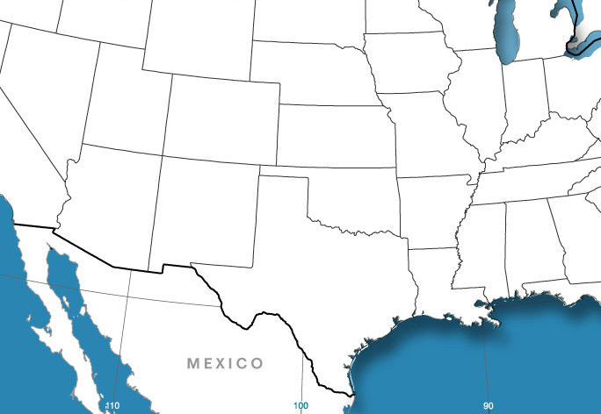
Dryline
Smaller scale than other fronts
Mainly seen in the Plains states, especially in W Texas, OK and KS (spring/early summer)
Narrow zone where there is a sharp change in moisture (dewpoint temperature)
Black or brown scalloped line
Separates warm, dry air and warm, moist air
Severe thunderstorms (e.g., supercells) can form along the dryline.
Cold dry air
cP
L
cT
Warm dry air
mT
Warm moist air

