Slide 1
climate
Funding provided by NOAA
Sectoral Applications Research Project
Basic Climatology
Oklahoma Climatological Survey

Slide 2
Remember These?
Factor 1: Our Energy Source
Factor 2: Revolution & Tilt
Factor 3: Rotation!
Factor 4: Latitude
Factor 5: Altitude
Factor 6: Land & Water are Different

Slide 3
The Influence of Water
Average January / July temperatures for three cities at latitude 35N:
Location | January | July | Difference
Santa Monica, CA | 51.6 | 63.5 | 11.9
Oklahoma City, OK | 36.7 | 82.0 | 45.3
Hatteras, NC | 46.1 | 79.2 | 33.1

Slide 4
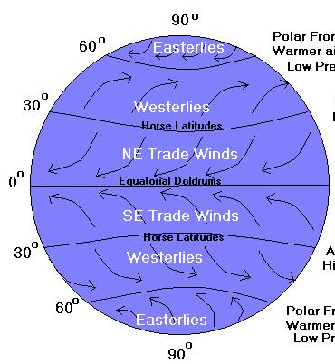
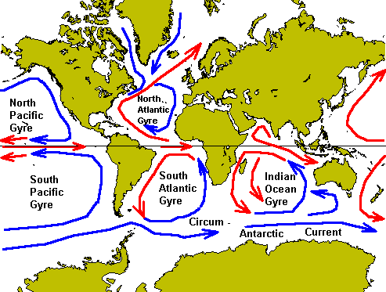
Factors that Influence Climate
Which side of the ocean you’re on!
The winds help stir ocean currents. Generally, western shores get cold water from the poles, eastern shores get warm from the equator.

Slide 5
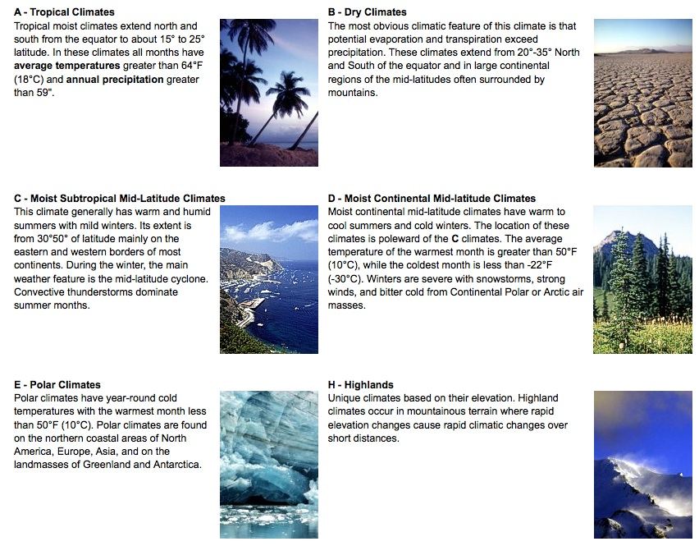
Climate Zones

Slide 6
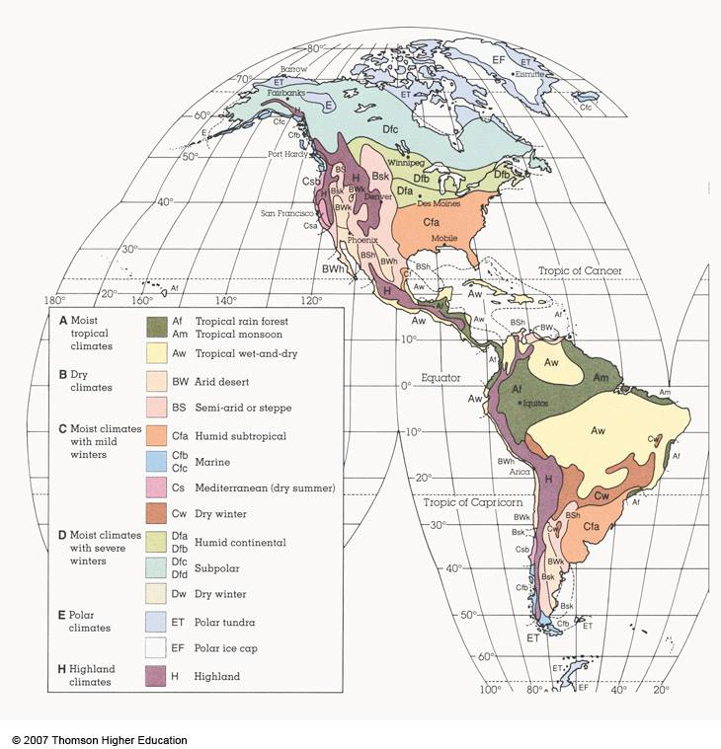

Slide 7
Limitations to “Naming” Climates
Implies sharp boundary between climate zones
in reality there is a gradual transition (Oklahoma is a great example!)
Relates too strongly to vegetation
useful in areas with little climate data, but it is better to use temp/precip measurements
Some of the groups (esp. Moist subtropical mid-latitude) are very broad, including what appear to be very different climate types

Slide 8
A WORD ABOUT NORMALS

Slide 9
What is Normal?
A tool helpful when comparing conditions to the long term
A 30-year average
Updated every 10 years
There are normals for:
Days, months and years
Temperature, rainfall, snowfall, and more!

Slide 10
September Rainfall: OKC
1971 | 4.25” |  | 1976 | 1.53” |  | 1981 | 1.48” |  | 1986 | 9.54” |  | 1991 | 11.85” |  | 1996 | 5.88”
1972 | 2.05” |  | 1977 | 1.21” |  | 1982 | 2.86” |  | 1987 | 4.58” |  | 1992 | 2.92” |  | 1997 | 1.38”
1973 | 8.00” |  | 1978 | 0.96” |  | 1983 | 0.90” |  | 1988 | 5.19” |  | 1993 | 7.17” |  | 1998 | 4.39”
1974 | 6.24” |  | 1979 | 0.72” |  | 1984 | 1.02” |  | 1989 | 4.51” |  | 1994 | 2.15” |  | 1999 | 4.88”
1975 | 1.92” |  | 1980 | 2.21” |  | 1985 | 4.59” |  | 1990 | 7.35” |  | 1995 | 6.05” |  | 2000 | 1.73”
The average of all these numbers is 3.98”
– the normal September rainfall at Oklahoma City.
The 1st Dirty Secret of Normals:
Normals only tell you the average for a particular month, day or year. They don’t tell you anything about natural variability!

Slide 11
All Normals Work the Same Way
Oklahoma City’s …
Normal September Rainfall: 3.98”
Normal September Temperature: 73.2 degrees
Normal September 26th High: 81 degrees
Normal “First Freeze of Fall”: November 4
All of these are based on 30 numbers recorded between 1971-2000!

Slide 12
Normal vs. “supposed to”
A normal is just an average!
It doesn’t mean “supposed to”
It’s not “supposed to” rain 3.98” at OKC in September
It doesn’t “usually” rain 3.98” at OKC in September
It has never rained exactly 3.98” at OKC during any September dating back to 1896
The 2nd Dirty Secret of Normals:
For rainfall, most months are below-normal!

Slide 13
Normal vs. “Supposed To”
From 1971-2000, the average OU-OSU score was OU 31, OSU 14.
This doesn’t mean OU is “supposed to” win 31-14 each following year.
OU never won 31-14!
In 2001, OSU won 16-13.
Each year’s score (individual event) was decided by factors other than the 30-year “normal”

Slide 14
So, what’s my point?
In Oklahoma, and in much of the U.S., climate values are highly variable.
Large variability makes “supposed to”, “usually” and even the word “about” pretty meaningless on a month-to-month basis.
However, for longer-term rainfall (seasonal, annual, and beyond), departures from “normal” mean more.

Slide 15
So, why have normals?
People adjust their practices (ag, water resources, etc.) based on recent history
Normals are exactly that: recent history
About a generation of history, to be exact
Normals are a good diagnostic tool to put events in perspective
Normals are a great planning tool (again: agriculture, water resources, etc.)

Slide 16
OKLAHOMA’S CLIMATE

Slide 17
Oklahoma’s Climate
Remember … the Earth’s average temperature is about 58 degrees

Slide 18
Oklahoma’s Variable Climate
A whole bunch of really hot days for such a middle-of-the-road climate…
…and it gets cold in the winter too!

Slide 19
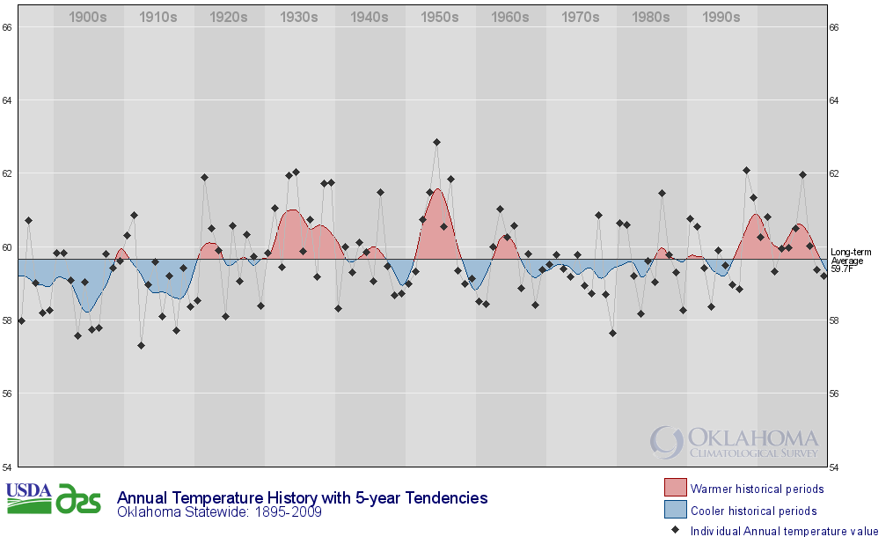
Year-to-Year Variability

Slide 20
It Rains … In Places

Slide 21
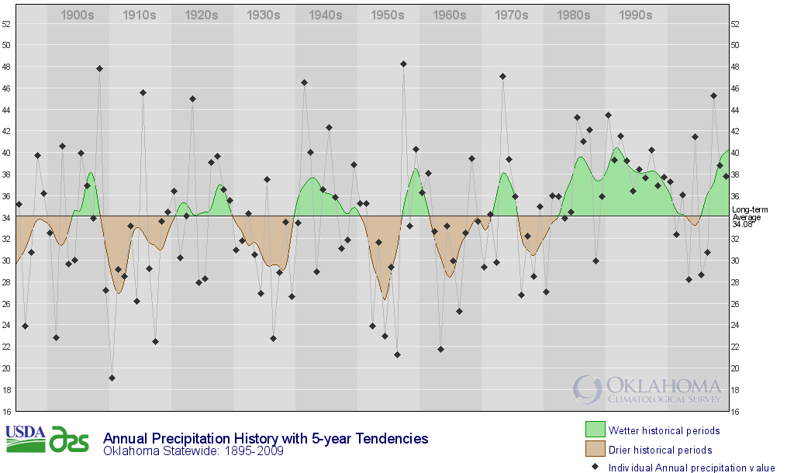
Even more variable rainfall!

Slide 22
It Even Snows!

Slide 23
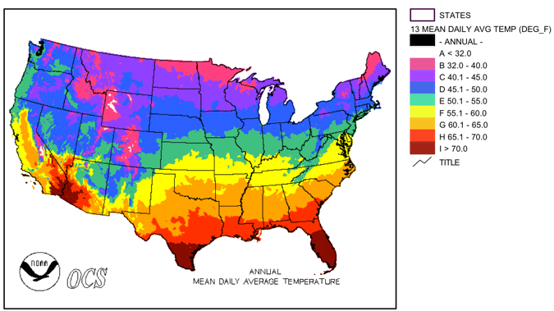
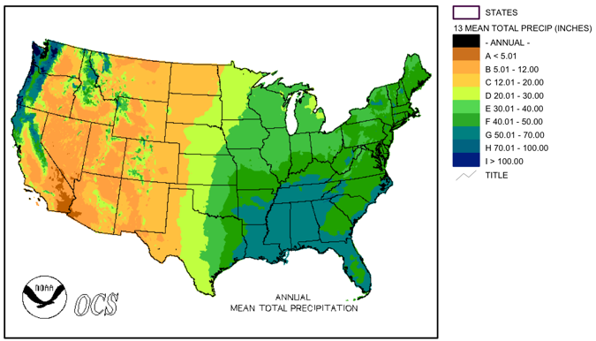
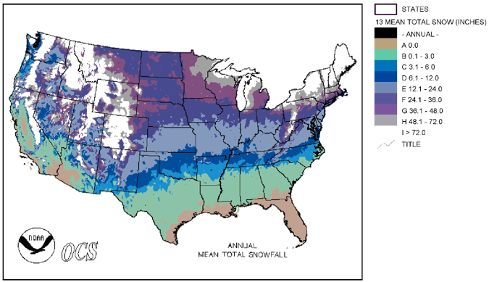
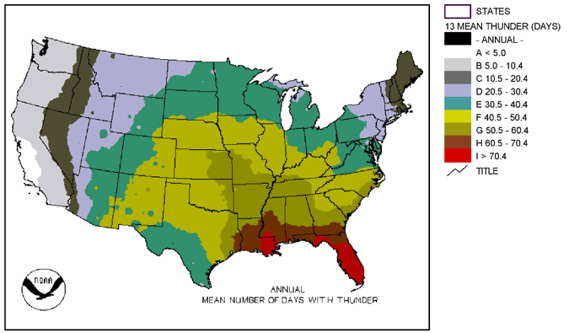
So How Does This Compare?
Source: National Climatic Data Center

Slide 24
What Makes Oklahoma’s Weather?
Cool, Dry Air
Warm, Dry
Air
Warm, Moist
Air

Slide 25
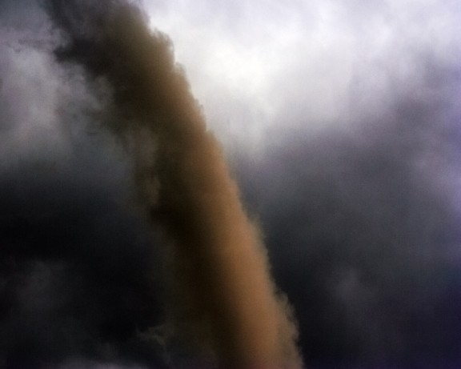
Oklahoma Climate Hazards
Tornadoes

Slide 26
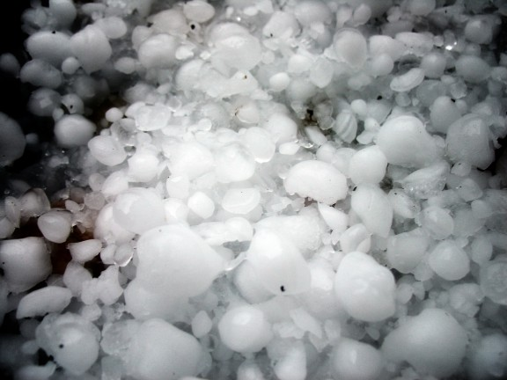
Oklahoma Climate Hazards
Tornadoes
Severe Storms (winds, hail, lightning)

Slide 27
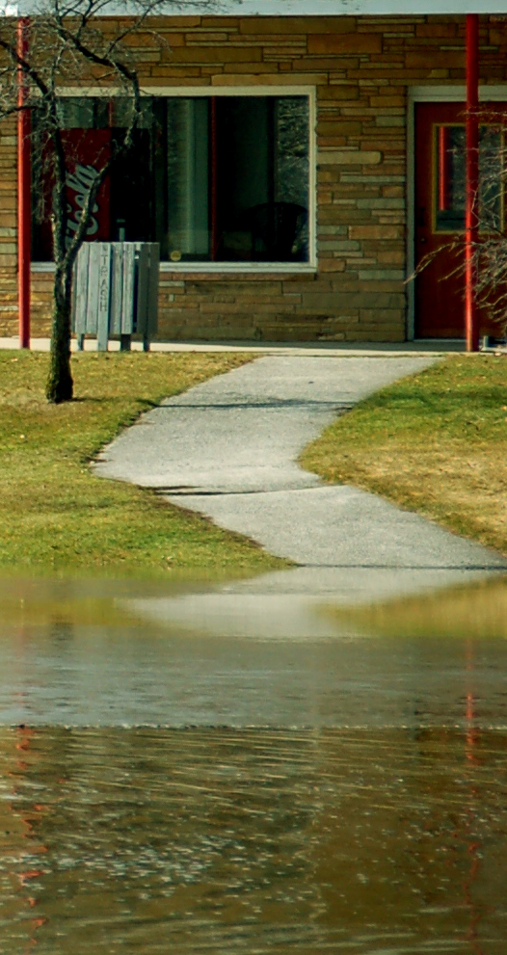
Oklahoma Climate Hazards
Tornadoes
Severe Storms (winds, hail, lightning)
Flooding

Slide 28
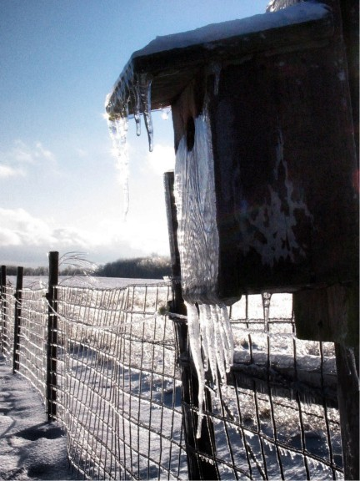
Oklahoma Climate Hazards
Tornadoes
Severe Storms (winds, hail, lightning)
Flooding
Winter Storms

Slide 29
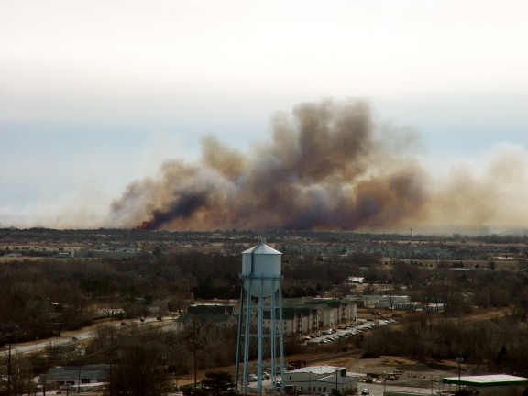
Oklahoma Climate Hazards
Tornadoes
Severe Storms (winds, hail, lightning)
Flooding
Winter Storms
Wildfires

Slide 30
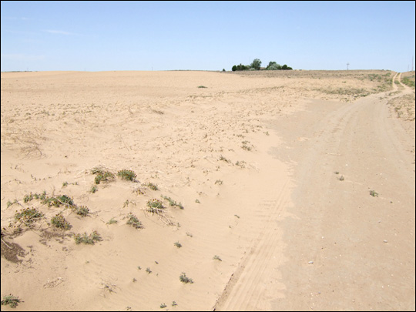
Oklahoma Climate Hazards
Tornadoes
Severe Storms (winds, hail, lightning)
Flooding
Winter Storms
Wildfires
Drought

Slide 31
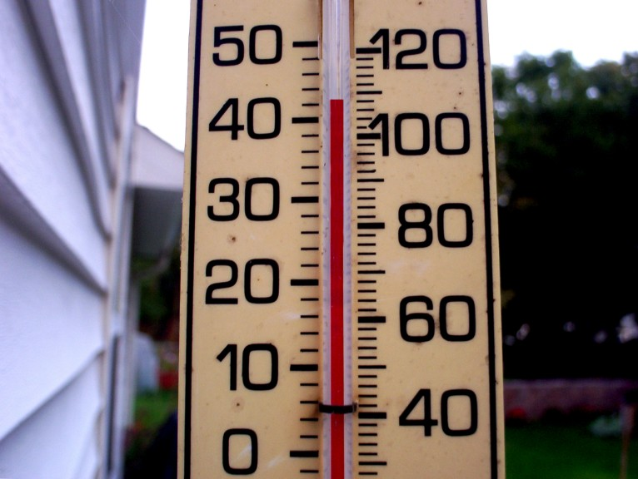
Oklahoma Climate Hazards
Tornadoes
Severe Storms (winds, hail, lightning)
Flooding
Winter Storms
Wildfires
Drought
Extreme Heat

Slide 32
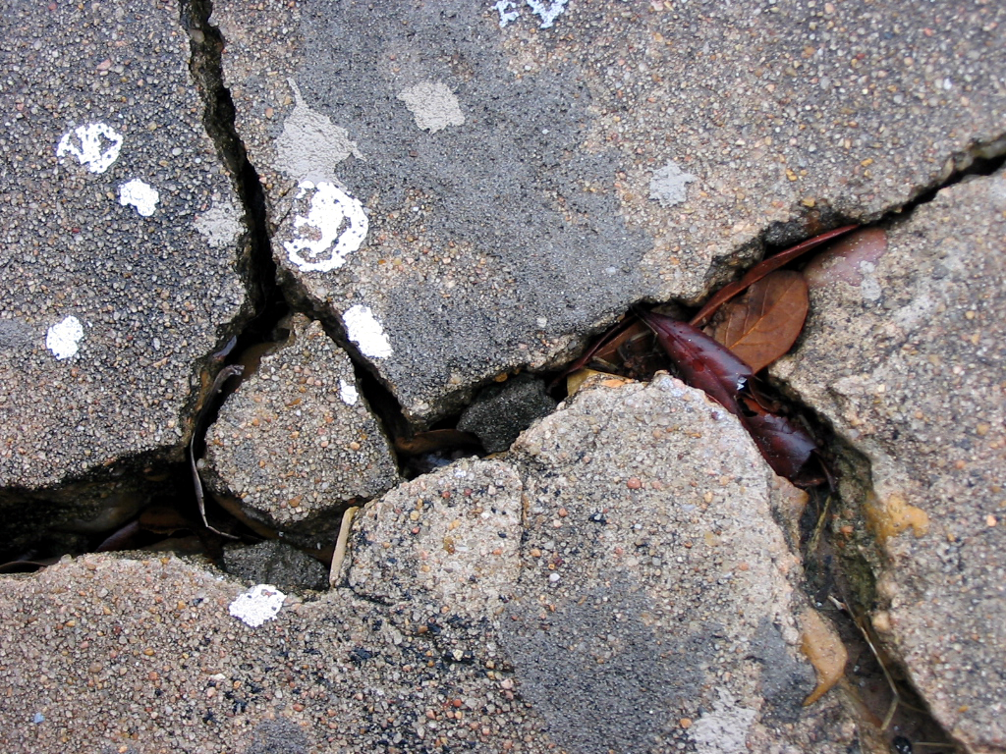
Oklahoma Climate Hazards
Tornadoes
Severe Storms (winds, hail, lightning)
Flooding
Winter Storms
Wildfires
Drought
Extreme Heat
Expansive Soils

Slide 33
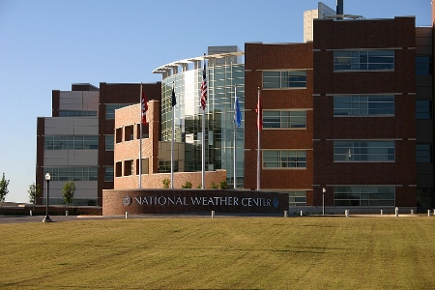
But all of that…
Photo Credit: University of Oklahoma
…makes THIS possible!

