Slide 1
The atmosphere in motion
Funding provided by NOAA
Sectoral Applications Research Project
Basic Climatology
Oklahoma Climatological Survey

Slide 2
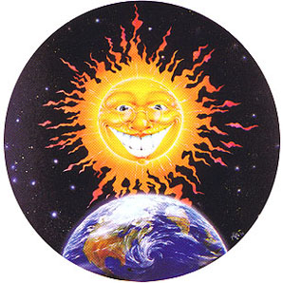
Factor 1: Our Energy Source
Hi, I’m the Sun! I provide 99.9999+ percent of the energy that drives the Earth’s weather and climate patterns. In other words, I pretty much make weather happen on your planet.
Also, if it wasn’t for me, you wouldn’t be here!

Slide 3
Energy From The Sun
Direct (more intense) vs. oblique (less intense) energy
Less direct energy:
Colder temps!
More direct energy:
Warmer temps!
Equator
Less direct energy:
Colder temps!

Slide 4
Factor 2: Revolution & Tilt
We’re tilted (23½ degrees) relative to the sun.
We also revolve around the sun (once a year)
Combined, these give us the seasons

Slide 5
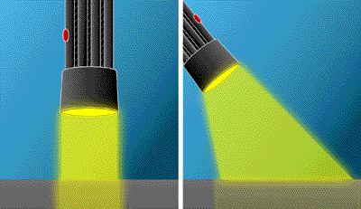
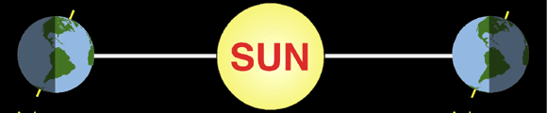
Seasons
Two main effects of tilt:
  Affects the sun angle
    sun rises to a lower angle in the sky in winter
    less direct light in winter
  Affects the time-per-day exposed to sunlight
    Days in the winter are shorter
Concept box: perpendicular light strikes more intensely than light from an oblique angle.
N.H. Summer
(tilted toward)
N.H. Winter
(tilted away)

Slide 6
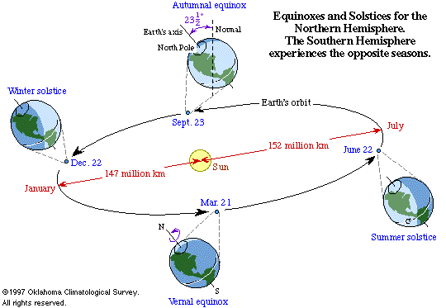

Slide 7
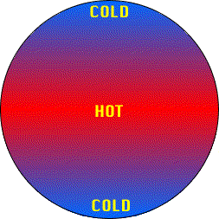
Consequences of Uneven Heating
Uneven heating should produce a global temperature pattern that looks like this... Does it?
  Yeah, pretty much.
©Oklahoma Climatological Survey

Slide 8
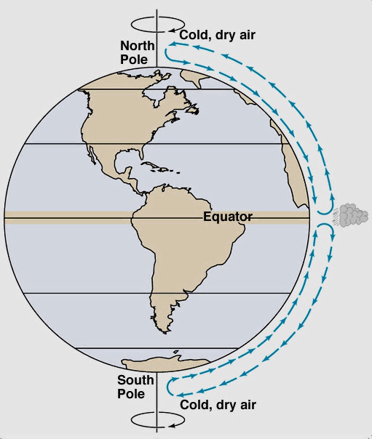
Major Circulation Patterns
Earth’s oceans and atmosphere move heat from the equator (and cold from the poles).
Warm air (less dense) rises at the equator and sinks as it cools (at the poles)
This drives our weather patterns!
This is what our circulation patterns could look like, if …
  the earth didn’t rotate!
Extra heat here needs to move toward poles

Slide 9
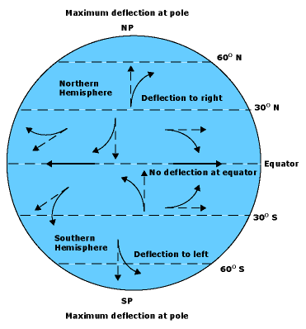
Factor 3: Rotation!
The earth spins
  which gives us day and night.
It also throws a curve (literally!) at our weather patterns.
On a global scale, stuff doesn’t travel in long, straight lines.
Concept box: The Coriolis Effect deflects motion to the right in the Northern Hemisphere (to the left in the S.H.). The effect increases nearer the poles.

Slide 10
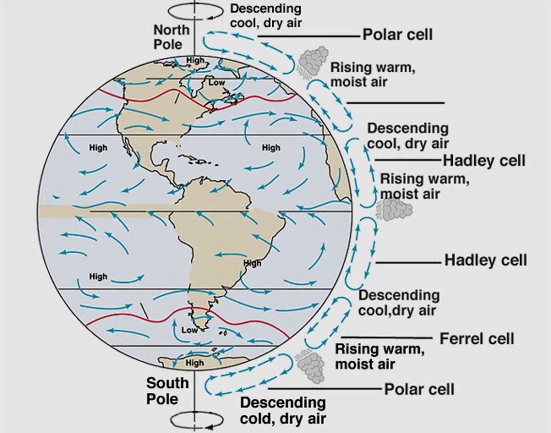
Major Circulation Patterns
The earth’s rotation breaks the equator-to-pole travel into three major circulation belts in each hemisphere
Sinking air is dry
Rising moist air makes precipitation

Slide 11
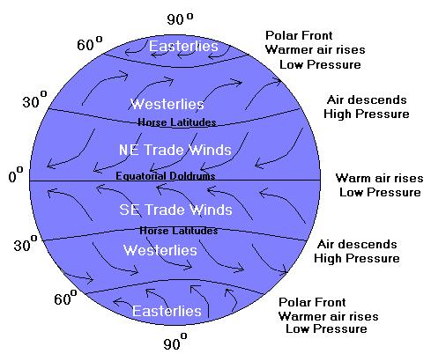
Major Circulation Patterns
Generally speaking:
  Easterly winds near the equator;
  Westerly winds in temperate regions (most of the U.S., most of the time)
  Easterlies again near the poles.

Slide 12
Factor 4: Latitude
Variation of sunlight affects temperature (more total energy: higher temps)
Least variation at the equator:
  generally warm year round (most direct sunlight)
More variation at mid-latitudes:
  warm in the summer, cool in the winter (Oklahoma)
Most variation at high-latitudes:
  cool in the summer, cold in the winter (least direct sunlight).

Slide 13
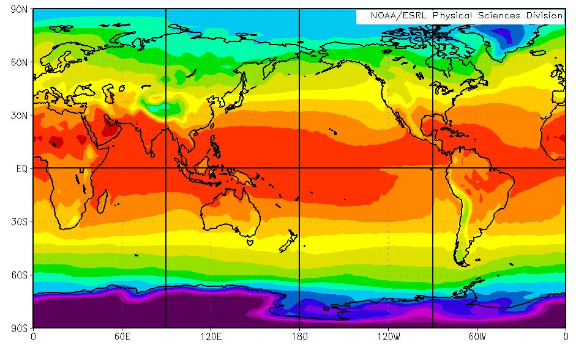
The Role of Latitude
Barrow, AK (71N)
  July: Two straight months of sun (still cool, though, because the sunlight is less direct). Average Temp: 40 F
  January: Two straight months of darkness. Avg Temp: -14 F
  Bottom line: much cooler, large range
B
M
Maracaibo, Venezuela (8N)
July: Avg Temp: 83 F
January: Avg Temp: 81 F
Bottom line: Warmer, more constant

Slide 14
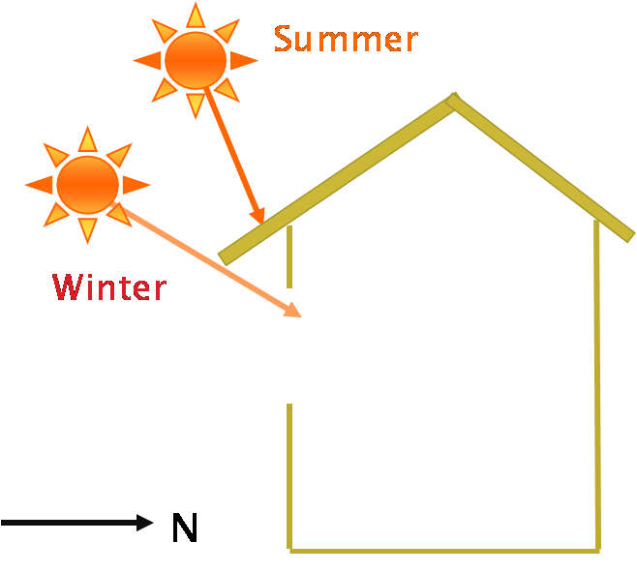
Hey, we build for this stuff!
Mid-Latitude Home Design
  Summer in OK, peak sun angle: ~78 degrees
  Winter in OK, peak sun angle: ~31 degrees
Overhang should be long enough for summer shade, yet short enough to allow winter sun

Slide 15
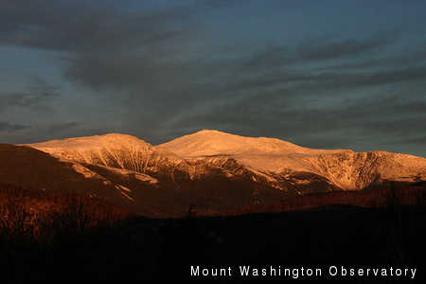
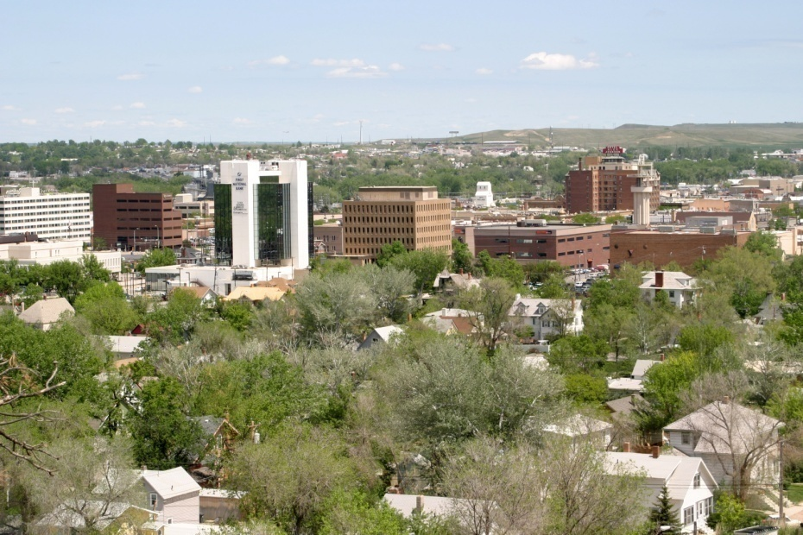
Factor 5: Altitude
Generally Speaking: Higher Altitude → Cooler, drier climate
(In climate, like in life, there are exceptions to every rule!)
Mt. Washington, NH (44°N, 6288 ft.) annual temp: 27.2F
Rapid City, SD (44°N, 3,202 ft.) annual temp: 46.7F

Slide 16
Altitude
Lapse rate = rate of change of temperature with height
Lapse rate = ~-5.4°F/1000ft (up to top of troposphere, around 7.5 miles)
  For every 1000 feet you ascend, the temperature drops ~5.4°F!
5000 ft
32.0ºF
4000 ft
37.4ºF
3000 ft
42.8ºF
2000 ft
48.2ºF
1000 ft
53.6ºF
0 ft
Sea Level, 59ºF

Slide 17
Altitude: Rain Shadow Effect
Rain on one side of the mountain, dry on the other
  Air is lifted up, expands and cools, and forms clouds
  Any precipitation falls on this side of the mountain
  Air continues over mountain, but without its moisture
  As this dry air sinks, it warms because it is compressed
Cool, moist
Hot, dry

Slide 18
Factor 6: Land & Water are Different
Land surfaces heat and cool much more quickly than water/oceans.
  This is important because the atmosphere is mostly heated from below.
Also, continents get in the way of oceans
Remember our idealized “bowling ball” world?

Slide 19
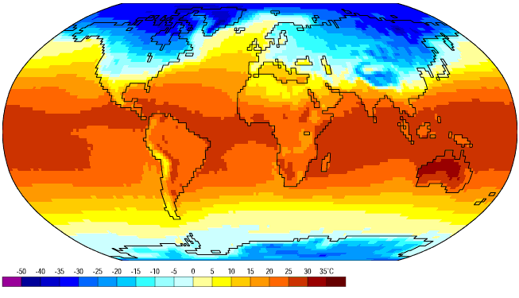
Actual January temperatures
This is January. How do the observations differ from our ideal bowling ball? Why?

Slide 20
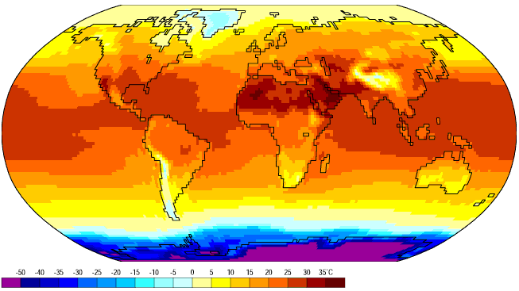
Actual temps in July.
This is July. What has changed since January? Which hemisphere has more land?

Slide 21
Let’s Review…
Factor 1: Our Energy Source
Factor 2: Revolution & Tilt
Factor 3: Rotation!
Factor 4: Latitude
Factor 5: Altitude
Factor 6: Land & Water are Different

Slide 22
GLOBAL WEATHER PATTERNS

Slide 23
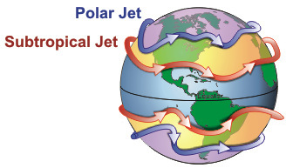
Jet Stream
Relatively narrow bands of strong winds in the upper levels of the troposphere
Generally west-to-east, but parts can be north-south
Forms at the boundaries of circulation cells
The Polar Jet is usually stronger because the temperature differences are greatest

Slide 24
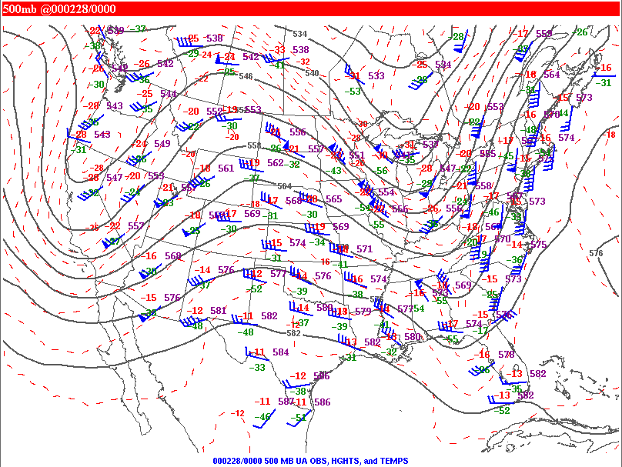
Ridges and Troughs
RIDGE
TROUGH
TROUGH
Windy, cooler, cloudier, possible precip.
Calmer, warmer, sunnier, rarely precip.
Windy, cooler, cloudier, possible precip.
Ridges: Warm air, usually moving from equator to pole. Associated with: tranquil weather, lighter winds, clearer skies, this is summer’s “heat dome”.
Troughs: Cold air, usually moving from pole to equator. Associated with: disturbed weather, stronger winds, clouds, precipitation and “weather systems”.

Slide 25
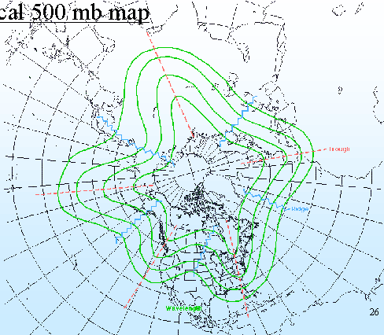
Global Weather Patterns
These ridges and troughs make a pattern around the world
Energy moves through these “waves” as they migrate around the globe
Disruptions in one place can have impacts at far distant locations
NP
A typical 500 mb map showing series of troughs and ridges

Slide 26
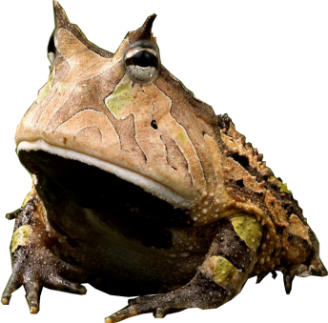
Teleconnections
Connectedness of large-scale weather patterns across the world
  If you poke one area, another area is affected as well (can be across the world, very far away)
  Dropping a pebble in a pond—ripples created interact with waves
For Example:
  El Niño-Southern Oscillation (ENSO)

Slide 27
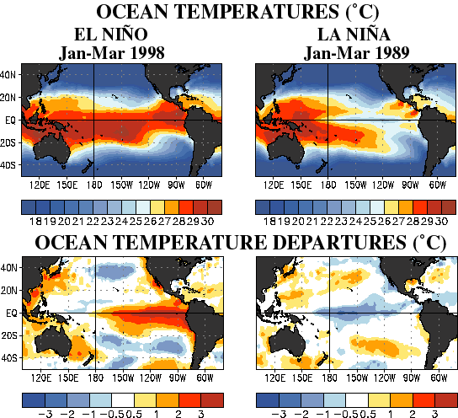
El Nino / La Nina
Equatorial Pacific temps significantly warmer than “normal”
Equatorial Pacific temps significantly cooler than “normal”
Right now, we are in an El Nino phase

Slide 28
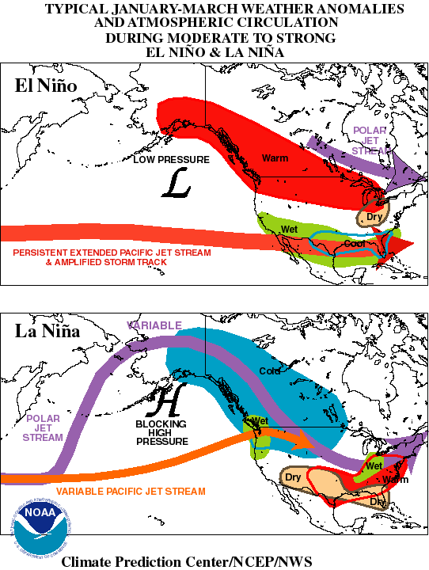
Typical ENSO Winter Effects
El Nino:
  Lots of [non-Arctic] storms tracking rapidly from west-to-east across southern half of U.S.
  Very wet across Southern states; very warm across Northern states
La Nina:
  Storm track often stays north of us
    OK warm & dry for extended periods.
  When it jumps south (quickly) we get weather systems, but they often lack sufficient moisture
    We go from warm, dry and windy to cold, dry and windy
  The storm system finally explodes with precipitation somewhere around Memphis

Slide 29
Other “Teleconnections” Features
PDO: Pacific Decadal Oscillation
  “Sloshing” between northern and central Pacific, typically 20-30 year period.
  Effects similar to El Nino
  May be a major contributor to extended drought patterns
NAO: North Atlantic Oscillation
  From Iceland to Azores: more pressure oscillations
  Stronger impact on N. American east coast & Europe
  “overcame” El Nino effects this past winter in eastern U.S.
PNA: Pacific – North American Oscillation

