Slide 1
The Atmosphere
Funding provided by NOAA
Sectoral Applications Research Project
Basic Climatology
Oklahoma Climatological Survey

Slide 2
What we are going to cover
Composition of the Atmosphere
State Variables
Measuring the Weather
Climate Patterns
Global Weather Patterns
Clouds
Pressure Systems, Air Masses & Fronts
Thunderstorms
Other Weather Hazards
Climate Change

Slide 3
First, Some Definitions…
Meteorology - a science that deals with the atmosphere and its phenomena and especially with weather and weather forecasting
Weather - the state of the atmosphere with respect to heat or cold, wetness or dryness, calm or storm, clearness or cloudiness
Climate - the statistical collection of weather conditions at a place over a period of years

Slide 4
Weather vs. Climate
Weather
Condition of the atmosphere at any particular time and place, day-to-day state of the atmosphere
Climate
Accumulation of daily and seasonal weather events over a long period of time (weeks, months, years and longer)
Includes weather and weather extremes (heat waves, cold spells)
Long-term averages of weather variables (e.g., temperature, precipitation amount and type, air pressure, humidity, cloudiness, sunshine, wind speed and direction), departures of weather variables from normals (more about normals later!)

Slide 5
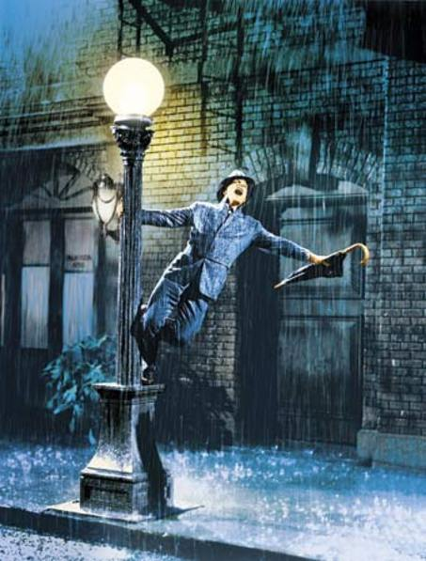
Weather vs. Climate
Type of clothing we wear today
Windows open or closed today? This week?
If a crop will reach maturity: hail can destroy a crop in a day!
Warm and rainy for a day: raincoat
Type of clothing we buy and keep
Housing: straw hut vs. brick house
Crop selection (timing and species): Mangoes are not a good crop in Oklahoma
Warm and wet for MANY years: rainforest
What weather determines
What climate determines

Slide 6
Composition & Structure of the atmosphere

Slide 7
What gasses make up the atmosphere?
Gas | Symbol | Content
Nitrogen | N₂ | 78.084%
Oxygen | O₂ | 20.947%
Argon | Ar | 0.934%
Carbon Dioxide | CO₂ | 0.033%
Neon | Ne | 18.20 parts per million
Helium | He | 5.20 parts per million
Krypton | Kr | 1.10 parts per million
Sulfur dioxide | SO₂ | 1.00 parts per million
Methane | CH₄ | 2.00 parts per million
Hydrogen | H₂ | 0.50 parts per million
Nitrous Oxide | N₂O | 0.50 parts per million
Xenon | Xe | 0.09 parts per million
Ozone | O₃ | 0.07 parts per million
Nitrogen dioxide | NO₂ | 0.02 parts per million
Iodine | I₂ | 0.01 parts per million
Carbon monoxide | CO | trace
Ammonia | NH₃ | trace
Source: NOAA National Weather Service Jetstream

Slide 8
Layers of the Atmosphere
Exosphere (up to 6,200 miles)
Thermosphere (up to 430 miles)
Very few particles, but highly energized
Ionosphere (37-190 miles): highly energized particles reflect radio waves
Mesosphere (up to 53 miles)
Gasses become very thin
Temperature decreases with height (less absorption)
Stratosphere (up to 31 miles)
Virtually no vertical motion
Temperature warms with height (absorption of radiation)
Troposphere (ground to 4-12 miles)
Most human activities occur in the troposphere
Density and pressure decrease with height
Temperature decreases with height
Source: NOAA National Weather Service Jetstream

Slide 9
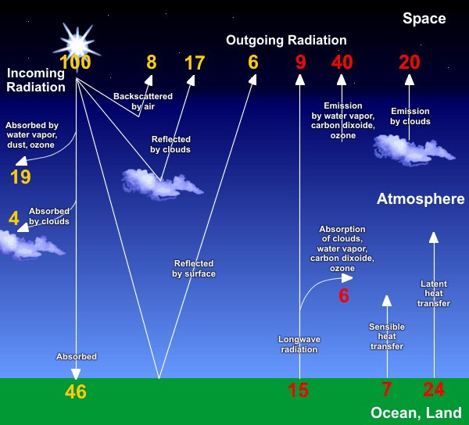
The Earth’s Energy Balance
Incoming energy from the sun (solar radiation) heats the Earth
Some of the energy is reflected by clouds or the atmosphere back into space
Some of the energy is absorbed by the Earth and re-emitted
Incoming solar radiation is shorter wavelengths (higher energy) than what is emitted by the Earth
Atmospheric gasses trap some of the longer-wave radiation
The atmosphere keeps Earth at an average temperature of about 58°F
Source: NOAA National Weather Service Jetstream
Without atmospheric gasses, the Earth’s average temperature would be about 0ºF!

Slide 10
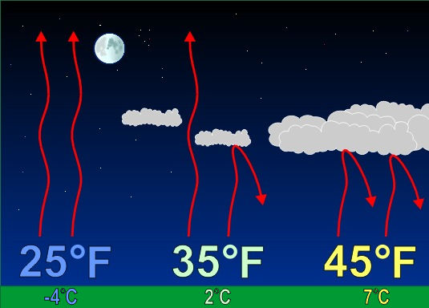
The Earth’s Energy Balance
Water vapor is very good at absorbing and re-radiating the longer-wavelength energy from the Earth
During the day, the Earth stores more energy than it releases
At night, without incoming solar radiation, the energy is released
Without clouds, most of the energy escapes back into space
With clouds, more energy is captured and re-radiated back toward the ground, keeping surface temperatures higher
Source: NOAA National Weather Service Jetstream

Slide 11
STATE VARIABLES

Slide 12
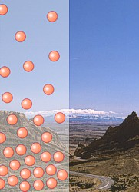
PRESSSURE
The motion of molecules creates a force, pressure, as they strike a surface (you)
The number of molecules packed into a volume determines its density
Often thought of as weight but not quite the same; you weigh less on the moon than on earth because the effects of gravity are less, but you have the same density
The more molecules, the more pressure
At sea level, this force is about 14 pounds per square inch, or about 1 ton per square foot
This force raises a column of mercury 29.92 inches
Source: NOAA National Weather Service Jetstream

Slide 13
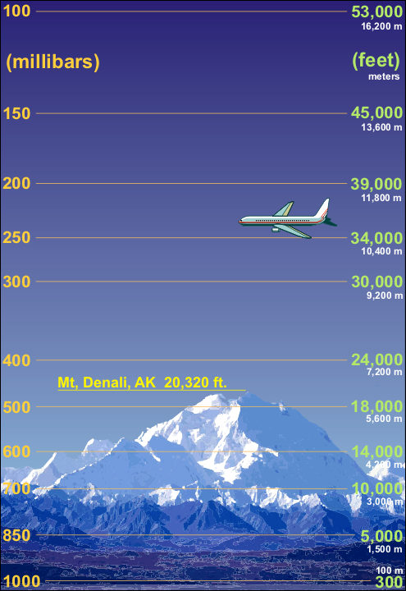
PRESSSURE
The number of molecules are greater near the surface of the earth than at higher elevations
Thus, pressure (force) decreases with elevation
Half of the atmosphere’s molecules are below ~18,000 feet (the 500 millibar level)
Warm air is less dense than cold air
Higher energy moves molecules farther apart
‘Pushes’ the 500 mb level upward
Source: NOAA National Weather Service Jetstream

Slide 14
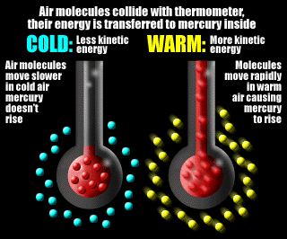
TEMPERATURE
Temperature is a measure of the energy of a ‘parcel’ of molecules
Temperature scales
Fahrenheit: freezing point = 32 degrees; boiling point = 212 deg.
Celsius: freezing point = 0 degrees; boiling point = 100 degrees
F = 1.8 * C + 32
Kelvin: zero = point at which all motion ceases
K = C + 273.16
Energy from the sun warms the planet, which we experience as heat
Dark colors absorb more radiant energy than light colors
Measure of reflectivity: albedo
Source: Oklahoma Climatological Survey

Slide 15
TEMPERATURE
Heat is transferred one of 3 ways:
Radiation: molecules absorb electromagnetic radiation, increasing their energy (heat)
Conduction: heat is transferred directly from one molecule to another
Convection: fluid (air) surrounding a warm object heats and rises
Warmer = less dense
The less dense area rises and pushes the fluid above it out of the way.
The fluid cools away from stove top and begins to sink. (cooler=more dense)

Slide 16
MOISTURE
Plays a big role in the atmosphere
Water vapor can be from 1-4% of total atmospheric mass
Converting moisture between vapor (gas), liquid (water), and solid (ice) absorbs / releases energy
Amount of moisture expressed as:
Relative humidity (%): the proportion of moisture that the air is capable of holding
Dew Point (degrees): the temperature at which the air would become saturated, for a given amount of moisture
Relative Humidity

Slide 17
TEMPERATURE & MOISTURE
Evaporation - the process by which a liquid is transformed into a gas. The process uses heat, leaving the surroundings cooler than before the process.
Condensation - the process by which a gas becomes a liquid; the opposite of evaporation. The process releases heat.
Freezing – the process by which a liquid is transformed into a solid. This process releases heat.
Melting – the process by which a solid is transformed into a liquid. This process uses heat.
Sublimation - the process by which a solid directly changes into a gas. This uses heat.
Precipitation - any form of liquid or solid water, which falls from the atmosphere and reaches the ground.
Condensation
Evaporation
Precipitation
Sublimation
Freezing
Melting

Slide 18
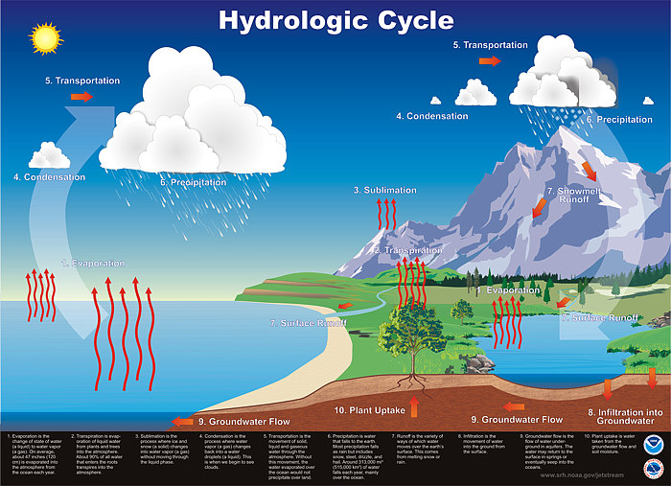

Slide 19
The Hydrologic Cycle
Evaporation - transformation of a liquid into a gas, in this case water into water vapor
- recall sublimation is the process where solids (snow) are converted directly to gas (water vapor)
Transpiration – evaporation of water secreted by the leaves of plants
- 99% of water taken up by plants is transpired into the atmosphere
Condensation – conversion of water vapor into water droplets, seen as clouds, fog, mist, dew, or frost
Precipitation – coalescence (sticking together) of tiny water droplets create larger drops which fall to Earth
Infiltration – Some of the precipitation is absorbed into the ground and filters down through layers of soil and rock
Runoff – precipitation that cannot be absorbed by the ground runs off into streams, lakes, and rivers, and eventually to the ocean
Source: NOAA National Weather Service Jetstream

Slide 20
MEASURING THE WEATHER

Slide 21
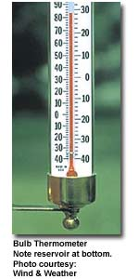
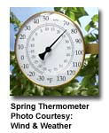
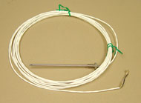
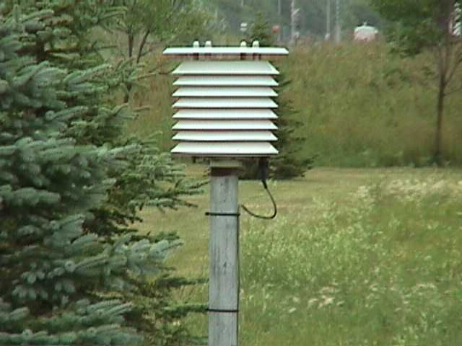
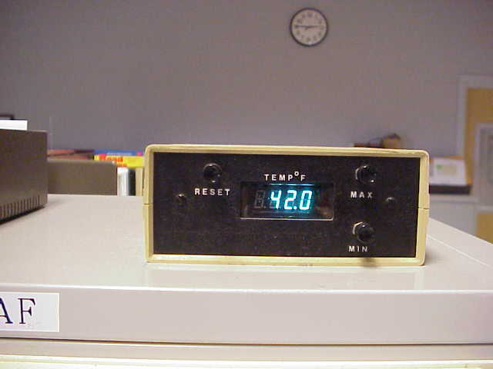
Measuring Temperature
A thermometer measures the heat content of the air
Thermometers often use alcohol, which has a lower freezing point than water
The fluid expands as temperature increases
Electronic thermistors are often used in automated weather systems

Slide 22
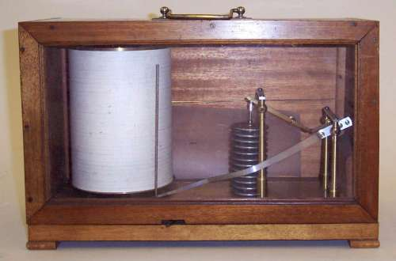
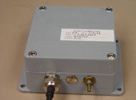
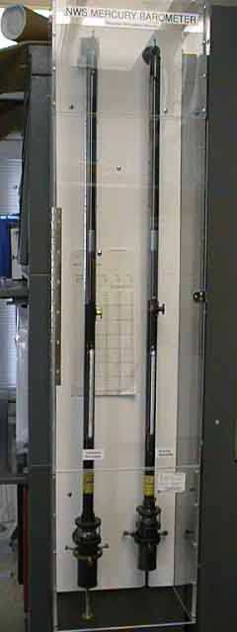
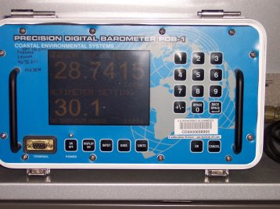
Measuring Pressure
A barometer operates much like a scale, responding to the ‘weight’ of the air above it
Pressure readings are shown by a needle that moves upward or downward as pressure changes
Some barometers record pressure on a strip chart
Many barometers today are automated with digital readouts

Slide 23
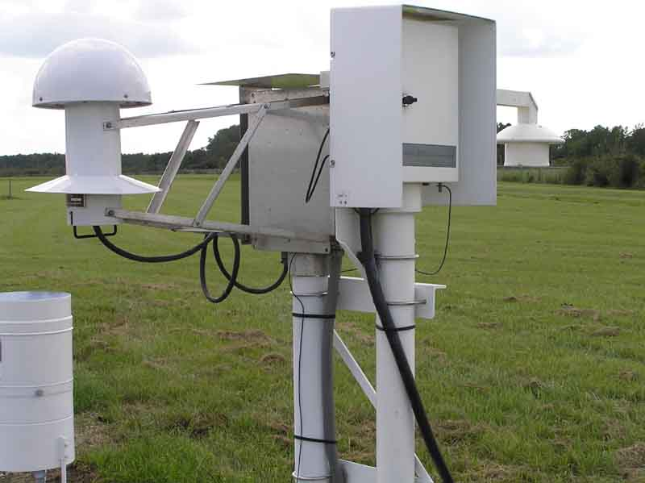
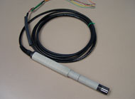
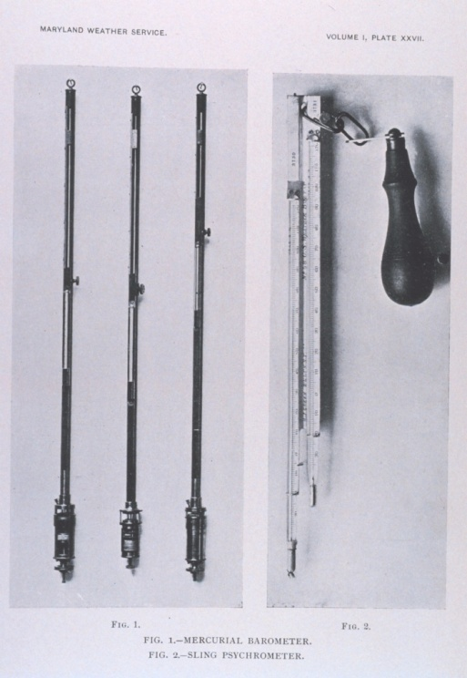
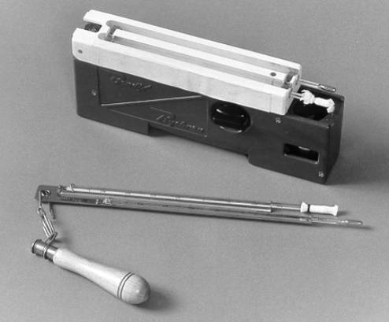
Measuring Moisture
A hygrometer is an instrument used to measure the water content of the atmosphere
Calculates either relative humidity or dewpoint
A psychrometer is a type of hygrometer consisting of pair of thermometers
One is a regular thermometer that measures the actual temperature of the air, called the dry bulb temperature
The other has a moistened wick; water is evaporated cooling the thermometer to a moisture equilibrium temperature called the wet bulb temperature
The amount of water vapor the air is able to hold at each temperature is determined; the ratio of these determines the relative humidity
Materials that lengthen or shorten based on the moisture content of the air are also used in hygrometers
Hair is a great measuring device!

Slide 24
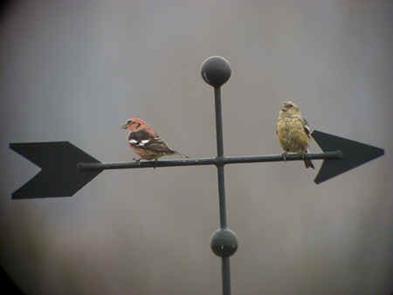
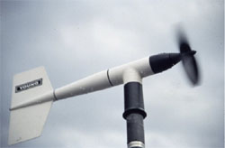
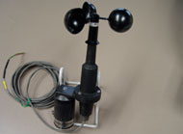
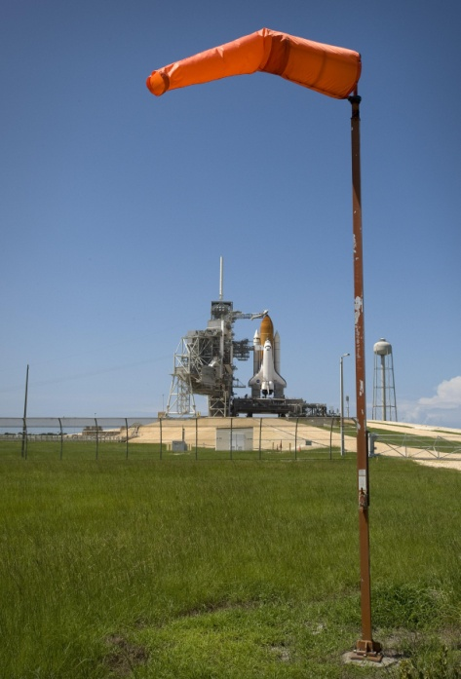
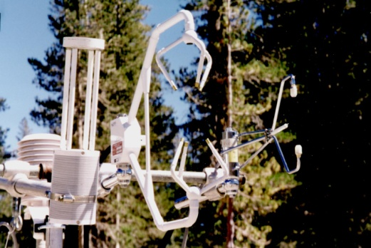
Measuring Wind
Wind speed is directly measured with an anemometer
Wind turns a propeller; faster wind speeds make the propeller spin faster
A magnet is attached to the propeller shaft; each revolution is counted to calculate speed
Wind direction is measured with a wind vane
Air blows against a flat surface, aligning the axis in the direction of the wind
An arrow points into the wind
Wind speed can be estimated with a wind sock
Often used at airports for a quick visual of wind direction and approximate speed
Sonic anemometers measure the speed with which particles pass between their sensors

Slide 25
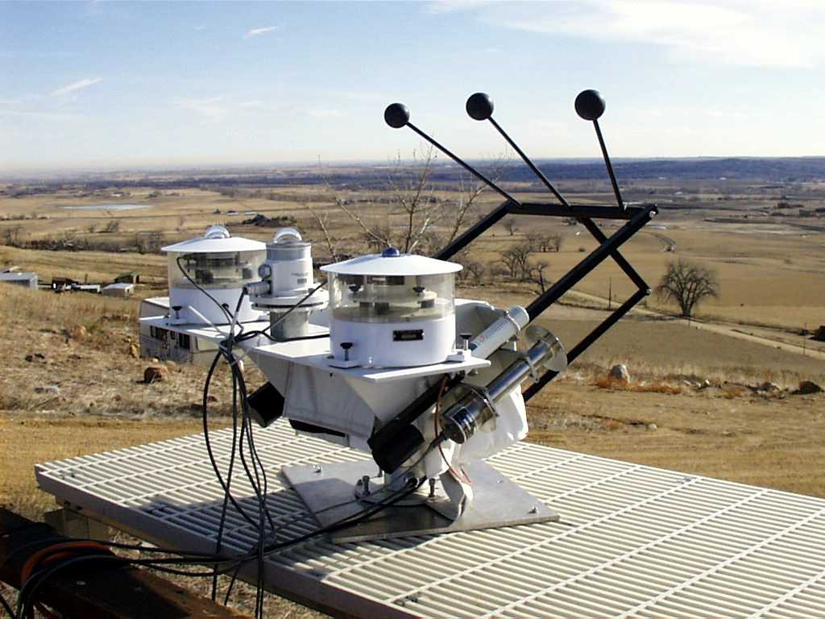
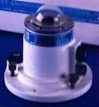
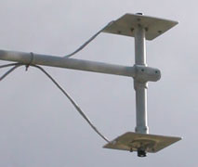
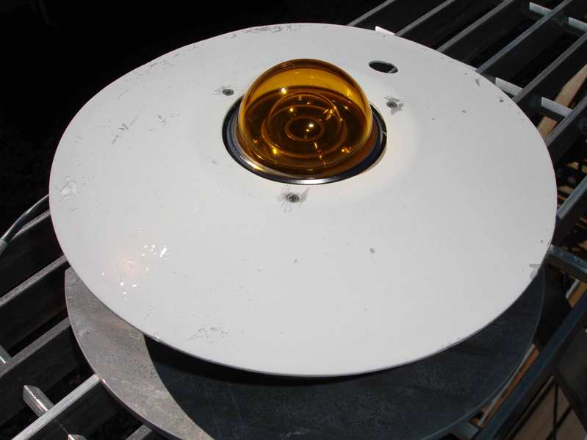
Measuring Sunshine
A pyranometer is a radiation sensor that measures solar radiation
Solar radiation may be direct (incoming from the sun) and reflected from the surface
Solar radiation is needed to calculate energy balance
A Celiometer uses light to measure the height of clouds
From this, sky cover can be recorded

Slide 26
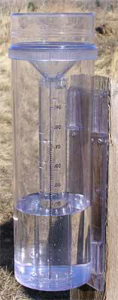
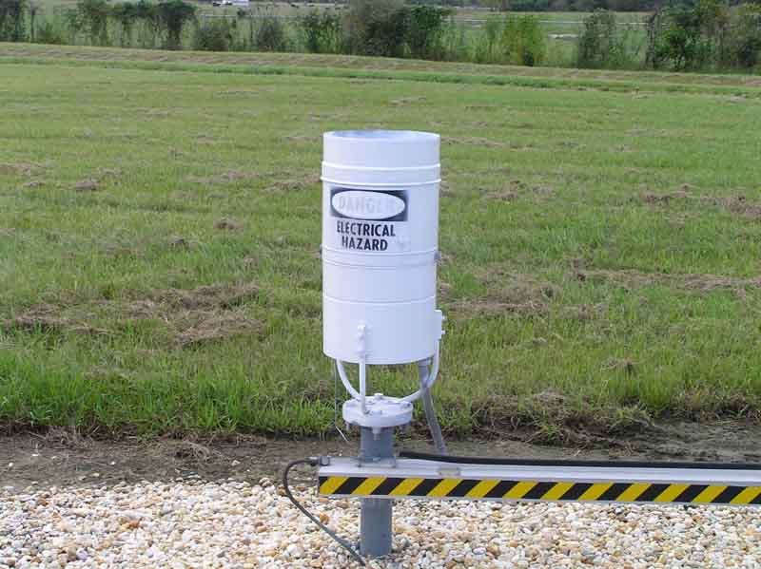
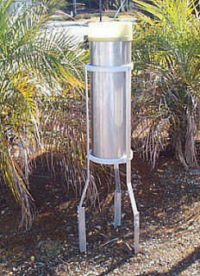
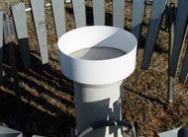
Measuring Rainfall
Rainfall is measured with a rain gauge
Direct read rain gauges simply collect rainfall and are read manually
A smaller inner tube allows finer resolution
Tipping bucket rain gauges have a small bucket that tips (and empties) whenever a certain amount of rain fills the bucket
A magnetic switch counts the number of tips, which is converted to rainfall accumulation
Weighing gauges collect rainfall on a scale; the weight of the water determines how much rain fell
Water may be lost through evaporation
Some rain gauges are heated to melt and measure winter precipitation

